Slide 1
Introduction to Psycholinguistics and Neurolinguistics

Slide 2
Overview of this Linguistics Module
Topic 1 Introduction to areas of linguistics and problem-solving
Topic 2 Historical Linguistics
Topic 3 Phonetics
Topic 4 Sociolinguistics
Topic 5 Writing systems
Topic 6 Language Acquisition
Topic 7 Morphology
Topic 8 Syntax
Topic 9 Psycholinguistics / Neurolinguistics
Topic 10 Machine Translation

Slide 3
What is Psycholinguistics?
Psycholinguistics is the psychology of language.
Psycholinguistics aims to help us understand of how language is represented and processed in the mind and brain.
In this unit, we are going to look at different speech disorders that inform us on how humans use language to communicate ideas and feelings, and how these communications are processed and understood.

Slide 4
What is Psycholinguistics?
We are going to look at the following topics:
Specific Language Impairment (SLI), also referred to as Developmental Language Disorder (DLD)
William Syndrome (WS)
Broca’s Aphasia
Wernicke’s Aphasia

Slide 5
Specific Language Impairment (SLI) and Williams Syndrome (WS)
These two conditions are particularly interesting as they appear to be each other’s mirror images:
  Children with SLI otherwise have largely normal cognitive development and intelligence. Only their language is impaired.
  In contrast, children with WS have relatively fluent speech while other cognitive functions are impaired.
SLI and WS are interesting in that they show a double dissociation: A double dissociation means that two mental processes can be shown to function independently of each other. In other words, language is an independent mental process within cognition.
SLI is nowadays also referred to as Developmental Language Disorder (DLD).
Notes:
Cognition refers to the mental processes involved in gaining knowledge and comprehension. These include (among many others) thinking, knowledge, memory, evaluation, judgement, and problem-solving, language, imagination, perception and planning.

Slide 6
Task 9.1: What is Specific Language Impairment (SLI) / Developmental Language Disorder (DLD)?

Slide 7
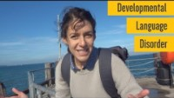
Task 9.1: Specific Language Impairment (SLI)/DLD
Watch the video on SLI/DLD and complete Exercise 1 on Worksheet 9.1:https://www.youtube.com/watch?v=8gHoyoM5wC8 or click below
Notes:
https://www.youtube.com/watch?v=8gHoyoM5wC8

Slide 8
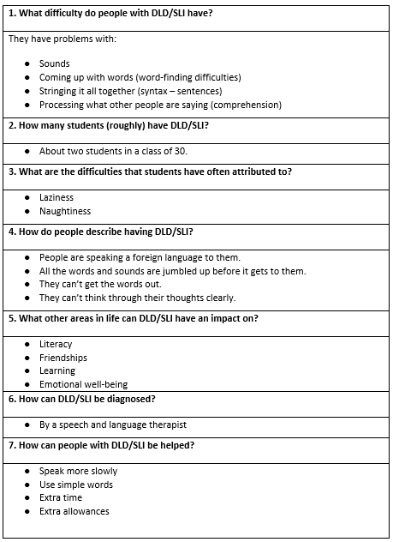
Feedback Exercise 1

Slide 9
Specific Language Impairment (SLI)/DLD
People with SLI:
have normal hearing,
have a nonverbal performance IQ of 85 or higher,
have normally developed oral structure and oral motor function,
don’t have any neurological difficulties (e.g. seizure disorders, cerebral palsy, brain lesions),
don’t generally have an underlying behavioural, emotional, communicative or social difficulty (e.g. no autism).
Non-linguistic development in children with SLI

Slide 10
Specific Language Impairment (SLI)/DLD
The language emerges late.
Language development is slower than in typical developing children.
Children with DLD have difficulties with receptive and expressive language skills.
Morphology (words) and syntax (sentences) are the most affected aspects of their language.
They often have difficulties with phonological rules (i.e. how sounds contribute to meaning), and therefore their speech becomes less intelligible.
Word-finding difficulties are common.
Linguistic development in children with SLI
Notes:
Receptive language skills: understanding language (listening and reading)
Expressive language skills: producing language (talking and writing)

Slide 11
Some types of grammatical errors produced by children with SLI:
Noun plural omission:
  ‘And not spot on’
  (Correct version: ‘And it didn’t have spots on’)
Verb tenses:
  ‘He say, I’m a monster’
  (Correct version: ‘He said I’m a monster’)
Genitive Inflection (Possessive ‘s):
  ‘My sister use my Dad car but she keep smashing it’.
  (Correct version: ‘My sister used my Dad’s car but she kept smashing it.’)
Wrong pronoun:
  ‘And him jumped on the television’
  (Correct version: ‘And he jumped on the television’)
Omission of ‘to be’ as main verb (copula be):
  ‘Cos they her favourites’
  (Correct version: ‘Cos they’re her favourites’)
Determiner (article) error:
  ‘Maybe have a chickenpox, or maybe have something’. (Correct version: ‘Maybe he has chickenpox or something’)
Omission of subject in obligatory context:
  ‘Bit Daddy leg no notice’
  (Correct version: ‘He bit daddy’s leg but he took no notice’)
Notes:
Examples from Bishop (1994)

Slide 12
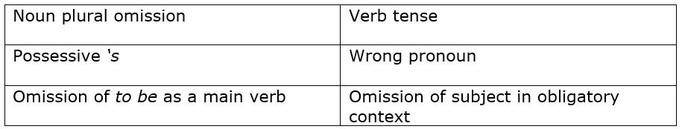
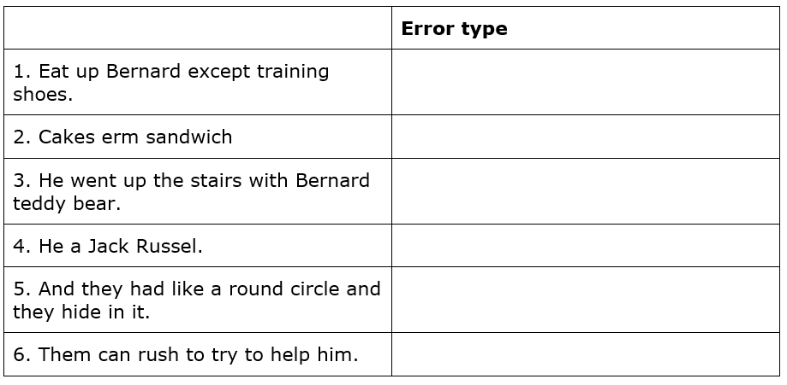
Task 9.1 Worksheet 9.1
Complete Exercise 2 on worksheet 9.1

Slide 13
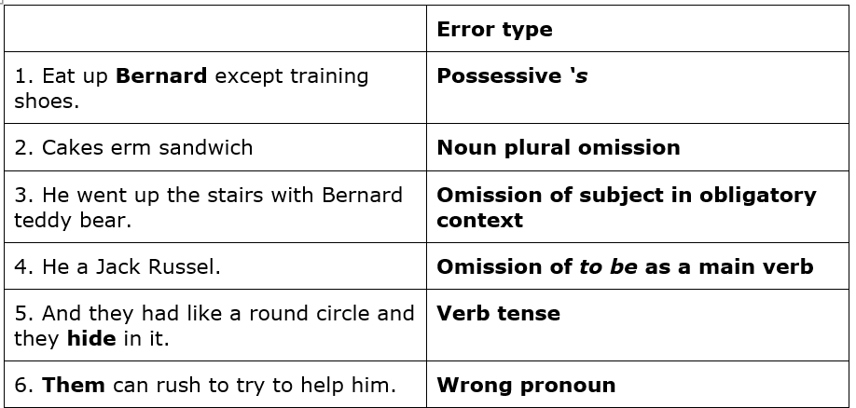
Feedback Exercise 2

Slide 14
Task 9.2: What is Williams Syndrome?

Slide 15
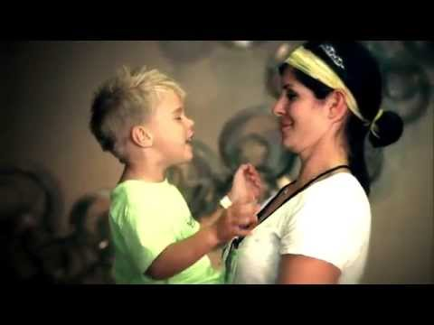
Task 9.2: Williams Syndrome
Watch the video (https://www.youtube.com/watch?v=M6n4z0XjPh4) and answer Exercise 1 on Worksheet 9.2:
Notes:
https://www.youtube.com/watch?v=M6n4z0XjPh4

Slide 16
Williams Syndrome (WS)
Children with WS have mild to moderate intellectual difficulties.
They have distinctive facial features.
They often have heart and blood vessel problems.
They have difficulties with everyday tasks, such as tying shoelaces.
They have difficulties with cognitive tasks, such as putting items in order from larger to smaller or higher to lower.
They have difficulties with drawing.
WS is caused by missing more than 25 genes from a specific are of chromosome 7.
Non-linguistic development in children with WS

Slide 17
Williams Syndrome (WS)
The language of children with WS is relatively intact.
By the time children with WS reach puberty, their language skills outperform their other cognitive skills, although their language remains below chronological age level (e.g. they perform worse than typically developing children of the same age do).
Language emerges later than in typically developing children of the same age.
Linguistic development in children with WS

Slide 18
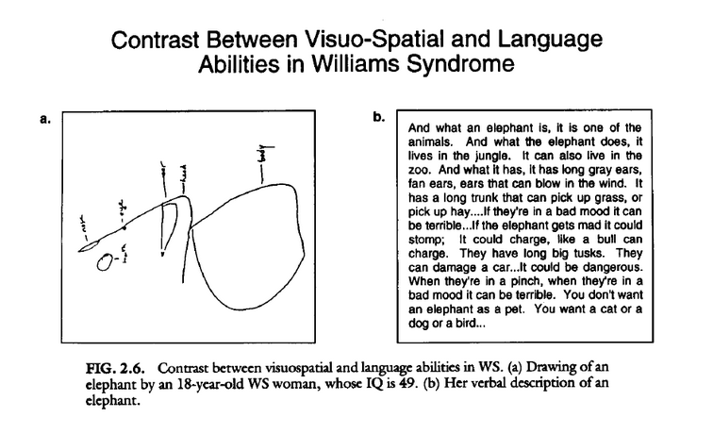
Task 9.3
Worksheet 9.2: Exercise 2
Look at the Figure and answer the following questions:
1. Describe the picture.
2. Read the person’s description of an elephant. What can you say about the language? Consider the choice of vocabulary and the grammar.
3. What can you say about the person’s cognitive abilities?

Slide 19
Task 9.2: Worksheet 9.2, Exercise 2
Notes:
Source of Figure: Bellugi, Wang, Jernigan (1994) https://www.researchgate.net/publication/243647513_Williams_syndrome_An_unusual_neuropsychological_profile

Slide 20
Feedback Task 9.2: Exercise 1
The picture compares the drawing of an elephant with the verbal description of one by an 18-year-old person with WS with an IQ of 49. The drawing is disorganised. We would not be able to recognise the drawing if it were not for the verbal labels that the person provides.
The verbal description of the elephant is fluent and rich. It includes information about what the elephant is, what it does, what it has ‘It has long grey ears, fan ears, ears that can blow in the wind. It has a long trunk that can pick up grass or pick up hay’. The grammar is intact. The person uses quite complex sentences, including relative clauses (It has long grey ears, fan ears, ears that can blow in the wind). Grammatical inflection is target like (as it should be).

Slide 21
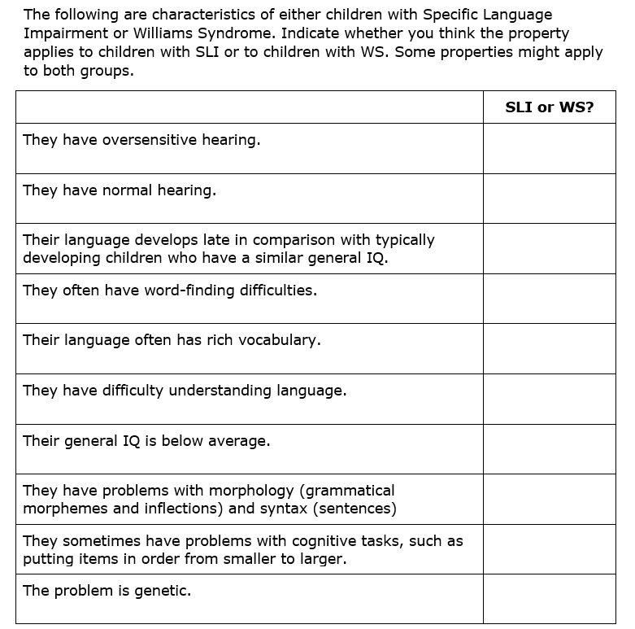
Task 9.2: Worksheet 9.2, Exercise 3

Slide 22
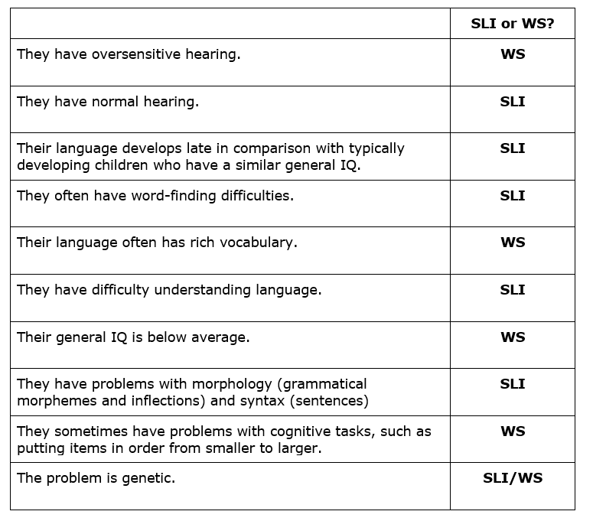
Feedback Exercise 3:

Slide 23
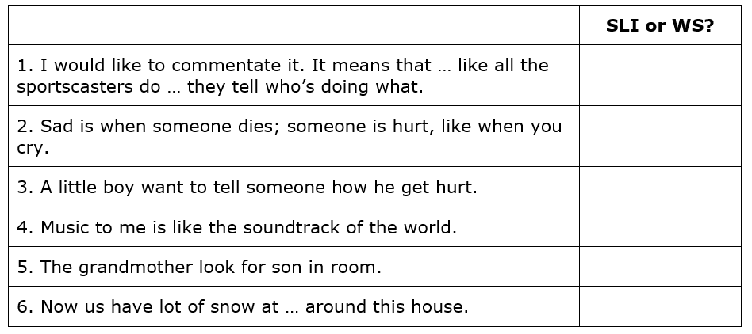
Worksheet 9.2: Exercise 4

Slide 24
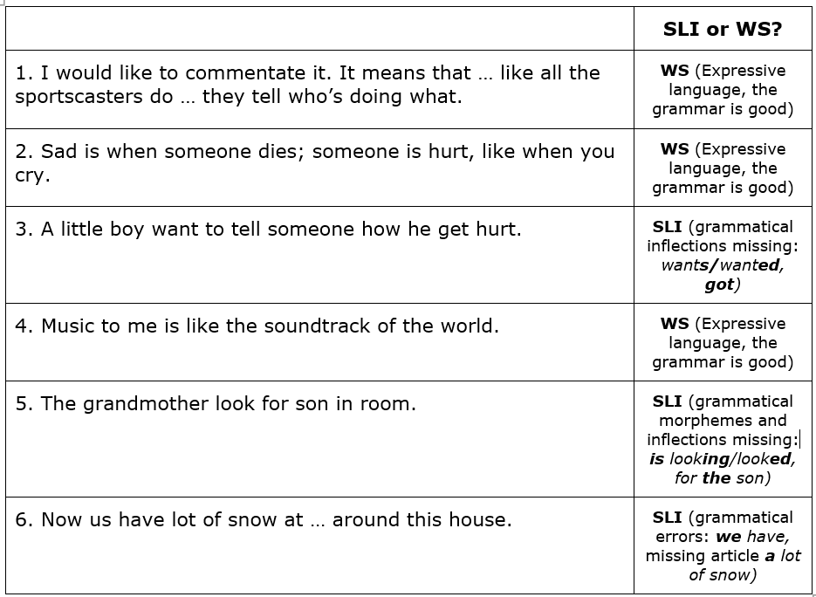
Feedback Exercise 4:

Slide 25
Neurolinguistics: Is there any evidence that there are regions in the brain that are specialized for language?

Slide 26

Task 9.3: Is there any evidence that there are regions in the brain that are specialised for language?
Watch the following clip: https://www.youtube.com/watch?v=yXbAMHzYGJ0
Notes:
https://www.youtube.com/watch?v=yXbAMHzYGJ0

Slide 27
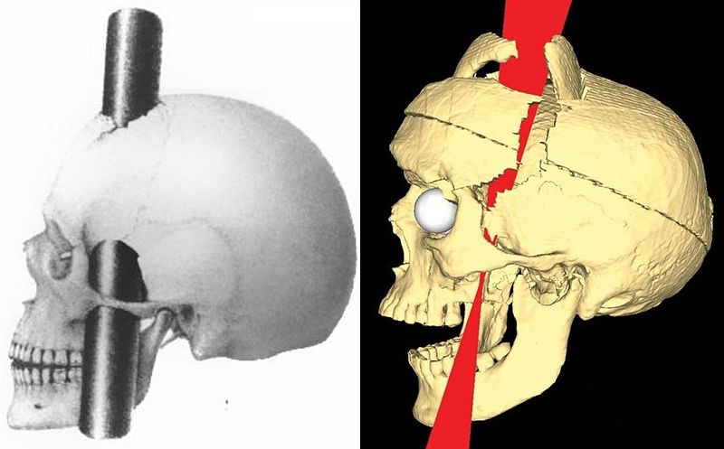
The miraculous survival of Phineas Gage
The iron rod went entered Gage’s head under his left cheek bone (as seen in the models on the right) and went completely out through the top of his forehead.
Most of the front part of the left side of his brain was destroyed.
It was assumed that no one could recover from such severe head injury.
Phineas Gage recovered and was well enough to resume work a few months after the accident.
Notes:
Source of picture: https://commons.wikimedia.org/wiki/File:PhineasGage_IronPaths_BigelowVanHornCombined.jpg

Slide 28
Why is Phineas Gage’s story interesting for science?
Damage to the frontal part of the brain did not have any effect on Phineas Gage’s language (Gage still had the ability to speak and understand language).
Even though the brain may be the location for language, it is not situated right at the front.
The injury to Gage’s brain produced some selective changes to his personality, but not to language and other intellectual abilities.
This provides evidence for the assumption that the brain has a modular structure: different human abilities and behaviours can be traced to different parts of the brain.
How can scientists find out if there is a part of the brain that is specialized for language?
Notes:
With Phineas Gage’s story in mind, students might make suggestions along the following lines:
People with injuries to specific parts of the brain might show specific identifiable language disabilities.

Slide 29
Is there any evidence that there are regions in the brain that are specialised for language?
Scientists look at patients who have specific identifiable language disabilities (that means that only specific areas of language are affected, while other areas of language and other intellectual abilities might be retained).
If these patients have damaged specific areas of the brain, this suggests that the localized brain damage might cause the language problem.
It follows that the area of the brain that is impaired is the locum (=the place) of a specialized language area in the brain.

Slide 30
Evidence from patients with Aphasia

Slide 31
What is aphasia
An impairment of language function due to damage to specific regions in the brain.
Difficulty understanding and/or producing language.
The causes for aphasia can be a stroke, head trauma, brain tumors or neurodegenerative disease (such as dementia).

Slide 32
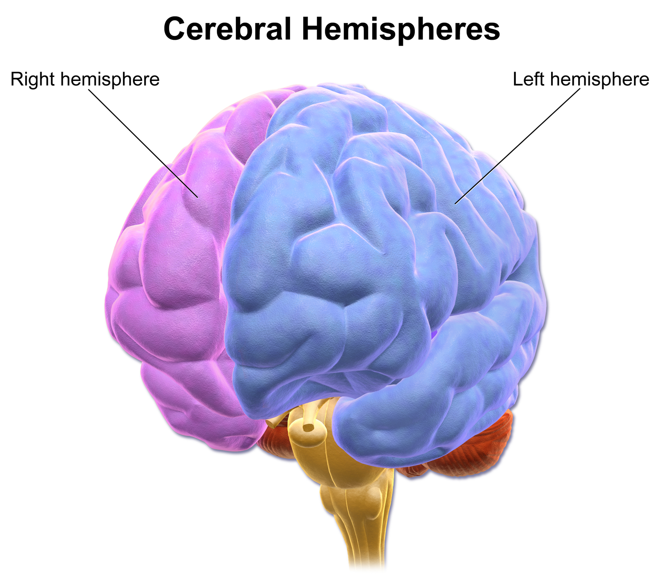
Brain lateralization
The brain is made up of cerebral hemispheres, the right and the left hemisphere.
The two hemispheres are joined by a nerve tract called the corpus callosum. The two hemispheres communicate via the nerve tracts of the corpus callosum.
By and large, the right hemisphere controls the left side of the body, and the left hemisphere controls the right side of the body.
If you pick up something with your left hand, this action is controlled by your right hemisphere. In turn, if you point to something with your right hand, the action is controlled by your left hemisphere.
Notes:
Source of the picture: https://commons.wikimedia.org/wiki/File:Blausen_0215_CerebralHemispheres.png

Slide 33
Broca’s Area
Language was the first cognitive function to be localised in the brain on the basis of empirical evidence.
In 1864, Paul Broca, a French surgeon, linked the ability to produce language to the left side of the brain.
How did he do that?
Broca based his claim on the observation that damage to the left side of the brain caused loss of language. In turn, damage to the right hemisphere did not cause language loss.
Notes:
If the ability to produce language is located in the left side of the brain, we expect damage to the language areas in the left hemisphere to cause specific language problems (e.g. damage to left hemisphere results in speech difficulties). On the other hand, if the right hemisphere was damaged, we would not necessarily expect language to be affected.

Slide 34
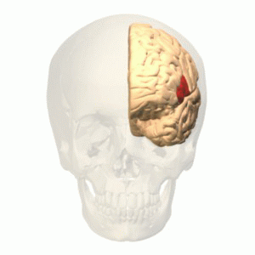
Broca’s Area
Broca examined the brains of eight patients who had language impairment following a brain injury.
Broca performed an autopsy and found damage to the frontal lobe of the left hemisphere (the red area on the image on the right).
We say that patients with injuries to Broca’s area have Broca’s aphasia (remember that aphasia is the term used to describe language disorders that occur after brain damage to a specific area of the brain).
Notes:
Source of picture: https://upload.wikimedia.org/wikipedia/commons/4/4a/Broca%27s_area_animation.gif

Slide 35
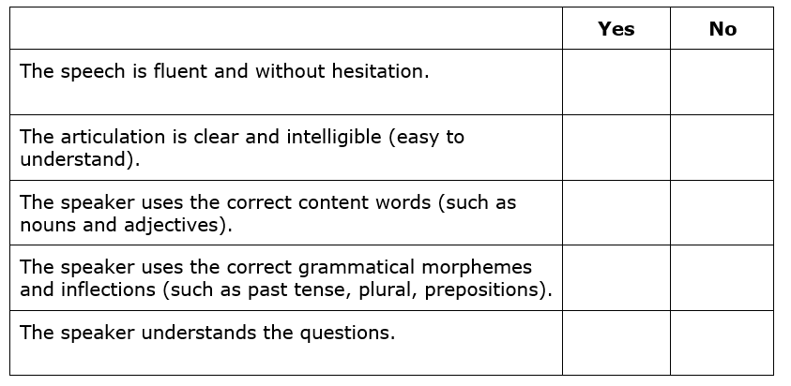
Task 9.3: Worksheet 9.3: Exercise 1
Watch Sarah’s experience of Broca’s aphasia and answer Exercise 1 on Worksheet 9.3:

Slide 36
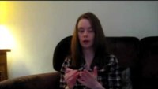
Task 9.3: Worksheet 9.3 Broca’s Aphasia
https://www.youtube.com/watch?v=IP8hkopObvs
Notes:
https://www.youtube.com/watch?v=IP8hkopObvs Watch the video and do worksheet 9.3

Slide 37
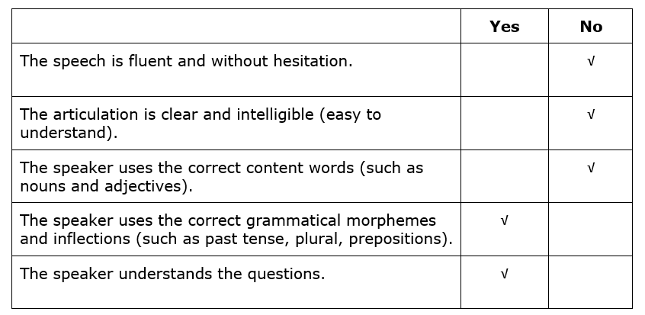
Feedback Exercise 1:

Slide 38
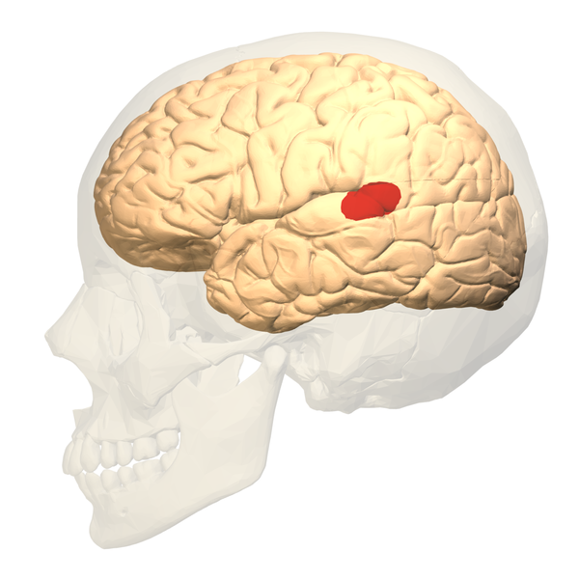
Wernicke’s Area
In 1874, Carl Wernicke described another type of aphasia.
His patients had injuries in the back part of the left hemisphere.
This region is now known as Wernicke’s area (it can be seen in the red part in the image on the right).
Patients who suffered injury to Wernicke’s area are said to suffer from Wernicke’s aphasia.

Slide 39
Task 9.3: Worksheet 9.3: Exercise 2
Watch Byron’s experience of Broca’s aphasia and answer Exercise 2 on Worksheet 9.3:

Slide 40
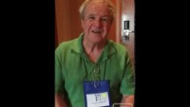
Wernicke’s Aphasia
Watch the short clip and describe the person’s symptoms:
Notes:
https://www.youtube.com/watch?v=3oef68YabD0

Slide 41
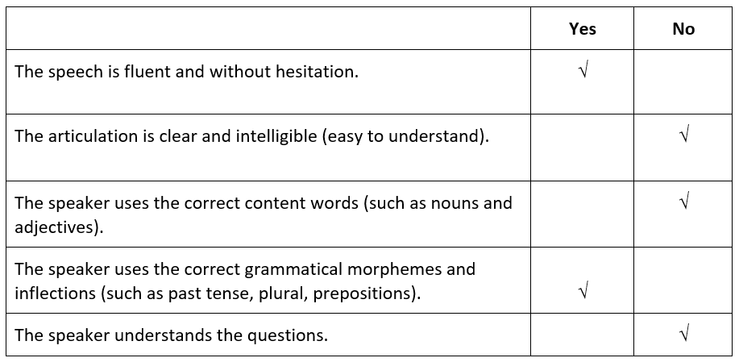
Feedback Exercise 2:

Slide 42
Difference between Broca’s and Wernicke’s Aphasia
Broca’s Aphasia:
Reduced amount of speech.
Distorted articulation.
Slow, often effortful speech.
Lots of hesitations.
Speech mainly has lexical morphemes (mostly nouns, verbs and adjectives).
Frequent omission of functional morphemes (e.g. articles, prepositions) and inflectional morphemes (e.g. plural –s, past tense –ed): The grammatical markers are missing.
Broca’s aphasia is also referred to as agrammatic aphasia.
Wernicke’s Aphasia:
Can produce very fluent speech.
Speech is often difficult to make sense of.
Difficulty in finding the right word.
Speakers use strategies to overcome word-finding difficulties, such as trying to describe objects or talking about their purpose.
Wernicke’s aphasia is also referred to as fluent aphasia.

Slide 43
Worksheet 9.3: Exercise 3
The following utterances were said by people who were suffering either from Broca’s aphasia or Wernicke’s aphasia. Indicate which were made by Broca’s or Wernicke’s aphasics and give one reason for your answer (examples from Fromkin, Rodman & Hyams, 2003):
Goodnight and in the pansy I can’t say but into a flipdoor you can see it.
Well … sunset … uh horses nine, no, uh, two, tails want swish.
Oh, … if I could I would, and a sick old man disflined a sinter, minter.
Words … words … words … two, four, six, eight, … blaze am he.
In girls we see many happy days.
I’ll challenge a new bike.
Yes … ah … Monday … ah … Dad … and Dad … ah … Hospital … and ah … Wednesday … Wednesday nine o’clock and ah Thursday … ten o’clock ah doctors
Me? Yes sir. I’m a male demaploze on my own. I still know my tubaboys what for I have that’s gone hell and some of the go. (Reply when asked if he was a doctor)

Slide 44
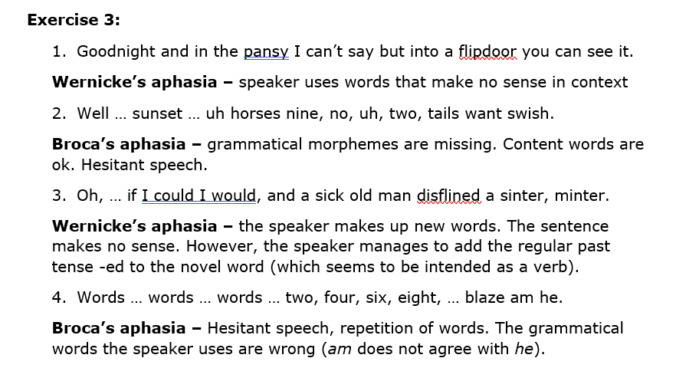
Feedback Exercise 3: Sentences 1 – 4

Slide 45
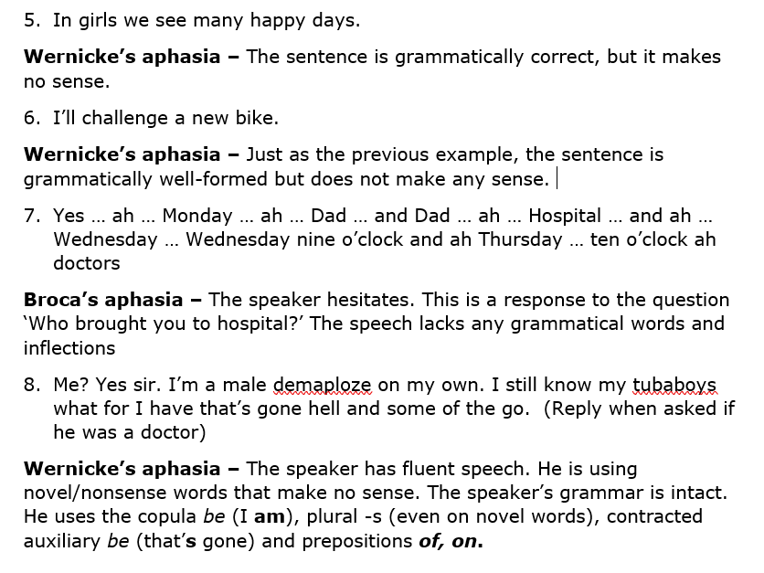
Feedback Exercise 3: Sentences 5 – 8

Slide 46
Ideas for projects
Phineas Gage
Genie (already mentioned in Topic 6 – Language Acquisition)
Careers in Speech and Language Therapy

Slide 47
Additional resources DLD / SLI
Information on DLD/SLI:
https://radld.org/
Oliver Sacks Mind Traveller – ‘Don’t be shy, Mr Sacks’:
https://www.youtube.com/watch?v=2J8YNyHIT64
(This is a 50-minute movie about Williams Syndrome by Oliver Sacks)
Probing the evolution of human language in a model organism:
https://www.youtube.com/watch?v=k27DfgKGVp8
(A short video about the FoxP2 gene and the evolution of human language)

Slide 48
Additional resources Aphasia
This site has some very interesting videos with samples of people with different types of aphasia:
https://www.aphasia.org/stories/different-types-aphasia/
Another video on Aphasia:
https://ed.ted.com/lessons/aphasia-the-disorder-that-makes-you-lose-your-words-susan-wortman-jutt
(this can also be found on Youtube: https://www.youtube.com/watch?v=-GsVhbmecJA)

Slide 49
Reference
Bellugi U., P. Wang, TL. Jernigan. 1994. Williams syndrome: An unusual neuropsychological profile. In S. Broman, J. Graffman (eds). Atypical cognitive deficits in developmental disorders: Implications for brain function. Hillsdale, NJ: Erlbaum, pp. 23–56. [https://www.researchgate.net/publication/243647513_Williams_syndrome_An_unusual_neuropsychological_profile]
Bishop, D.V.M. 1994. Grammatical errors in specific language impairment: Competence or performance errors? Applied Psycholinguistics 15, 507 – 550.
Fromkin, V., R. Rodman & N. Hyams. 2003. An Introduction to Language. Thomson Heinle.

