Slide 1
Topic 5: Writing Systems
Linguistics

Slide 2
Overview of this Linguistics Module
Topic 1 Introduction to areas of linguistics and problem-solving
Topic 2 Historical Linguistics
Topic 3 Phonetics
Topic 4 Sociolinguistics
Topic 5 Writing systems
Topic 6 Language Acquisition
Topic 7 Morphology
Topic 8 Syntax
Topic 9 Psycholinguistics / Neurolinguistics
Topic 10 Machine Translation

Slide 3
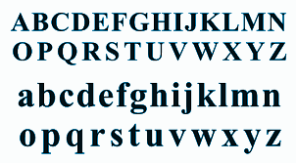
What is a writing system?
A writing system (also called a script) is a system of symbols used to represent language.
There are different kinds of writing systems, with symbols that represent different things.
For example, English uses an alphabet (the Latin alphabet):

Slide 4
About Writing
Writing developed as a way of representing spoken language, not vice versa (as seen in Topic 2 Phonetics)
So, if there is a discrepancy, you should question the spelling (Why is it written ‘gh’ when it is pronounced f?), not the pronunciation (Why is it pronounced f when it is written ‘gh’?)
Most writing systems (even alphabetic ones) are not fully “phonetic”
  Letters can have different values
  The same sound can be written differently

Slide 5
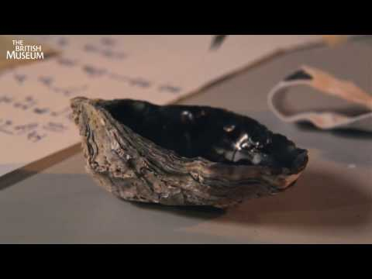
History of Writing
Watch the video: https://www.youtube.com/watch?v=j7nM3YOwu00
Notes:
Watch the six minute video on the history of writing and printing.
Also a good overview: https://www.languageinsight.com/blog/2019/a-short-history-of-writing/
The secret history of writing (BBC documentary - 2 hours! - https://www.youtube.com/watch?v=TyfIS9b77A8)

Slide 6
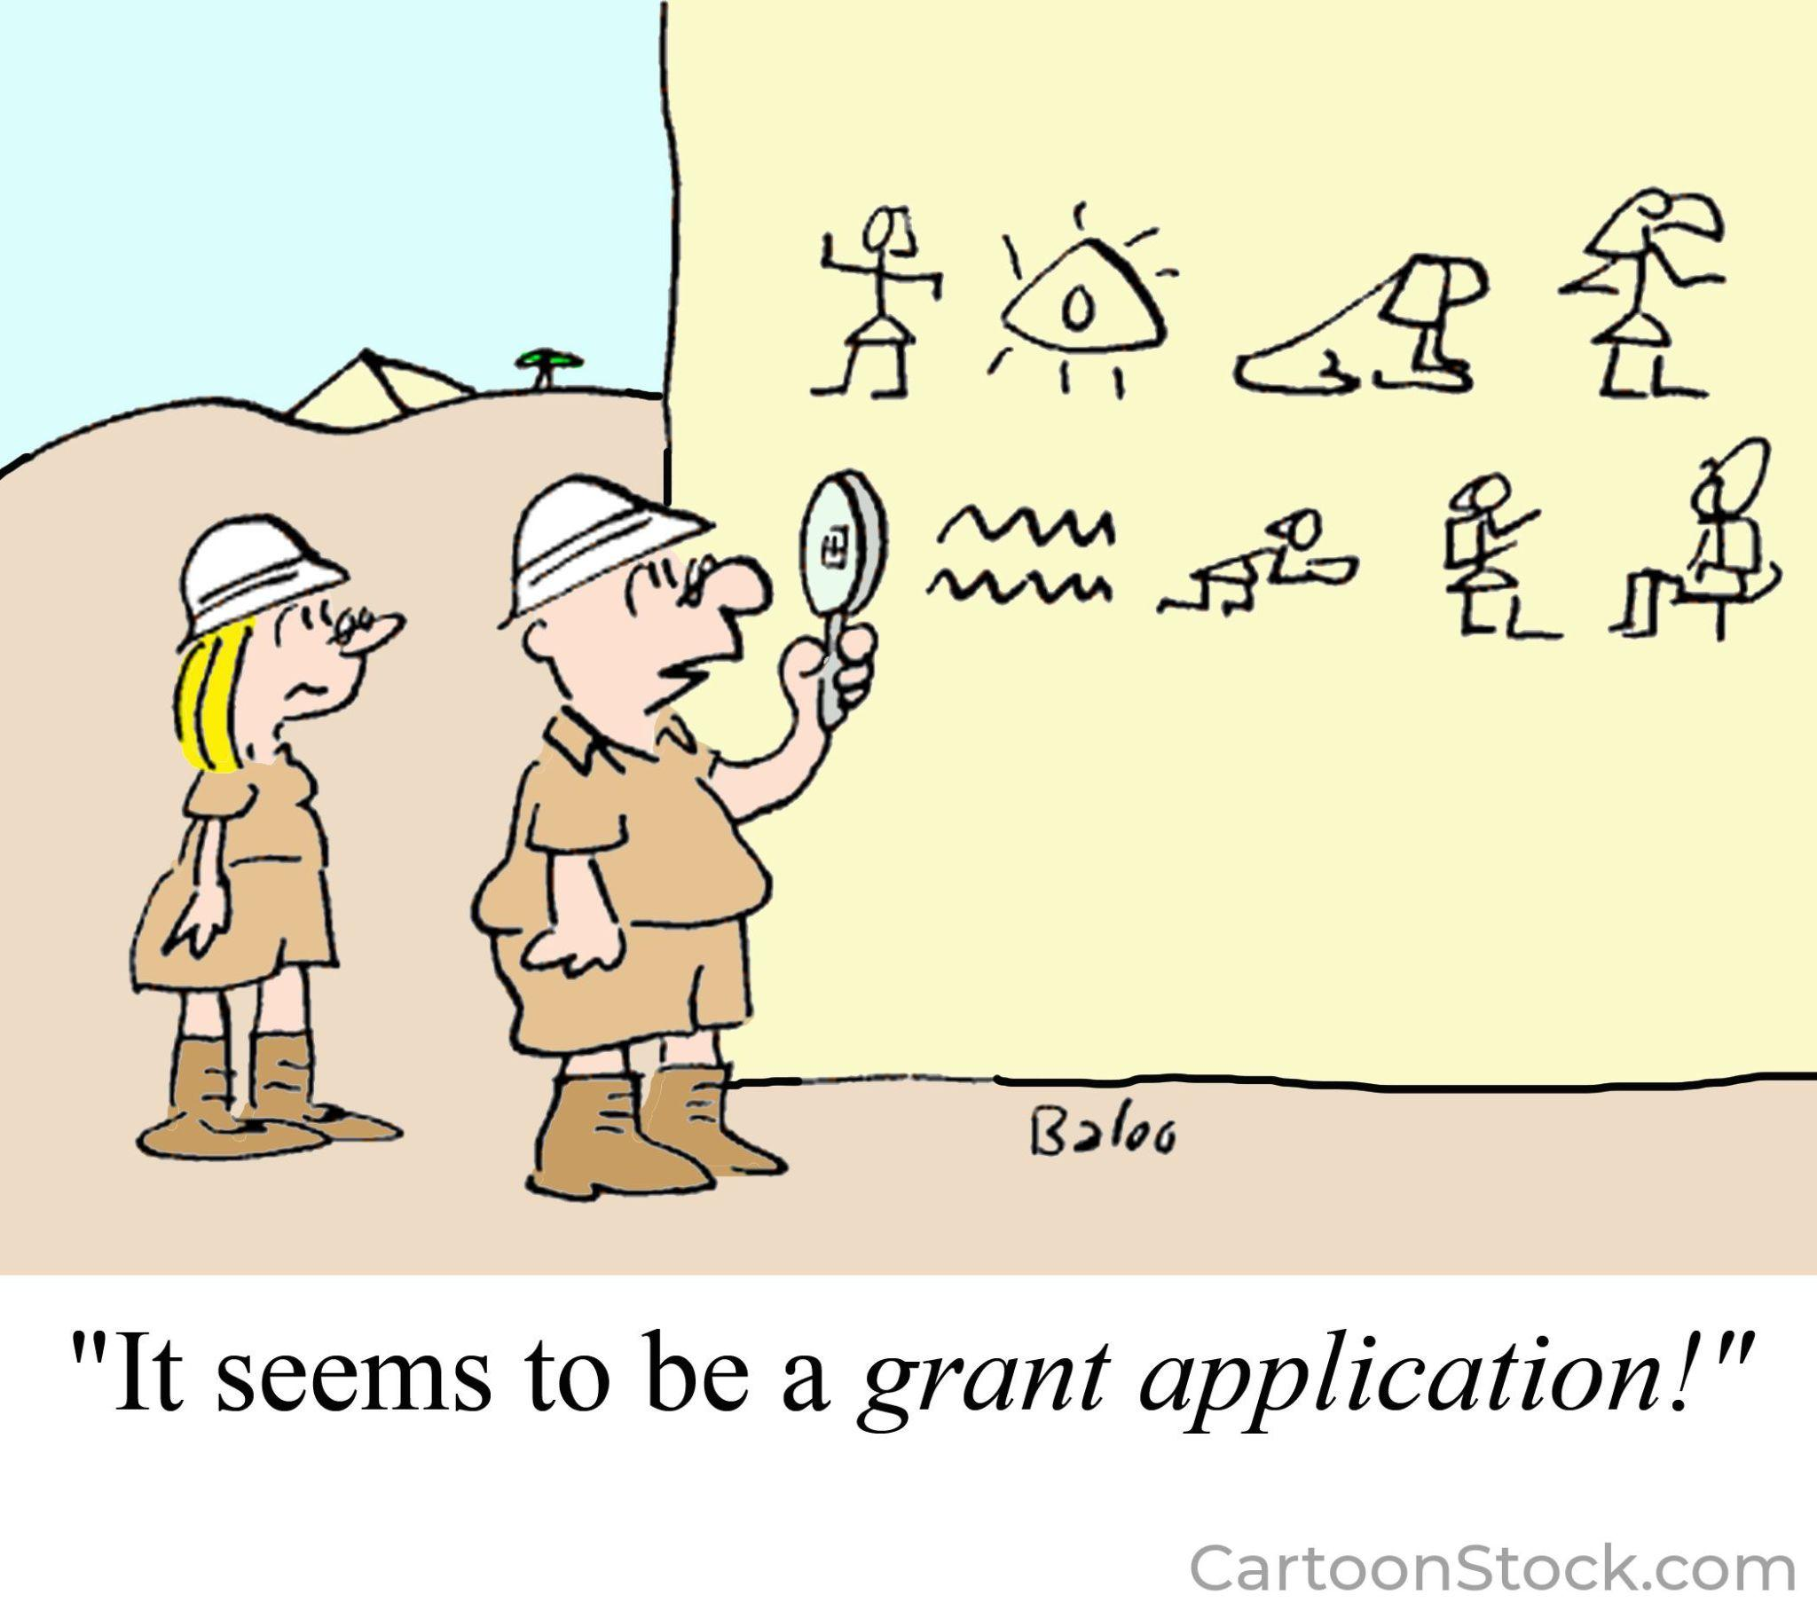
Notes:
CartoonStock.com Educational License

Slide 7

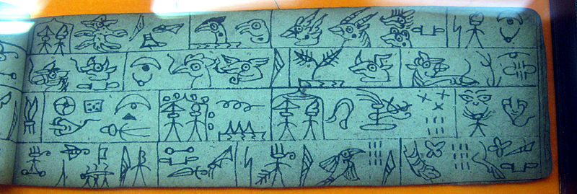
Types of writing system: Pictographic
Elements are pictures, combined in graphically-interpretable patterns (e.g. temporal sequence or spatial relationship)
Each picture is am idea /object that tell a story e.g. emojis
Notes:
Picture: Wikimedia Commons Free to use https://commons.wikimedia.org/wiki/File:Lijiang_Oct_2007_199.jpg
The Dongba script of the Naxi people was invented in the 13th century and is the only pictographic writing that is still in use today. This example is from a codex that is displayed in the Wenchang Gong.

Slide 8

Types of writing system: Ideographic
Elements denote ideas, combined in a logical fashion
Example: Blissymbols
‘I want to go to the cinema’

Slide 9

Types of writing system: Logographic
Elements denote words or morphemes, combined morphosyntactically (both morphology and syntax)
Example: Chinese characters
Same script can be used for
different languages (since
characters do not necessarily
have a fixed pronunciation)
Notes:
Image from AILO puzzle on Chinese Football (Harold Somers) https://ailo.adaptcentre.ie/wp-content/uploads/2022/06/Chinese-Football-and-Solution-combined-1.pdf if students would like to try it.

Slide 10
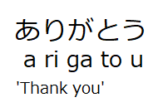
Types of writing system: Syllabic
Elements denote syllables, combined phonologically
Example: Japanese, (also Korean, Inuktitut, etc)

Slide 11
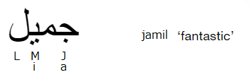
Types of writing system: Moraic
Like syllabic elements, but units are a bit smaller
Typical examples are where characters represent consonants, vowels are marked as diacritics (dots, squiggles etc!), or not marked at all.
Examples: Hebrew, Arabic, many Indian scripts
  (note Arabic is written right-to-left)
جميل ‘fantastic’

Slide 12
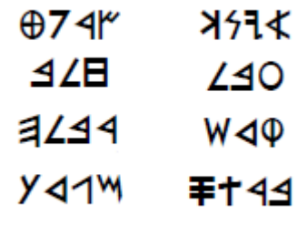
Types of writing system: Alphabetic
Elements denote phonemes (more or less), combined phonologically
Typical example: English uses Latin alphabet but has (many) sounds that Latin lacks, so has to use letter combinations for the missing sounds, like sh, th, vowel sequences
Example: Phoenician (from this alphabet came the Aramaic script and the Greek alphabet, which led to the Latin one we use today) that features symbols for both consonants and vowels.
Image from AILO Phoenician puzzle if students would like to try it at the end of this topic. It is quite a challenging puzzle.
Notes:
Phoenician puzzle: https://ailo.adaptcentre.ie/wp-content/uploads/2022/06/Phoenician-Puzzle-and-Solution.pdf
Quite challenging puzzle

Slide 13
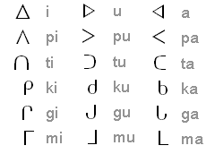
Types of writing system: Featural
Elements denote distinctive features of phonemes (such as voicing or place of articulation), combined phonologically
Example: syllabic Korean (individual characters are composed of distinctive elements):
비빔밥 bibimbap (a Korean dish)
Can you see which elements
represent b, i, m, a, p?
Example: moraic Inuktitut (consonant symbols are oriented in one of three directions to denote vowel):

Slide 14
Direction of Writing
Left-to-right most common
Right-to-left (eg Hebrew, Arabic)
Top-to-bottom (Chinese, Japanese)
  may start at top-left or top-right
Bottom-up (very rare)
  Example: Ogham
Boustrophedon (alternating L-R and R-L)
Optional direction
  Example: Japanese vehicles front-to-back; mirror-writing on emergency vehicles

Slide 15
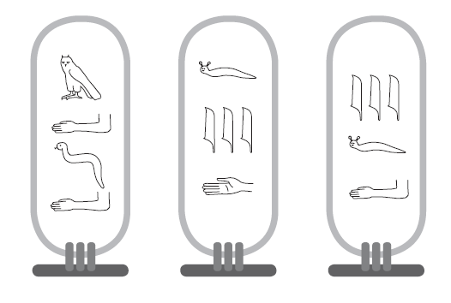
A simple writing system
Written here are the names Iva, Maja, Vid.
Which is which?
What is the direction of writing, are there any additional rules for symbols?
What kind of writing system is this (what each symbol represents)?
Notes:
The teacher should invite the students to answer the questions.
Rules
Writing system: top to bottom (i tells you direction)
Each symbol reps a letter
No additional rules?

Slide 16
What kinds of questions can we ask about this writing system?
How did you start to work it out?
What is the word order?
What kind of writing system is this (what each symbol represents)?
What is the direction of writing?
Are there any additional rules for symbols?

Slide 17
Answers (rules found)
Maja Vid Iva
Rules:
Writing system: top to
bottom (the position of ‘i’ in Vid and Ida indicates direction)
Each symbol represents a
letter
No additional rules.
Notes:
The teacher should invite the students to answer the questions.
Rules
Writing system: top to bottom (i tells you direction)
Each symbol represents a letter
No additional rules.

Slide 18
Task 5.1 Trying a Logographic puzzle

Slide 19
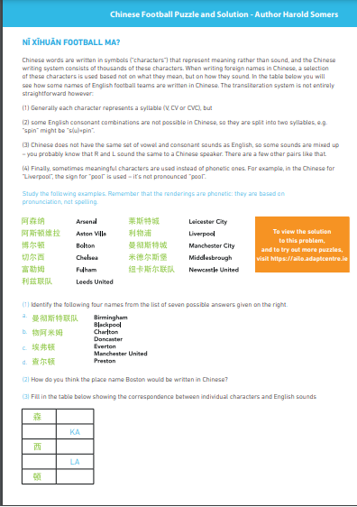
Exercise 5.1 Let’s try a Logographic writing system (Chinese)
Give the students the AILO puzzle on English football team names in Chinese (and Solution)
Try the puzzle for 15 minutes in pairs
How did you go about this puzzle? What patterns did you find?

Slide 20
Task 5.2 Ogham Writing System

Slide 21
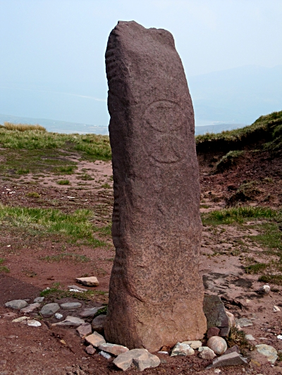
Ogham Stones
Dates to at least 1,600 years ago.
Used to inscribe Primitive Irish
oldest known form of the Gaelic
languages) onto stones.
Image: Ogham Stone from Faha,
Kerry, Ireland with added
cross symbol
Notes:
Image: Ogham Stone from Faha, Kerry, Ireland; with added cross symbol
Creative Commons Attribution Wikimedia https://commons.wikimedia.org/wiki/File:Ogham_Stone_(geograph_2391021).jpg

Slide 22
Ogham Letters
The word ogham refers to the ‘form’ of the letters
The letters themselves are called the ‘Beith-luis-nin’
  after the letter names of the first three letters in the ogham alphabet
  like ‘alphabet’ derives from the first two names of the letters alpha and beta.
The ogham alphabet originally consisted of twenty distinct characters called feda “trees”, and arranged into four groups called aicme “families”.
Notes:
Source: https://ogham.co/

Slide 23
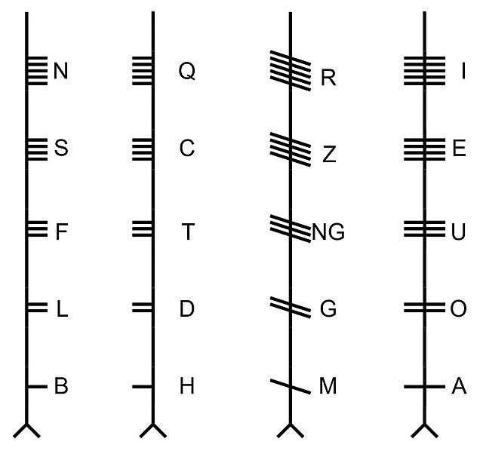
The 4 aicme (denoted by first letter B, H, M, A)
Notes:
Image wiki media creative commons https://commons.wikimedia.org/wiki/File:All_Ogham_letters_without_Forfeda_-_%C3%9Cbersicht_aller_Ogham-Zeichen_ohne_Forfeda.jpg

Slide 24
The 4 aicme (denoted by first letter B, H, M, A)
Why do you think they are split into four groups this way?
E.g. what have “A” letters got in common?
What is the direction of writing?
Notes:
Image wiki media creative commons https://commons.wikimedia.org/wiki/File:All_Ogham_letters_without_Forfeda_-_%C3%9Cbersicht_aller_Ogham-Zeichen_ohne_Forfeda.jpg

Slide 25
The 4 aicme (denoted by first letter B, H, M, A)
Why do you think they are split into four groups this way?
What have “A” letters got in common?
The different groups correlate the direction of the strokes.
A (notches) are all vowels
What is the direction of writing?
Bottom to top
Notes:
The groups denote the strokes. The A group ‘notches’ are all vowels.

Slide 26
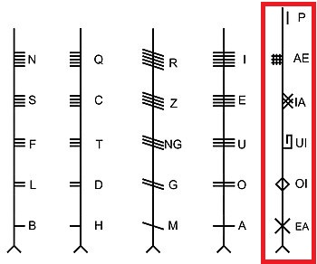
The Forfeda
Five additional letters called forfeda were introduced mainly in the manuscript tradition several centuries after the epigraphic peak (writing in/on stone) of ogham usage.
They appear to have represented sounds felt to be missing from the original alphabet

Slide 27
There is no j, w or y in the Ogham alphabet
Five additional letters called forfeda were introduced mainly in the manuscript tradition several centuries after the peak of ogham usage.
They appear to have represented sounds felt to be missing from the original alphabet

Slide 28
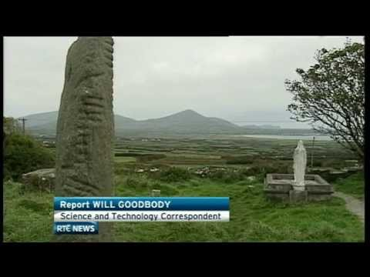
Digitising of Ogham Stones
Notes:
https://www.youtube.com/watch?v=IlJBcfvoeaY
RTÉ News piece on digitising ogham stones

Slide 29
Exercise 5.2 Ogham translation
Give the students Worksheet 5.2 Ogham to work on the Ogham transliterations

Slide 30
Task 5.3 Old Norse Runic Writing System

Slide 31
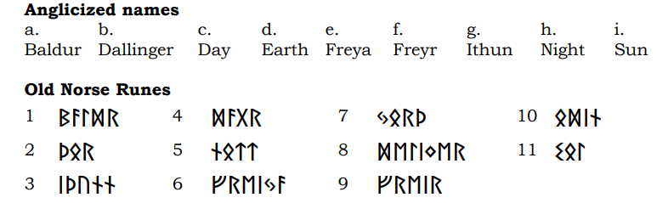
Exercise 5.3 AILO Puzzle on Old Norse
Give the students AILO Elder Futhark Runes Puzzle and Solution
Your task is to match Old Norse God names to the Elder Futhark Runic Alphabet.

Slide 32
Additional resources (Ogham)
https://ogham.celt.dias.ie/menu.php?lang=en
https://ogham.glasgow.ac.uk/

