Slide 1
Introduction to Sociolinguistics
TY Linguistics

Slide 2
Overview of this Linguistics Module
Topic 1 Introduction to areas of linguistics and problem-solving
Topic 2 Historical Linguistics
Topic 3 Phonetics
Topic 4 Sociolinguistics
Topic 5 Writing systems
Topic 6 Language Acquisition
Topic 7 Morphology
Topic 8 Syntax
Topic 9 Psycholinguistics / Neurolinguistics
Topic 10 Machine Translation

Slide 3
Task 4.1 Introduction to Sociolinguistics

Slide 4
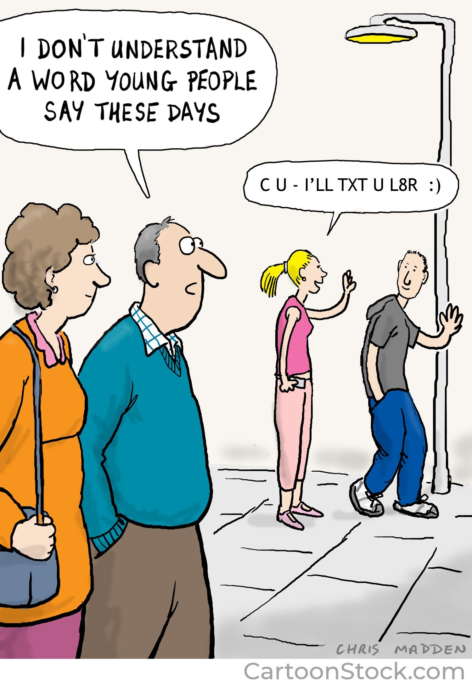
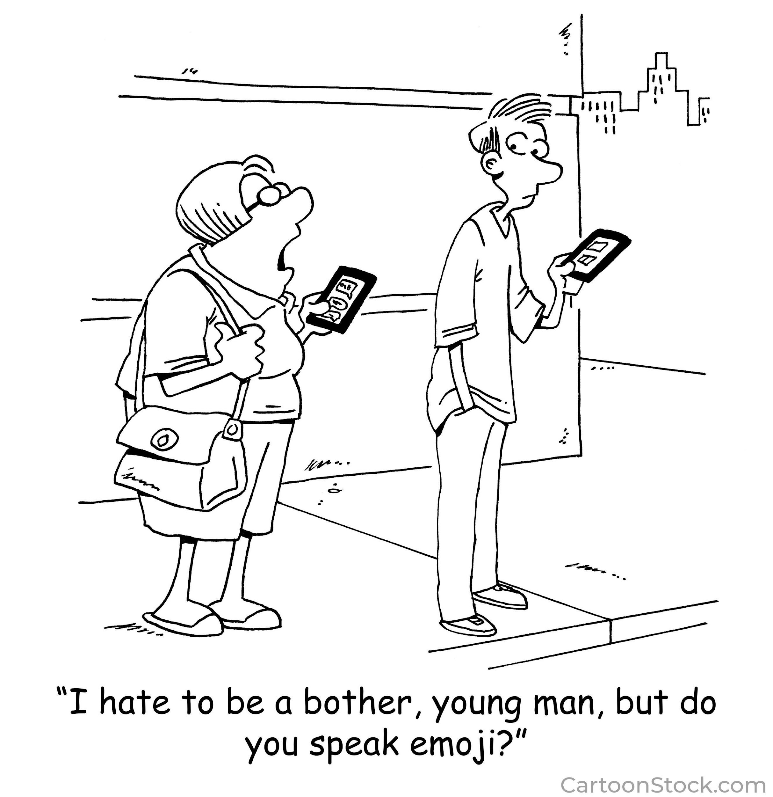
What is Sociolinguistics?
Sociolinguistics is concerned with the relationship between language
and society.
Notes:
Pose the question to the class first before showing them the answer. No need to go in to detail here yet as the next exercise will do that.

Slide 5
Activity 4.1.1 Select the words that YOU would associate with Sociolinguistics.
Accent
Age
Change
Code Switching
Community
Culture
Education
Ethnicity
Family
Gender
Geography
Identity
Immigration
Language Variety
Register
Religion
Setting
Slang
Social Class
Urbanization
Notes:
Pre-Activity to get the students thinking about the topic.
1. Get them to highlight the words that they think are associated with Socio-Linguistics.
2. Tease out a few answers from students – why do they think that particular word is linked.
3. If there are any words that students don’t choose, pick that word out and ask students to consider how it is actually related to the topic e.g. education….could be linked to native and foreign language teaching and learning
Note – any of these words are acceptable answers and students might also come up with words that aren’t on the list
Pre-Activity to get the students thinking about the topic.
1. Get them to highlight the words that they think are associated with Socio-Linguistics.
2. Tease out a few answers from students – why do they think that particular word is linked.
3. If there are any words that students don’t choose, pick that word out and ask students to consider how it is actually related to the topic e.g. education….could be linked to native and foreign language teaching and learning
Note – any of these words are acceptable answers and students might also come up with words that aren’t on the list

Slide 6
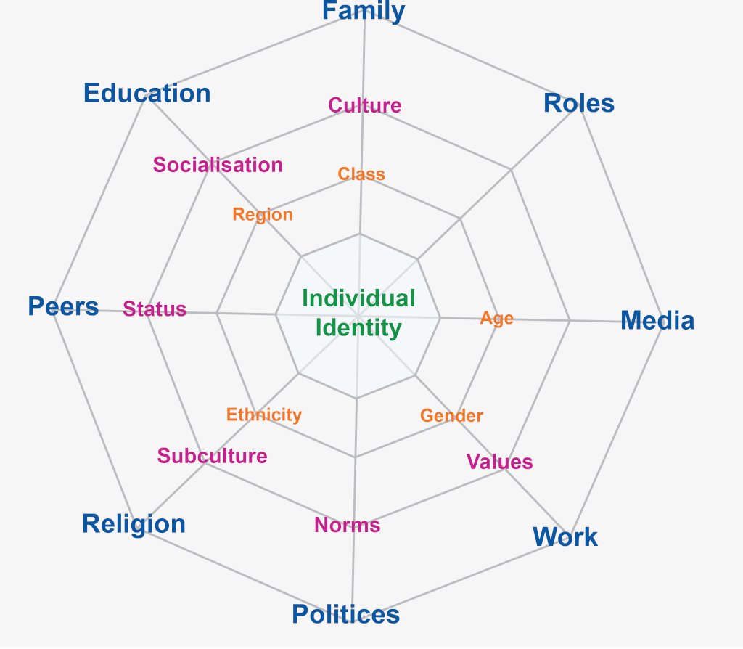
Language and Identity
“Identity is what underlies most people’s retention of at least some of their local features because ultimately what we say is who we are”.
Clive Upton, Professor Emeritus of English Language at the University of Leeds
Notes:
Age, education, ethnicity, media and other social factors can also influence our words and sound patterns and even though we might move away from the place we were brought up in, we often still retain many of the words and ways of pronunciation.
Web of Identity (Livesey, 2004). Source https://horizonofreason.com/culture/web-of-cultural-identity/

Slide 7
Activity 4.1.2 – Sociolinguistic Terminology
On the handout, match the correct linguistic term with its definition
1. Accent | J. Regional phonological or phonetic distinctions
Notes:
These are just some key definitions related to the subject of Sociolinguistics. We will be taking a closer look at a few of these in these lessons.

Slide 8
1. Accent | J. Regional phonological or phonetic distinctions
2. Creole | G. A stable natural language developed from the simplifying and mixing of different languages. It is spoken as a native tongue.
3. Dialect | E. A variety of a language that may have different but mutually intelligible pronunciation, vocabulary or phrases from the standard language
4. Idiolect | A. The unique characteristics of the language of an individual
5. Jargon | H. Technical terminology or characteristic idioms of a particular group
6. Language | F. The words and expressions used and understood by a large group of people
7. Pidgin | C. A simplified language which arises for the purposes of communication between two social groups, one of which is in a more dominant position than the other. The less dominant group is the one that creates this language.
8. Register | B. The way people use language in different situations e.g. formally or informally
9. Regional Dialect | I. A variety of the language associated with speakers living in a particular area
10. Slang | D. Informal words and phrases more typically associated with speech than writing. They can be related to a specific group of people or place.
Notes:
Answers on click

Slide 9
Activity 4.1.3- Sociolinguistics Terms in Context
Complete the sentence with the correct term from the previous exercise. Answers below on a click.
I would never say ‘How’s it going?’ to my school principal as that’s not the correct register to use in polite conversation.
Lol is one of the most common slang terms in electronic communication, that has now also moved in to general speech.
My boss always tells us that it is best practice to think outside the box and give 110%. I hate corporate jargon.
Whether you say Cén chaoi a bhfuil tú? Or Conás atá tu? Or Cad é mar atá tú? depends on which dialect of Irish that you speak. Is it Connacht, Munster or Ulster Irish?
Chinglish or Chinese pidgin English has only 700 words. It was used for over three centuries by Chinese traders in the Cantonese region of China and never developed in to a creole language.
Notes:
Students must choose the correct terminology from the previous table to complete these sentences. By doing this exercise first or at the same time might help some students also complete the table.

Slide 10
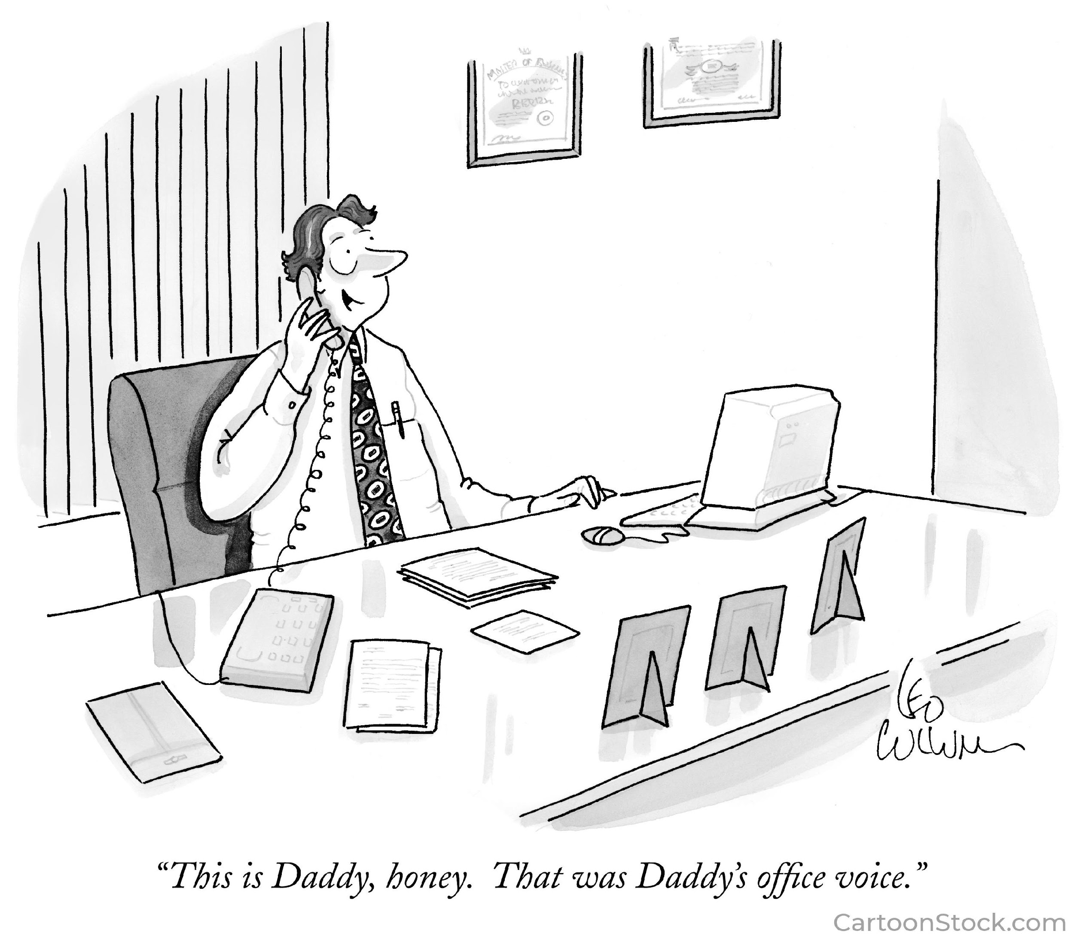
Language and Register
This is the level of formality that you might use in a conversation or text.
How do you decide what register is appropriate to use?
Why is it important to know the correct register to use?
What registers do you use?
Notes:
Prompt students with questions to point them in the right direction here.
How might you change what you say depending on who you are speaking to? Why do you do that? In English class what language register would you use to write a letter to a local newspaper? What about the language style you would use in a personal essay?
You wouldn’t address your friends in the same way that you’d talk to the school principal. Instead you subtly adjust the way that you’re speaking to convey respect for or familiarity with the person you’re addressing.

Slide 11
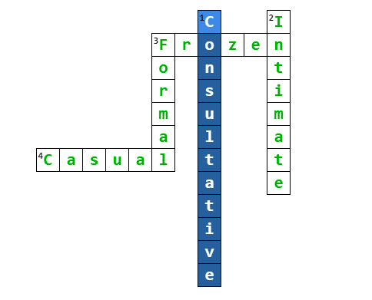
Activity 4.1.4 - The Five Registers of Language
Casual, Consultative, Formal,
Frozen or Intimate Register?
Across
3. Language that is always the same e.g. The Lord’s Prayer
4. Language between friends. Word choice general and not specific
Down
Less formal standard language used in conversation
2. Language between close family or friends
3. Standard language with specific word order and complete sentences
Notes:
There are 5 registers of language – complete the crossword with the correct term.
Note that the terminology for Intimate register can also be known as familiar register or informal register. More details on register can be found
At https://study.com/learn/lesson/language-register-types-examples.html
Answers to the crossword once you press click

Slide 12
Activity 4.1.5– Identify the Register
Please contact me at your earliest convenience.
I dunno what’s the craic at all with him.
It has been confirmed that schools will
reopen tomorrow.
I love you to the moon and back.
Formal
Casual
Intimate
Formal
I’d say the traffic will be chock a block later.
Our father, who art in heaven, hallowed be thy name.
Give me a call if you need any more help.
This is an announcement for flight EI412
Casual
Consultative
Frozen
Frozen
Notes:
Get students to label each sentence with the register that it most corresponds to.
Click on the slide to get the answers

Slide 13
Registers in other Languages
In some languages there are styles or registers that must be adhered to in certain social situations.
For example, in the MFL languages studied in Irish schools, there is a distinction between the familiar or informal ‘you’ (speaking to a friend or family member) and the polite or formal ‘you’ (speaking to someone in a higher position to you or in less personal encounters).
Notes:
Check out World Atlas of Language Structures Online for more information on politeness and pronouns https://wals.info/chapter/45

Slide 14
Activity 4.1.6 Register in other Languages
A. In groups, complete the table on your handout translating the formal and informal word for ‘you’. Use the collective knowledge of the class first before using an online translator!
B - These languages might also have to consider differentiating between singular/plural/masculine/feminine within the formal/informal register. Can you explain further and give an example?
C. Are there any other languages that you speak that also have this differentiation?
 | French | German | Italian | Polish | Russian | Spanish
Informal ‘You’ | Tu | Du | Tu | Ty | ты | Tú
Formal ‘You’ | Vous | Sie | Lei | Pan/Pani | Вы | Usted
Notes:
These and other languages might also differentiate between singular and plural, masculine and feminine within the formal/informal register. Get students to explain them in class.
Q. A – Press click and the answers to the table will appear on the slide
Q. B – Languages such as Spanish also differentiate between the formal and informal ‘you’ in the singular and plural so there are 4 different ways of saying you in Spanish. Tú and Vosotros are informal (singular and plural) and Usted and Ustedes are formal (singular and plural).
German has even more words for the pronoun.
Q C - Some other languages that have similar differentiation between the formal and informal word for ‘you’ are: Japanese, Catalan, Portuguese, Danish, Dutch, Bulgarian, Serbo-Croatian

Slide 15
Activity 4.1.7 – Same but Different
Create a list of words/phrases in English and any other language(s) you study or know, to highlight the different register for the same thing. When is it appropriate to use them?
A few examples are given to get you started:
English – loo/toilet, put up with/tolerate
Irish – Le grá/Is mise le meas (letter endings -with love/yours respectfully)
French – Un mec/un homme (a guy/man)
German tschüss/auf wiedersehen (Goodbye)
Spanish – Querido/estimado (Greeting - dear)
Notes:
This activity aims to get students actively on their knowledge of informal and formal words or phrases and reflecting on how they know when it is appropriate to use each one. This knowledge is inherent in their native language but can also easily transfer over to any other language that they are learning.
If they know or are studying more than one language, please encourage them to make a list in other languages as well.
Your TY class is probably made up of students learning different languages in school or who speak other languages at home. You could group these together when doing this activity OR another option is to have one student in each group working on a different language e.g. Irish, German, Polish, etc.

Slide 16
Task 4.2
Accents, Dialects and Languages of Ireland

Slide 17
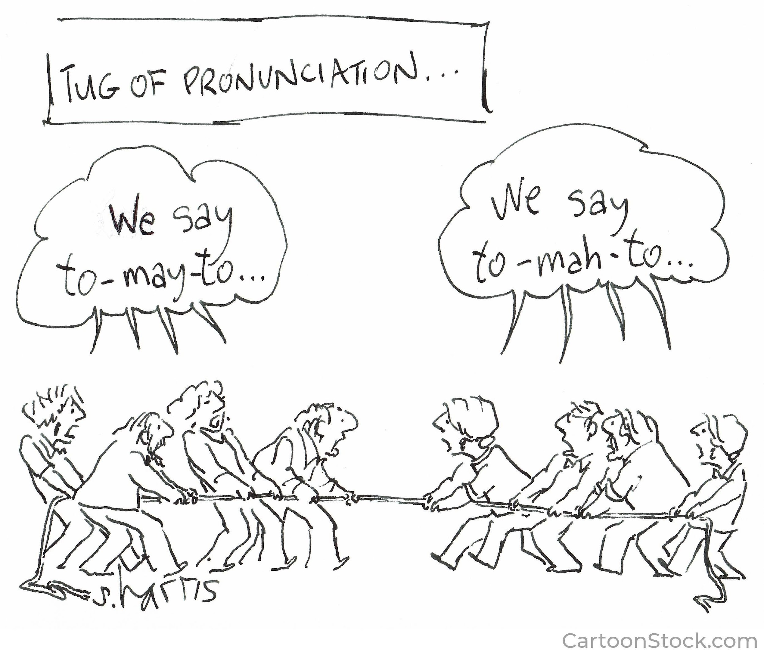
Discussion on Accents
When you think of the word ‘accent’, what do you think of?
Consider all the accents that you are used to hearing around you at home, school, tv etc. What differentiates them?
What can an accent tell you?
Why do we have different accents?
What accents do you particularly like?
Are there any accents that you find more difficult to understand? Why?
Have you ever changed your accent? Why? In what context?
Have you ever judged or been judged because of your accent? Explain
Do you think that people might be treated differently depending on their accent? Why?
Notes:
Ask students to consider these questions individually before joining up with a partner or small group to discuss in more detail.
Encourage discussion at a class level
Encourage discussion within the class

Slide 18
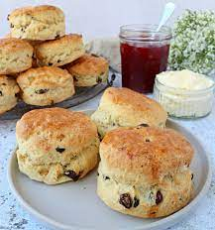
Activity 4.2.1 – The Great Scone Debate
How do you pronounce the word? Like ‘gone’ or ‘cone’?
Do a survey in your class, or even better, of a selection of staff in your school, to see if you all say it the same way.
What conclusions can you draw? Why might you have different pronunciations of it?
What or who might influence the way you say the word?
Notes:
Ask students to consider these questions individually before joining up with a partner or small group to discuss in more detail.
Encourage discussion at a class level
Encourage discussion within the class

Slide 19
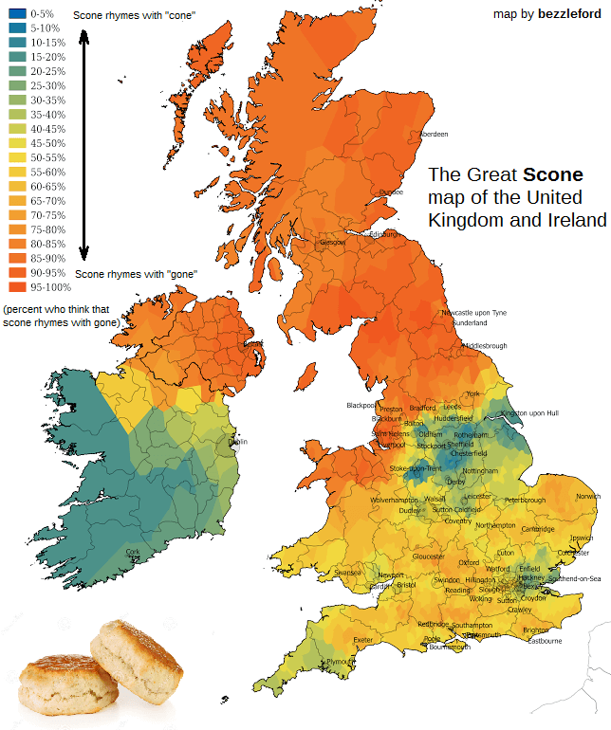
Notes:
Obviously individuals might pronounce this differently to what is on the map, but this is a good idea of how the pronunciation varies by region.
However, influence by another person, tv or social media etc. might alter how a word is pronounced, even though other people around pronounce it a different way.

Slide 20
Activity 4.2.2– Test your Ear
Listen to the recordings from dialectsarchive.com and guess where each person is from. (country and/or region). Write your answer on your worksheet. Test your Ear Dialectsarchive.com
What are your impressions when you hear these different accents? Consider the questions you discussed at the start of the lesson
Notes:
There are a range of accents used – you can pick a selection from these for your students. Some are clearer than others so perhaps listen to them first and choose which suit your class best.
NB - It’s important that you skip the first part of the audio where the author of the website introduces each recording and mentions where the accent is from. Therefore, skip to another part of the recording. You do not need to play the full audio.
1. Australia male
2. India male
3 Kentucky USA female
4 London female
5. Barbadian female
6.French male
7.American female (Maine)
8. Canadian male (Newfoundland)
9. Austrian male
10. South African male
11. Chinese female (Hunan)
12 Northern Ireland female
14 Scotland female
18 Liverpool female
Test your Ear Dialectsarchive.com https://www.dialectsarchive.com/test-your-ear)

Slide 21
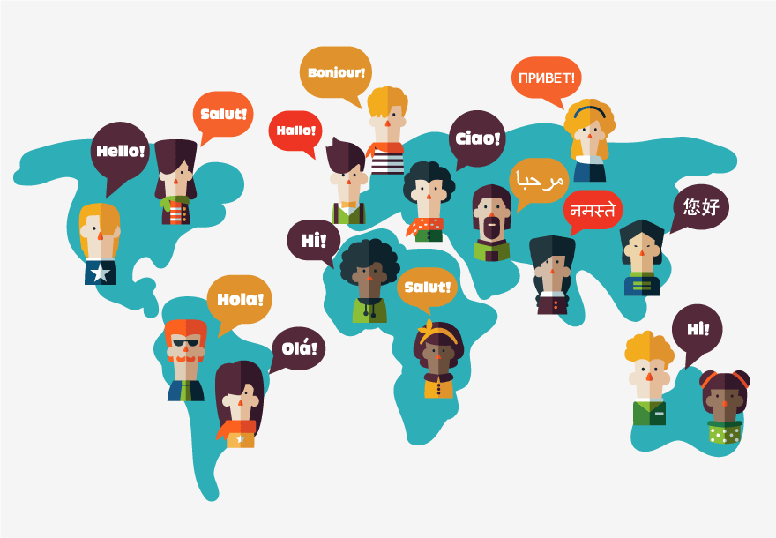
Activity 4.2.3 International Dialects of English
Dialects can differ in pronunciation, grammar, spelling and/or vocabulary. The following words all mean the same things but have a different
term in each dialect. How well do
you know them?
For example, in American English they say ‘elevator’ but in British English they use ‘lift’ or the word ‘movie’ is associated with America, whereas ‘film’ is traditionally used elsewhere.
Add the English word that you use
for each of these too!
Notes:
Note that these words can be formal or informal and/or slang.

Slide 22
American English | Australian English | British English
Awesome | Beaut | Great
Cookie | Bickie | Biscuit
Dude | Bloke | Man
Liquor Store | Bottle Shop | Off License
Candy | Lollies | Sweets
Pants | Daks | Trousers
Lavatory | Dunny | Toilet
Football | Footie | Soccer
Howdy | G’day | Hi
Gas Station | Service Station | Petrol Station
Sneakers | Runners | Trainers
Underpants | Undies | Underwear
Your English
Notes:
Encourage students to give their own words for these examples. Create a new list on the board with these.

Slide 23
Extension Activity 4.2.4 Dialects of Ireland and the UK
Have a go at this interactive quiz by the New York Times on the English spoken in Ireland and the UK.
https://www.nytimes.com/interactive/2019/02/15/upshot/british-irish-dialect-quiz.html
Is it able to indicate where you’re from? How accurate is it?
Try it out on your family or some of your teachers, especially if they are not from the same place as you.
Notes:
This quiz can be taken in class if you have lots of time or as homework and discussed at a later time.
If you don’t want to do this activity, you can just move on to the next section on the languages in Ireland

Slide 24
Activity 4.2.5 The Languages of Ireland
Irish Gaelic is constitutionally the first official language of the Republic of Ireland. Irish has the oldest vernacular (native/spoken-language) literature of any language in Western Europe and arrived here around 2,500 years ago.
Can you remember which group of languages within the Indo-European family that Irish Gaelic belongs to? Celtic
What other languages belong to the same family? Scottish Gaelic, Manx (dead), Welsh, Breton and Cornish (dead)
Which languages within that group would be more similar to Irish? Scottish Gaelic
4. What are the dialects of Irish and where are they spoken? Connacht, Munster and Ulster
Notes:
Discussion on the official languages of Ireland, Irish and English.
Answers on Click.
Links to the historical linguistics module
https://www.britannica.com/topic/Celtic-languages
Q. 2 Manx - By the early 1960s there were perhaps as few as 200 who were conversant in the tongue. The last native speaker, Ned Maddrell, died in 1974. The decline was so dramatic that Unesco pronounced the language extinct in the 1990s.
Cornish is a revived language, having become extinct as a living community language in Cornwall at the end of the 18th century. However, knowledge of Cornish, including speaking ability to a certain extent, continued to be passed on within families and by individuals, and a revival began in the early 20th century.
Q. 3 - Scottish Gaelic and Manx belong to the sub group Goidelic and the others belong to the subgroup Brittonic, therefore they are more similar.
Q. 4 (Leinster Irish has died out as a distinct dialect. Some would also say that another dialect ‘Urban Irish’ has developed outside of the traditional Irish speaking areas.
https://www.worldatlas.com/articles/what-languages-are-spoken-in-ireland.html

Slide 25
Languages of Ireland - English
English is the second official language of Ireland and is spoken by the majority of people in Ireland. The language was first brought to Ireland in the 12th Century and started out as a minority language. However, over the course of 800 years and the political, economic and geographical climate of the times, it became the dominant language.
What branch of the Indo-European language tree does English belong to? Germanic
What languages are most similar to English? Scots, Frisian
How is the structure of the English language differ to Irish? Consider the syntax and sentence structure
The sentence structure is different. Irish follows the VSO order (verb subject object) and English follows the SVO order (subject verb object)
Notes:
Q. 2 - Some people consider Scots to be a dialect of English, however, it is a distinct language. Frisian is spoken in parts of the Netherlands, Germany and Denmark and shares 80% lexical similarity with English. The next closest language is Dutch. https://www.babbel.com/en/magazine/languages-closest-to-English
Q. 3 –Go to the next slide to see an example in practice

Slide 26
Sentence Order in Irish and English
Irish – VSO English – SVO
Consider the English sentence “The dog ate the food.”
Subject: The dog
Verb: ate
Object: the food
The equivalent sentence in Irish is D’ith an madra an bia:
Verb: D’ith: Ate
Subject: an madra: the dog
Object: an bia: the food
Notes:
From- https://www.bitesize.irish/blog/irish-gaelic-grammar/

Slide 27
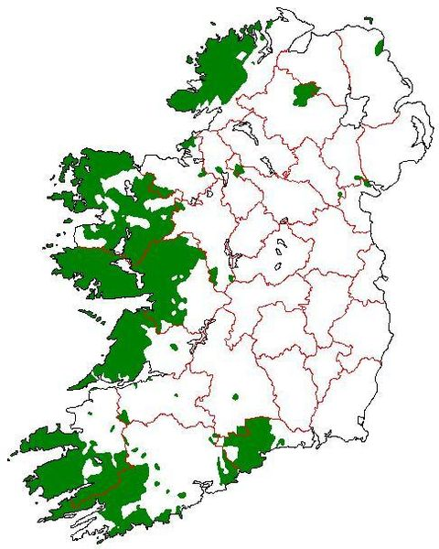
Activity 4.2.6 Endangered Languages
Today Irish is spoken mainly in the Gaeltacht areas and is a required language in schools. However, it is considered an endangered language because of the small number of people that speak it here and it risks falling out of use as speakers shift to using another language e.g English.
Consider the questions on the worksheet individually before watching the YouTube video(s) and then discussing answers in pairs or small groups. Share thoughts with the class.
Why do Languages Die The Economist
What does the world lose when a language dies PBS
Notes:
Questions to encourage reflection and discussion on Irish as an endangered language. Get students to consider these individually first, then play the YouTube video before they work together to come up with their answers.
There are a number of videos you can use for this depending on the time you have and interests of students. The video by the economist https://youtu.be/Qr8QsNCe3C4
Answers 1 and 3 and gives basic answer for Q. 2. (3 mins 25 sec)
The video ‘what does the world lose when a language dies by PBS https://youtu.be/9lNjnE_-Log gives much better insights in to questions 1-3 but is longer. (7 mins) but you could show sections of it e.g up as far as 3 minute for the first few questions. From 4.48-5.54 Q. 5 is covered very well. Q. 4 is touched upon after this.

Slide 28
Activity 4.2.6
Why would a language become endangered and potentially die? Globalisation, Older generation only speaking it, Migration Linguicide, Colonisation
What happens when a language dies out? What unexpected insights are being lost to the world with the collapse of its linguistic variety? Cultural and Social Identity may suffer. Language connects us to our ancestors and heritage.
What languages are also endangered? Hawaiian, Maori, Yiddish, Cornish, Greenlandic. Half of the world’s 7000 could disappear by the end of this century.
What would it mean for Ireland to have its native language, Irish, become obsolete?
How can we encourage minority and endangered languages within Ireland?
Notes:
The answers given here are not finite – encourage and share the ideas from students. There are many ‘right’ answers but these are a few ideas.
Q. 1 – Once younger people stop speaking the language and teaching it to their children, a language is in serious danger
Q. 2 – Music/Literature/Mythology/Humour/Behaviour/Habits/Style of Conversation may disappear (turn of phrase)
Q.3 – 12 more endangered languages - https://blog.busuu.com/surprising-endangered-languages/
Q. 4 - https://www.independent.ie/irish-news/irish-languagedefinitely-endangered-as-linguists-predict-it-will-vanish-in-the-next-century-40427361.html
Over to the students/class to discuss answers for Q. 4 and 5
Q. 5 – There are many endangered languages. Perhaps you could get students to investigate one of these.

Slide 29
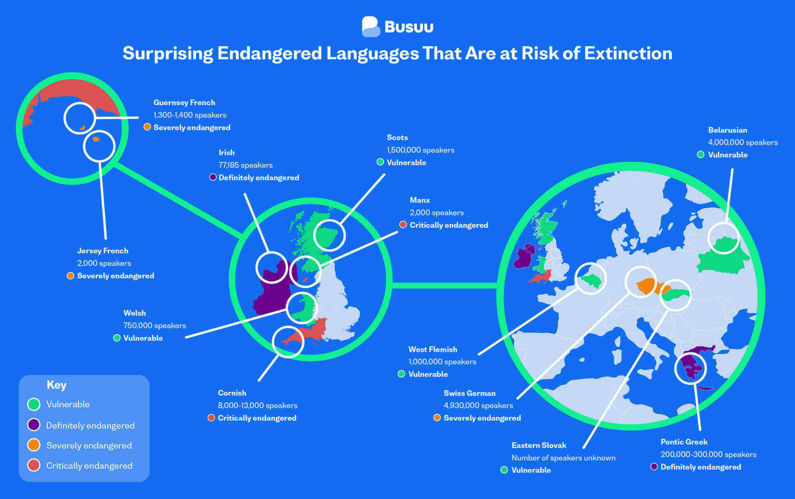
Notes:
12 European languages in danger

Slide 30
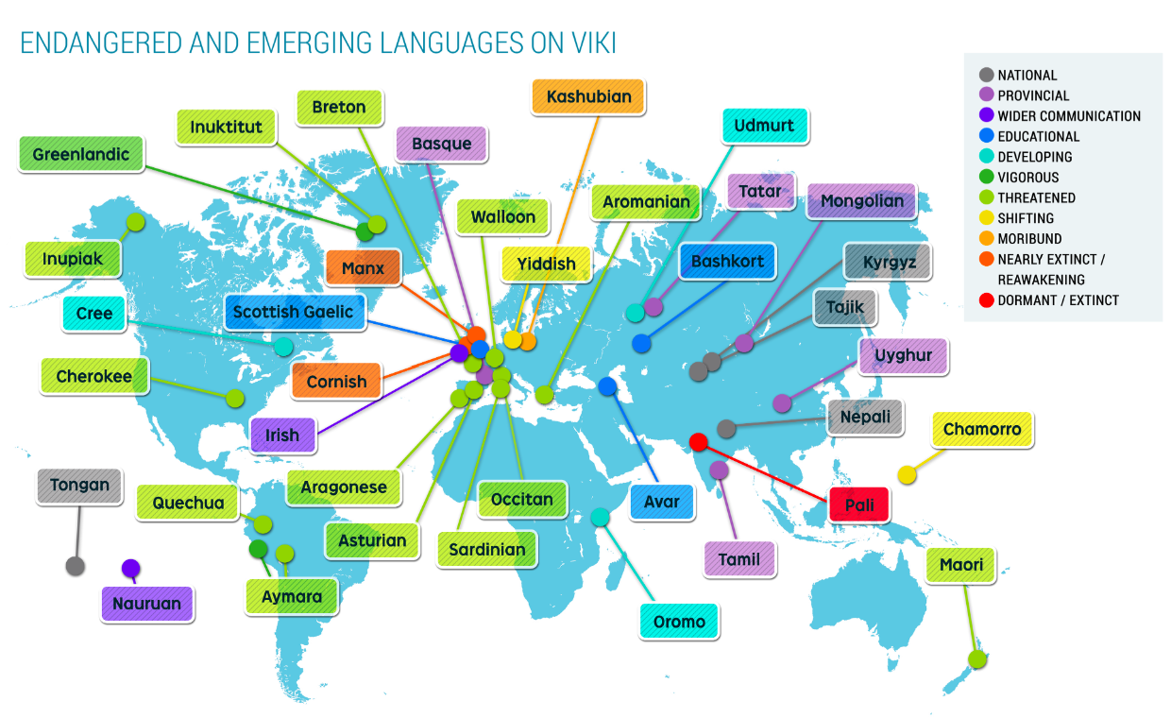
Notes:
An extended list of endangered languages )not exhaustive)

Slide 31
Activity 4.2.7 Lesser Used Languages in Ireland
Did you know that Ulster Scots is known as an official minority language of Ireland? It comes from the Germanic branch of languages and is similar to English. It is found mainly in the areas of Northern Ireland where the Scottish settled and is spoken by both Protestants and Catholics.
Task: Try this quiz to see how well you can understand a few Ulster Scots words and phrases. https://discoverulsterscots.com//language-games/wheen-o-wurds-1/index.html
Notes:
More details on Ulster Scots can be found at - https://www.britishirishcouncil.org/sites/default/files/file%20attachments/Wee%20Guide%20to%20Ulster-Scots.pdf
Or https://www.ulsterscotsagency.com/what-is-ulster-scots/

Slide 32
Extension Activity 4.2.8 - Heritage Languages of Ireland
According to the 2016 Census, the population of the Republic of Ireland was 4,761,865. Of these, 612,018 Irish residents spoke a foreign language at home, an increase of 19% since 2011. Polish was the most common language, followed by French, Romanian and Lithuanian. 30% of those who spoke a foreign language at home were born in Ireland, and 57.4% of these were children.
Explore the Central Statistics Office website (www.cso.ie) to find out the most recent figures for the languages spoken in Ireland. You will also need the overall population for that year.
The CSO also provides a Census County Snapshot – find the main languages spoken in your county. How do they compare nationally?
Use your IT skills and create a survey for the following groups to find out what languages they know, the languages they speak at home and if and when they use Irish e.g. only in school, daily etc.
Again, you will need the total number for each group to be able to accurately work out percentages and charts
  Your linguistics class
  Transition Year Students
  All students in the school (can be broken down per year group)
  Staff members
Notes:
This is a great activity to promote diversity and inclusion within your school.
The points given above are just guidelines so feel free to add to or edit as preferred

Slide 33
Extension Activity
Input all the data you have found to an Excel Worksheet and create a chart(s) of your choice to highlight the statistics
Create a report/poster/PowerPoint to showcase all the information that you have discovered and share with the rest of the school
Notes:
Decide with your class what format to use to share these findings and who will be targeted with the information

Slide 34
Task 4.3 AILO Puzzle on Cameroon Pidgin English (CPE)

Slide 35
4.3 AILO Puzzle on Cameroonian Pidgin English
Student Puzzle: Cameroonian Pidgin English (and solution)
You are tasked to match the Cameroonian Pidgin English (CPE) compounds given for each word to their likely English translations.

