Slide 1
Phonetics
Study of speech sounds
Linguistics Module

Slide 2
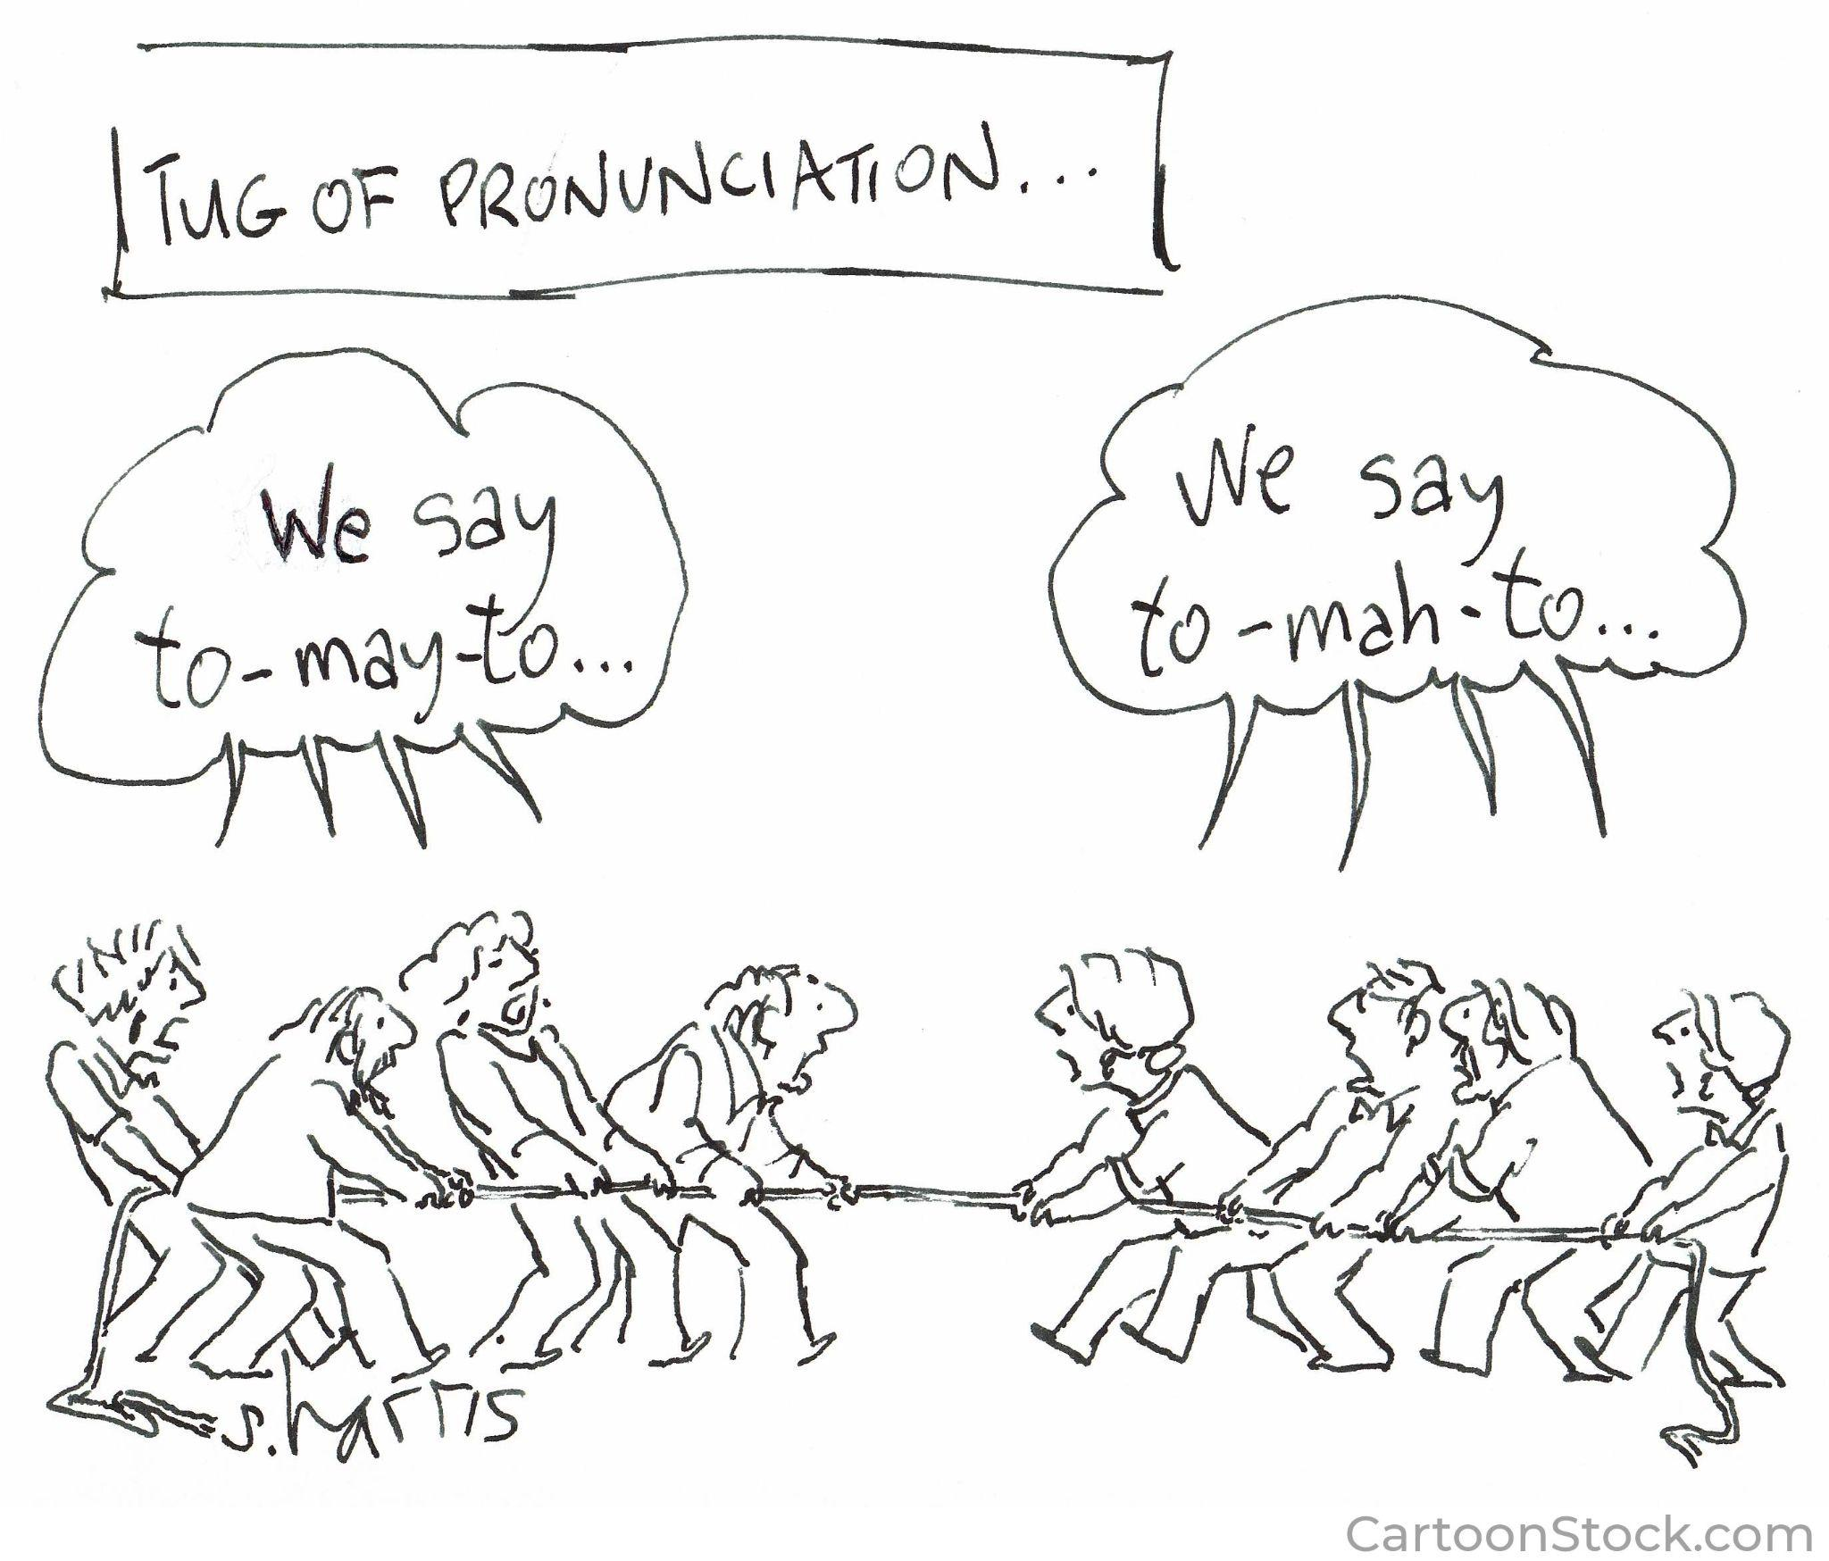
Notes:
Cartoonstock.com under education license

Slide 3
Phonetics - overview
Phonetics is about the sounds that languages use to make words
Languages differ in the inventory of speech sounds they use, though there are quite a few sounds that are found in lots of languages
In this topic we will focus on the sounds of English but make brief mention of sounds found in other languages
Speech sounds are divided between consonants and vowels, though there is some overlap between these two categories
We will look first at the range of speech sounds found in general
and then concentrate on the English sound system

Slide 4
Speech and non-speech sounds
Speech sounds are determined by the position of (mainly) the tongue, and other “organs of speech”
Some sounds have a meaning of their own in some languages, while in other languages the same sound can be used to form words. For example, a click sound to spur a horse has a meaning of its own and is not tied to one language, while clicks are used to create words in some African languages, alongside vowels and consonants in that language (i.e. they are part of the sound system).
Other sounds that have a specific meaning in English are tut-tut and gee-up.

Slide 5
Writing vs speech: the International Phonetic Alphabet (IPA)
Note the difference between writing and speech:
Writing developed as a way of representing spoken language, not vice versa
  so if there is a discrepancy, you should question the spelling, not the pronunciation!
Most writing systems (even alphabetic ones) are not fully “phonetic”
  Letters can have different values
  The same sound can be written differently
The International Phonetic Alphabet was developed to allow phoneticians to write down speech sounds unambiguously
  Most letter symbols are have their expected values, but not all
  There are some new symbols to “learn”
  Principle is: one sound per symbol and one symbol per sound

Slide 6
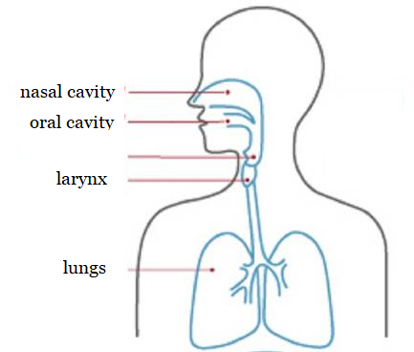
How is speech formed?
Almost all sounds are formed on a stream of air from the lungs which is modified in some way as it passes through the “speech tract”
The glottis (vocal chords) located in the larynx affects “voicing”
The velum controls whether air passes through the nasal cavity as well as the oral cavity (“nasalisation”)
The main factor is the position of the tongue relative to the other parts of the mouth
Curious fact: all the organs that we use for speech have been adapted, and have other primary uses →
Can you name them?

Slide 7
Consonant sounds
Consonants are sounds which involve a blockage in the vocal tract
Either complete (momentary) closure, or a partial blockage
Consonants are defined by three features:
Place of articulation
Manner of articulation
Voicing

Slide 8
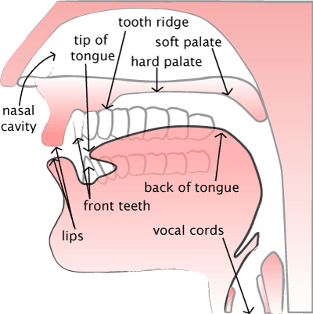
Place of articulation
Click on these black crop marks to reshape your image.
lips (labial)
lips+teeth (labio-dental)
tongue tip + teeth (dental)
  between teeth
  behind teeth
tongue tip and tooth ridge (alveolar)
blade of tongue and hard palate (palatal)
back of tongue and soft palate (velar)
root of tongue and back of throat (uvular) (not in English)
vocal folds only (glottal)

Slide 9
Manner of articulation
Complete closure “plosive” or “stop”
  very brief
  you can’t tell what the sound was until the closure is released
Gap is narrowed but not completely closed, allowing air to hiss through “fricative”
Combination of both: “affricate”
Complete closure but velum is lowered allowing air to pass through nasal cavity: “nasal”
Closure with tip of tongue, but air passes around the sides of the tongue: “lateral”
Tip of tongue curled back, closure is made with back of tongue tip: “retroflex”
Narrowing but no closure, like a vowel “frictionless continuant” or “semi-vowel”

Slide 10
Voicing - let’s try it together
Larynx or glottis consists of two folds of cartilage
They can be held tight
  to prevent food passing into the windpipe
  to compress air in the lungs eg when straining
  to utter a “glottal stop” as in “uh-oh” [ʔ]
Or, as the air passes through they can be allowed to vibrate to produce a “voiced” sound
Rate of vibration determines pitch
Loose vibration results in whisper
No vibration gives “voiceless” sound
Let’s try it! Tests for voicing:
Hold your fingers to your throat or put your hands over your ears, then pronounce a long SSSS then a long ZZZZ. If you can feel or hear buzzing then it’s voiced.

Slide 11
Consonants of English
 | Bilabial | Labio -dental | Dental | Alveolar | Palatal | Velar | Glottal
Stop | p b |  |  | t d |  | k g
Fricative |  | f v | θ ð | s z | ʃ ʒ |  | h
Affricate |  |  |  |  | ʧ ʤ
Nasal | m |  |  | n |  | ŋ
Lateral |  |  |  | l
Retroflex |  |  |  | r
Semi- vowel | w |  |  | r | j
Unfamiliar symbols: θ (thin) ð (this) ʃ (sh) ʒ (measure) ʧ (ch) ʤ (j) ŋ (ng)
NB [j] is ‘y’ (young) NOT ‘j’ !

Slide 12
Vowel sounds
Sounds formed by shape of tongue, but with no contact
Harder therefore to classify exactly
Defined by three main features
Which part of the tongue is raised
Relative height of tongue
Lip rounding
Vowels are usually voiced but can be voiceless (though not in English)
Can be nasalised (again, not in English)
Length is often distinctive
Glides (“diphthongs”) are possible, and quite common in English
Vowels differ greatly in different accents of English (much more than consonants) both per location and over time

Slide 13
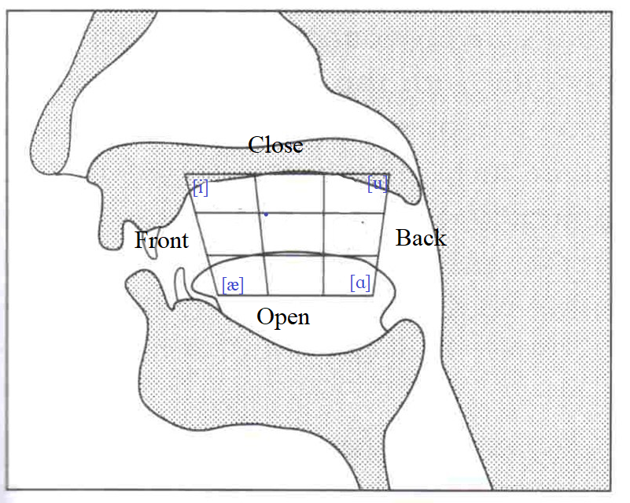
Vowel sounds
Plotted on a chart which represents the oral cavity
Which part of tongue is raised towards the roof of the mouth?
  Front, Central, Back
How high (relatively) is it raised?
  Close, Half-close, Half-open, Open
Are the lips rounded or spread?
  Front vowels typical spread, back vowels rounded
  But this can be reverse (though not in English) - e.g.
    French ‘u’, German ‘ü’ (close front rounded)
    French ‘eu’ German ‘ö’ (half-close front rounded)
    Turkish ‘ı’, Japanese ‘u’ (close back spread) like ‘ugh’

Slide 14
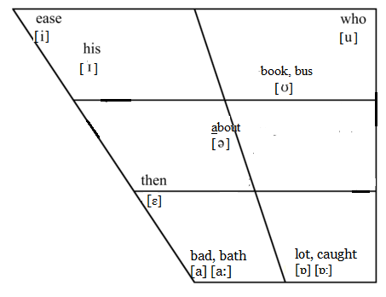
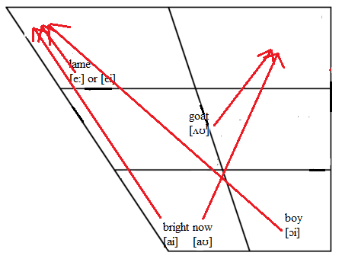
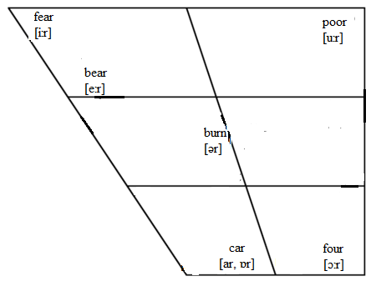
Vowels of (Hiberno-)English
Pure vowels Glides (diphtongs)
R-coloured
(“rhotic”)
Notes:
Hiberno English refers to the English language spoken on the island of Ireland.

Slide 15
Phonology
Some sounds are slightly different depending on context
Most obvious (in English) is “clear L” vs “dark L”
  compare L sound in ‘slip’ and ‘bull’
  but we think of them as the same sound or “phoneme”
[n] can be dental ‘tenth’, labio-dental ‘inform’, retroflex ‘unruly’, palatal ‘onion’, velar ‘incur’ … ie assimilated to the following sound
Velar nasal only occurs before velar plosives [k] and [g] as in ‘sink’ and ‘sing’
  For some speakers, the final [g] is also pronounced

Slide 16
Vowel or consonant?
Vowels and consonants can be defined by HOW they are produced, as we have done here
Or by their FUNCTION
  Semivowels [j] an [w] are essentially the same as the vowels [i] and [u], but they function as consonants in words like ‘yellow’, ‘weather’, ‘awake’ …
  Consonant that are “continuants” (ie not stops) can function as vowels, forming a syllable
  In English, syllabic L in ‘bottle’ (for some speakers), syllabic N in ‘sudden’
  R in some (rhotic) accents could be described as syllabic as in ‘bird’
  Also in paralinguistic forms such as ‘hmmm’, ‘shhhh’

Slide 17
Some non-English consonant sounds
Voiceless is shown first, then voiced
Bilabial fricatives ɸ (Japanese f) and β (Spanish, Greek v)
Palatal fricatives ç (German ich, Irish slender ch, h as in ‘Hughes’) and ʝ (Irish slender dh)
Velar fricative x (Irish broad ch, ‘loch’, German ‘Bach’) and ɣ (Irish broad dh, Spanish, Greek g)
Lateral fricative ɬ (Welsh ll, Zulu hl) and ɮ (Zulu dl)
Uvular stops q and ɢ (Arabic)
Notes:
Some examples you can use depending on classroom language or languages spoken at home

Slide 18
Some non-English consonant sounds (cont.)
Uvular fricative ʀ (French, most varieties) voicing depends on context, eg voiceless in ‘lettre’, voiced in ‘rouge’
Retroflex stops typical of Indian languages
Voiceless bilabial semi-vowel ʍ (wh in some varieties of English, written ‘wh’ but actually one sound, or else [hw]
Labio-dental semi-vowel ɥ (French ‘lui’)
Clicks (tut, gee up, clip clop) in Xhosa, Zulu and other African languages
Notes:
Some examples you can use depending on classroom language or languages spoken at home

Slide 19
Some general facts about languages’ sound systems
All languages have consonants and vowels, but the ratio differs hugely
Number of consonants varies from 117 ( in !Xũ, spoken by 5000 people in Angola/Namibia) to 6 (Rotokas, Melanesia); English has 24
All known languages (except one, an almost extinct Native american language) have bilabial sounds
Number of vowels ranges from (arguably) 2 (Karbadian, a Caucasian language with 650k speakers) to 28 (Kashmiri); English has ~20 depending on accent, quite a high number
Latin had 5 long vowels and 5 short vowels, hence the 5 vowel symbols in our alphabet - that’s (part of) why English spelling is so hard
Most languages (97%) have more consonants than vowels
Source: Mikael Parkvall, Limits of Language, Battlebridge Pubs, 2008

Slide 20
Some general facts about languages’ sound systems (cont.)
Languages also differ in the way words are constructed from the sounds (“phonology”)
Some languages allow only simple syllable structures V, CV (eg Japanese, Polynesian languages), and don’t allow “consonant clusters”
Others allow more or less complex consonant clusters initially or finally
  English allows initially CC or CCC as long as the first C is [s]
  not all combinations of Cs are allowed (“phonotactics”)
  Finally up to 4 or 5 Cs are possible (eg ‘twelfths’)

Slide 21
Exercise 3.1 Places of Articulation
Worksheet 3.1 Places of Articulation (includes diagram, worksheet and solution)
Extra helpful resource to complete above task: Youtube video by IPA Basics : Place of Articulation
Break the students into pairs to explore the places of articulation of consonants. Referring to the diagram, students must pronounce a list of words out loud, and fill in the worksheet.

Slide 22
Exercise 3.2 Phonetic symbols / IPA
Worksheet 3.2 Phonetic Symbols
Break students into pairs to use the phonetic symbols guide to fill in the worksheet.
Extra resource to help: A more comprehensive list of IPA symbols

Slide 23
Exercise 3.3 Articulation Test AILO Puzzle
Adapted All Ireland Linguistics Olympiad (AILO) Articulation Test Puzzle and Solution
Students read the Speech Therapy articulation test data and predict pronunciations. The solution is provided.

