Slide 1
Topic 10: Machine Translation
Linguistics module

Slide 2
Overview of this linguistics module
Topic 1 Introduction to areas of linguistics and problem-solving
Topic 2 Historical Linguistics
Topic 3 Phonetics
Topic 4 Sociolinguistics
Topic 5 Writing systems
Topic 6 Language Acquisition
Topic 7 Morphology
Topic 8 Syntax
Topic 9 Psycholinguistics / Neurolinguistics
Topic 10 Machine Translation

Slide 3
What is Machine Translation (MT)?
Machine Translation means converting text or speech in one language (source, “s”) to a text in another language (target, “t”).
MT is a subfield of Natural Language Processing (NLP) which deals with the use of computers to model and process human language

Slide 4
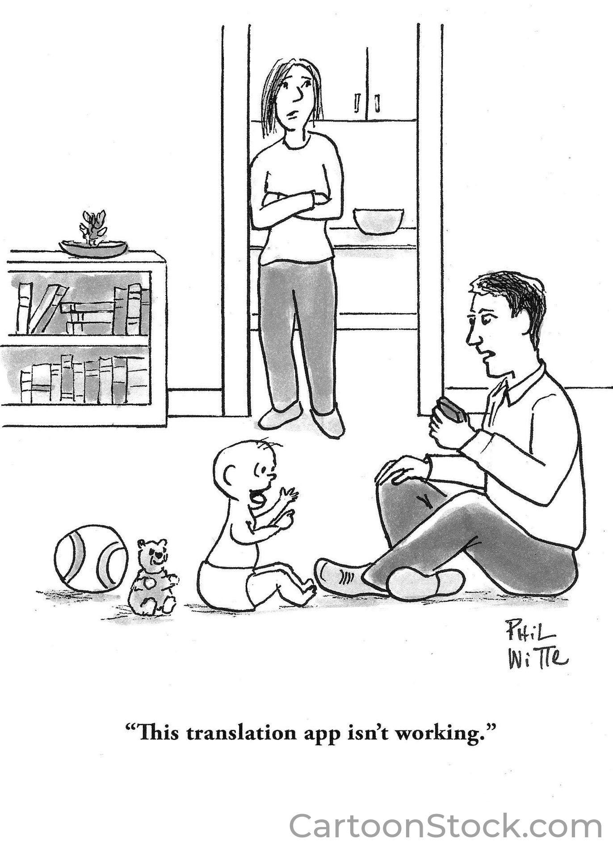
Notes:
Cartoonstock.com under education license

Slide 5
How does Machine Translation (MT) work?
Early MT systems: rules and dictionaries
  manual work carried out by language experts
  It took months to develop a new system
Modern systems: learn from parallel texts
  based on the probability that a target text “t” is a translation of a source text “s” P(t|s)
  no language knowledge is needed
  “only” large amounts of parallel texts
  it takes hours to develop a new system
  Statistical machine translation (SMT) from 1990 till 2016
  Neural machine translation (NMT) since 2016

Slide 6
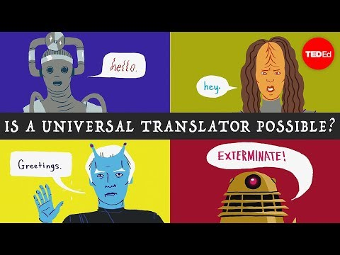
How computers translate (Rule-based and SMT)
Notes:
https://www.ted.com/talks/ioannis_papachimonas_how_computers_translate_human_language?language=en Ioannis Papachimonas
How computers translate human language (covers rule-based and statistical machine translation only)

Slide 7
How modern machine translation systems work these days?
Modern systems:
  learn the probability P(t|s) from parallel texts
Statistical machine translation (SMT)
  Learns this probability from frequencies of words and word groups in data
In the last 6 years: Neural Machine Translation (NMT)
  learns this probability as a complex mathematical function provided by neural networks

Slide 8
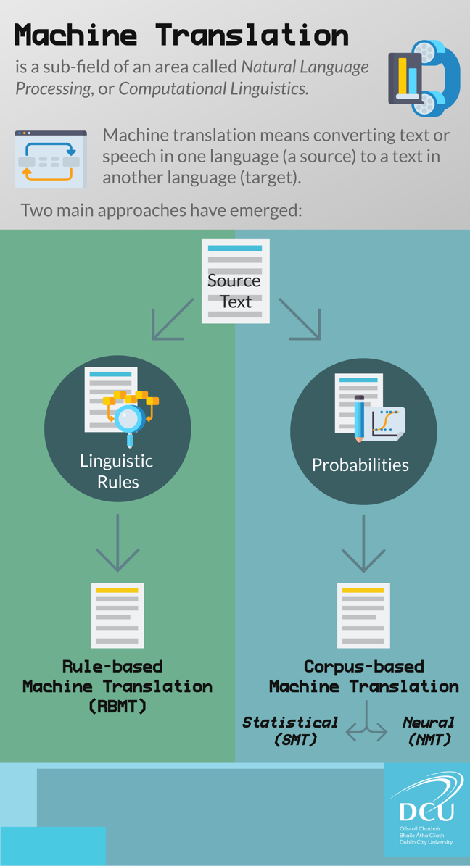
Machine Translation

Slide 9
Task 10.1
Learning from parallel texts

Slide 10
What are “parallel texts”?
Texts containing the same content in two (or more) different languages
Sentence alignment is necessary for current MT systems
(each line in one language corresponds to the line in another language)
Large amounts of parallel texts are needed for MT systems to learn to translate (millions of sentences)
PPLI Blue
Red 0
Green 156
Blue 222

Slide 11
10.1.1 An example of English-Spanish parallel text (0n worksheet 10.1 also)
English | Spanish
Torres and associates. | Torres y asociados.
Carlos Torres has three associates. | Carlos Torres tiene tres asociados.
His associates are not strong. | Sus asociados no son fuertes.
Torres has a company, too. | Torres también tiene una empresa.
His clients are angry. | Sus clientes están enfadados.
The associates are also angry. | Los asociados también están enfadados.
The company has three groups. | La empresa tiene tres grupos.
The groups are in Europe. | Los grupos están en Europa.
The modern groups sell strong pharmaceuticals. | Los grupos modernos venden medicinas fuertes.
The groups do not sell aspirin. | Los grupos no venden aspirina.
The small groups are not modern. | Los grupos pequeños no son modernos.
PPLI Blue
Red 0
Green 156
Blue 222
Notes:
On worksheet 10.1. Solutions there and on these slides. it’s better to give the worksheet so that students have time to look at the examples rather than on screen.

Slide 12
Learning to translate from parallel texts
Try to translate the following sentence into Spanish using the given parallel text:
Clients do not sell pharmaceuticals in Europe.
Does the parallel text on the previous slide provide enough information?

Slide 13
Learning to translate from parallel texts
Try to translate the following sentence into Spanish using the given parallel text:
Clients do not sell pharmaceuticals in Europe.
Does the given parallel text on the previous slide provide enough information to translate this sentence?
Yes! All necessary information can be found in the given parallel text and the translation is:
Clientes no venden medicinas en Europa .

Slide 14
Learning to translate from parallel texts
What about this sentence?
The pharmaceuticals are very strong.

Slide 15
Learning to translate from parallel texts
What about this sentence?
The pharmaceuticals are very strong.
the word “very” does not appear in the parallel text, so the text does not provide the information about the corresponding Spanish word
Las medicinas son ?? fuertes.

Slide 16
10.1.2 Another parallel text: English-Croatian
English | Croatian
A mouse. | Miš.
The mouse. | Miš.
A cat. | Mačka.
The cat. | Mačka.
A cat chases a mouse. | Mačka juri miša.
A cat chases a mouse. | Miša juri mačka.
A mouse chases a cat. | Miš juri mačku.
A mouse chases a cat. | Mačku juri miš.
The cat is with the mouse. | Mačka je sa mišem.
Fewer rules for word order (syntax) in Croatian
Richer morphology (many different word forms)
No articles
Notes:
On worksheet 10.1

Slide 17
Learning from parallel texts is now more difficult
for translating the following English sentence into Croatian:
The mouse is with the cat.

Slide 18
Learning from parallel texts is now more difficult
for translating the following English sentence into Croatian:
The mouse is with the cat.
All words are occurring in the given parallel text
but not all possible Croatian word *forms* are there
The translation is:
Miš je sa mačkom.
and the form “mačkom” is not in the parallel text.

Slide 19
Learning from parallel texts
the more different words in parallel texts, the better translation
the more different word forms in parallel text, the better translation
the more different structures in parallel text, the better translation
therefore, parallel texts for learning have to be large

Slide 20
Why is machine translation hard?
– morphology and syntax –
different syntax (sentence structure) in different languages
different morphology (number of word forms, rules) in different languages
  NMT systems handle these differences quite well, if they have learnt from large parallel texts
  there are still some errors, though

Slide 21
Why is machine translation hard?
– availability and size of parallel texts –
large parallel texts are not available in all languages
  actually, only for a small set of language pairs
also not for all types of texts
  for example, there are many for news, movie subtitles, but almost none for social media texts

Slide 22
Why is machine translation hard?
– ambiguity –
a large number of words (even phrases or sentences) in a language are ambiguous:
they can mean different things depending on the context
I got it!
I received it?
I bought it?
I understood it?

Slide 23
Why is machine translation hard?
– ambiguity –
ambiguous sentences:
“Minister accused of having 8 wives in jail”
“A man saw a woman with a telescope”
for computers, even
“A man saw a dog with a telescope”
can be ambiguous

Slide 24
Why is machine translation hard?
– ambiguity –
NMT translates much better than SMT
mainly because of syntax and morphology
! ambiguity is still a challenge

Slide 25
Why is machine translation hard?
– evaluation –
there is no single correct translation of a sentence
=> even evaluating machine translation is not trivial
  human evaluation:
requires time, effort and experienced evaluators
  automatic evaluation:
measures can calculate a score based on a “correct” translation (or a set of them)
fast, but cannot provide all necessary information
especially qualitative info (what is wrong, and why)

Slide 26
Why is machine translation hard?
– evaluation –
Users (and journalists) devise their own evaluations, almost always flawed
  Expecting the system to translate idioms, or jokes - not a fair test
  “Back and forth” translation, ie translate into a language and then translate the result back to English
    not a fair test: if the back-translation is good there is no guarantee the target translation was good - it could be just word-for-word garbage in both directions
    if the translation is bad you don’t know where it went wrong - on the outward trip or on the way back?
a good way to assess the usefulness is to use it (!), for example to translate a web page from a language you don’t know, and see how much of the result is understandable/useful
But translating INTO a language you don’t know is risky

Slide 27
Exercise 10.1.3 Learning from parallel texts (⅓)
Translate the Centauri sentence below into Arcturan:
farok crrrok hihok yorok clok kantok ok-yurp
How might you translate between two languages you know nothing about?!
Use the parallel text on the next slide!
Notes:
On worksheet 10.1

Slide 28
Exercise 10.1.3 Learning from parallel texts (⅔)
Centauri | Arcturan
ok-voon ororok sprok . | at-voon bichat dat .
ok-drubel ok-voon anok plok sprok . | at-drubel at-voon pippat rrat dat .
erok sprok izok hihok ghirok . | totat dat arrat vat hilat .
ok-voon anok drok brok jok . | at-voon krat pippat sat lat .
wiwok farok izok stok . | totat jjat quat cat .
lalok sprok izok jok stok . | wat dat krat quat cat .
lalok farok ororok lalok sprok izok enemok . | wat jjat bichat wat dat vat eneat .
lalok brok anok plok nok . | iat lat pippat rrat nnat .
wiwok nok izok kantok ok-yurp . | totat nnat quat oloat at-yurp .
lalok mok nok yorok ghirok clok . | wat nnat gat mat bat hilat .
lalok nok crrrok hihok yorok zanzanok . | wat nnat arrat mat zanzanat .
lalok rarok nok izok hihok mok . | wat nnat forat arrat vat gat .

Slide 29
Exercise 10.1.3 solution (3/3)
Centauri sentence:
farok crrrok hihok yorok clok kantok ok-yurp
Arcturan words:
in the best order (according to the Arcturan part of the parallel text):
{jjat, arrat, mat, bat, oloat, at-yurp}

Slide 30
Task 10.2
Ambiguity

Slide 31
Exercise 10.2 Ambiguity
Ambiguity AILO puzzle Running on MT puzzle (and Solution)
One of the most common errors in the modern Neural Machine Translation systems is word sense selection: the source language text may contain words which have multiple meanings and the MT system has chosen the wrong one.
In the puzzle, the effect of this has been simulated: we have taken an ordinary English text and replaced a number of individual words with alternative words which share a meaning with the original word, but which are not correct in this context. For example, in the first line, we have “angry-legged” instead of “cross-legged”.
Your task is to find the incorrect words and their correct replacements
Notes:
AILO MT puzzle

Slide 32
Task 10.3
Gender Bias in Language

Slide 33
Exercise 10.3 Gender Bias in Language (1/3)
When you hear about a ‘nurse’, it may be that a woman pops into your mind. But we all know there are male nurses also.
Similarly, there are many female doctors.
These stereotypes can also be found in Machine Translation data which lead to biased translations, and researchers are working to change this.

Slide 34
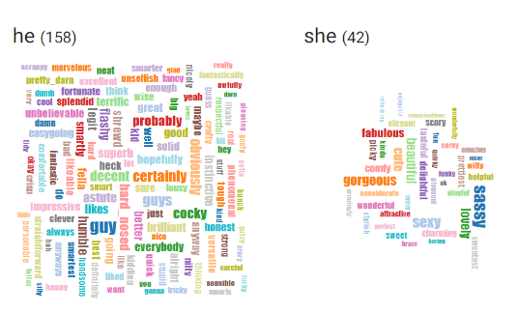
Exercise Gender Bias in Language (2/3)
Have a look at http://wordbias.umiacs.umd.edu/ and see if there are words that are commonly associated to a particular gender which you hadn’t considered before.
Example searches: nurse, doctor, pilot, caring, smart, happy

Slide 35
Exercise Gender Bias in Language (3/3)
Have a look into these sentences of real MT data https://github.com/gabrielStanovsky/mt_gender/blob/master/data/aggregates/en.txt
Try to translate a few of the test MT sentences using Google Translate into a language with grammatical gender you know ( e.g. French? Spanish? German?)
Which gender is meant? What issues can you find?

Slide 36
Extra resource
Task 10.4
Translating Images

Slide 37
Extra Resource
Exercise 10.4 Translating Images
Think of an object that is shiny/glittery, gold colour, has a loop one end, reflects the light, is made of a hard material.
Write down what you think it is.

Slide 38
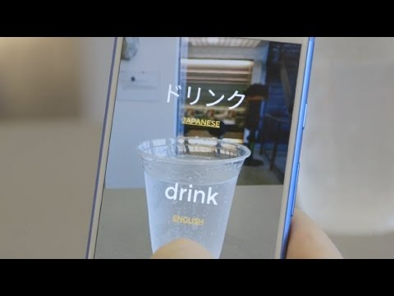
Exercise 10.4 Translating Images
Watch the video
After the video, take out your phones and visit the link below:
https://thing-translator.appspot.com/
Example:
Take a picture of a cup. Is the image description a cup?
What is the translation in a language you know? E.g. French
Your translation will be wrong depending on how much data the app has.
Notes:
Play the YouTube link above (https://youtu.be/bH5sU7ew5V4) and give them translator app. Let them play with it. Ask is it working. Some will say it’s working fine but someone may says it’s really wrong about something and we discuss that word and why might be wrong.. Discuss correct words, versus wrong words, why it might be. Machine Learning and Machine Translation need good data, and lots of data to learn. You can return to the item you described, what did they write dow? Then show it’s a christmas decoration not a necklace / earring..

Slide 39
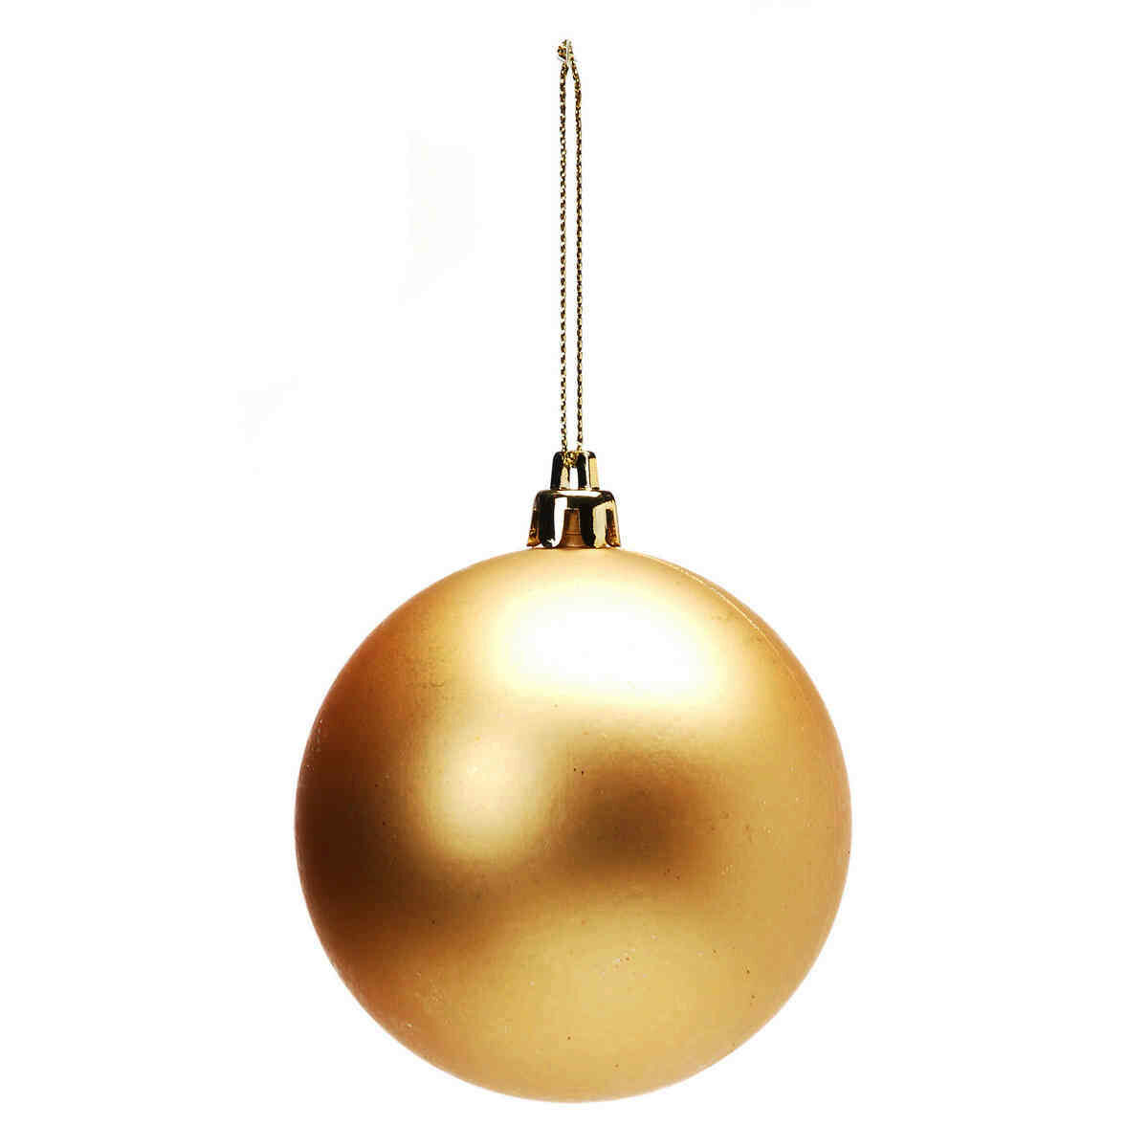
Exercise 10.4 It’s not so easy to know what is meant

Slide 40
Exercise 10.4 It’s not so easy to know what is meant
The image description may not match the image.
If this wrong, the next stage, where you are translating it into another language, will be really wrong.

