Slide 1
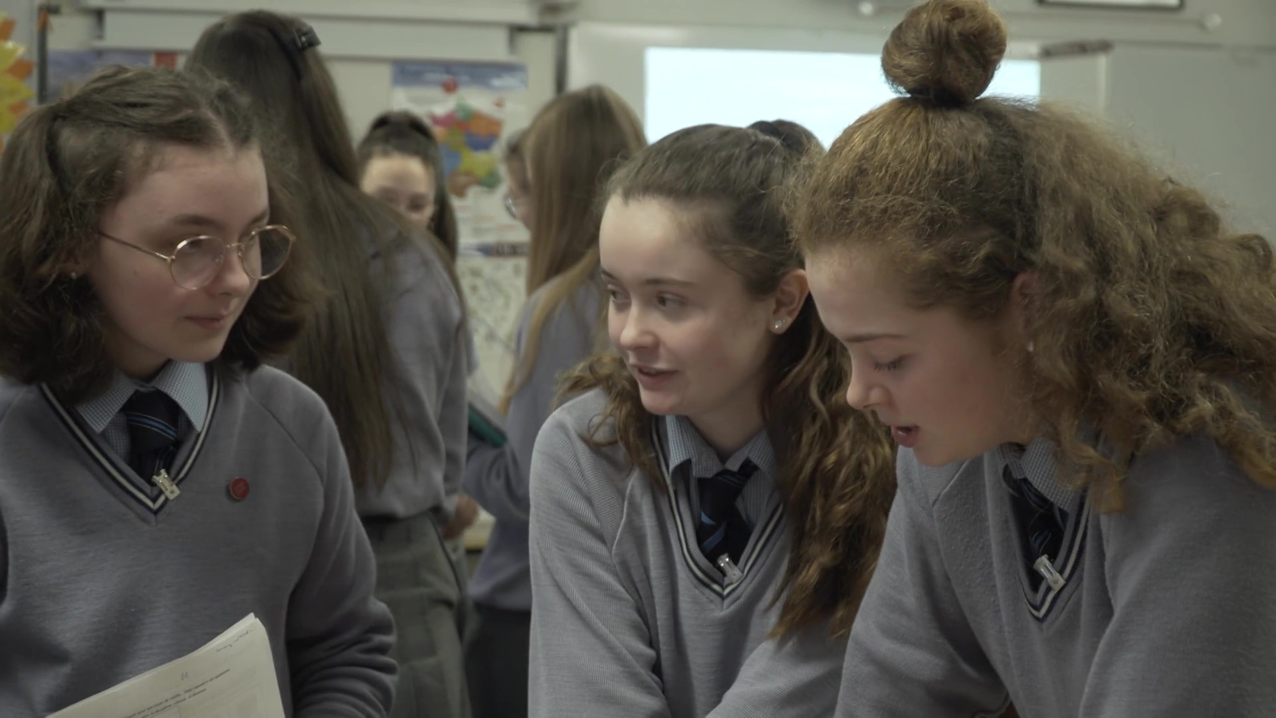
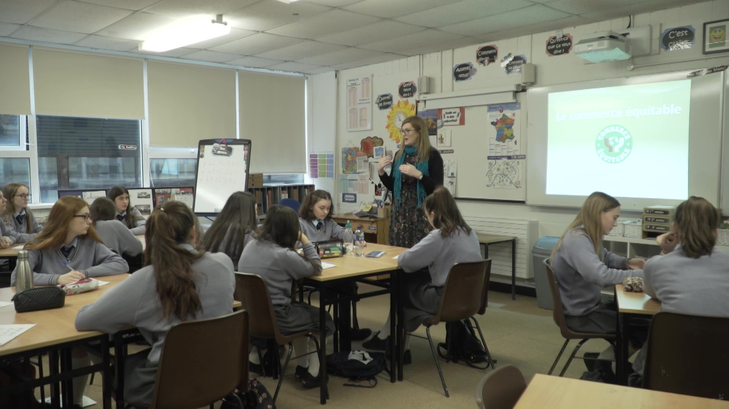
CLIL Webinar 2
Theory into practice:
Planning and Preparation
Craig Neville
Education Officer

Slide 2
Welcome back!
#PPLI_CPD #PPLI_CLIL

Slide 3
To begin: The 4CS
Exposure to alternative perspectives and shared understandings, which deepen awareness of otherness and self. (A)
Content
Communication
Cognition
Culture
Developing thinking skills which link concept formation (abstract and concrete), understanding and language (B)
Using language to learn whilst learning to use language (C)
Progression in knowledge, skills and understanding related to specific elements of a defined curriculum. (D)

Slide 4
To begin: The 4CS
Content
Communication
Cognition
Culture
Progression in knowledge, skills and understanding related to specific elements of a defined curriculum. (D)
Using language to learn whilst learning to use language (C)
Developing thinking skills which link concept formation (abstract and concrete), understanding and language (B)
Exposure to alternative perspectives and shared understandings, which deepen awareness of otherness and self. (A)

Slide 5
To begin: Communication (language of/for/through learning)
A) “There are three laws of motion according to Newton that describe the relationship between the body and forces"
C) So, I think that Newton’s third law explains why two people can lean against each other and not fall over.”
B) “Is it your turn? No, it’s my turn. I think you’re wrong.”
Language
of
learning
Language
for
learning
Language
through
learning

Slide 6
Pre-webinar 2 task…
How are the 4Cs represented in your typical MFL lessons?
How are the 4Cs represented in typical lessons in your other subject or another subject that you have taught?
Notes:
Points to mention,
- Look at the padlet and discuss the teacher outcomes.

Slide 7
4Cs in MFL Lessons and other lessons: CONTENT
MFL Lessons | Other Lessons
Vocab teaching around theme or topic (language of learning) Based on learning outcomes: skills/competency based Made explicit to learners | Content descriptions: topic, based on syllabus Based on learning outcomes at JC: skills-driven and content driven
Notes:
Points to mention,
- Look at the padlet and discuss the teacher outcomes.

Slide 8
4Cs in MFL Lessons and other lessons: COGNITION
Cognition
Meta-cognition
Notes:
Points to mention,
- Look at the padlet and discuss the teacher outcomes.

Slide 9
4Cs in MFL Lessons and other lessons: Communication
MFL Lessons | Other Lessons
Sometimes neglect the language for learning Language through learning not always encouraged. We like control! | Sometimes neglect the language for learning. Language through learning is taken for granted.
Notes:
Points to mention,
- Look at the padlet and discuss the teacher outcomes.

Slide 10
4Cs in MFL Lessons and other lessons: Culture/Community
MFL Lessons | Other Lessons
Culture is central to our classrooms. We teach and develop intercultural awareness in students. We create communication communities in our classrooms | Sometimes neglect the language for learning. Intercultural awareness is not always present in other lessons. We do this in our other classrooms, but do we foster it?
Notes:
Points to mention,
- Look at the padlet and discuss the teacher outcomes.

Slide 11
Learning outcomes of CPD
have a basic understanding of the theoretical principals underpinning CLIL pedagogy and how to apply these in practice
be able to assess and evaluate the effectiveness of CLIL teaching and learning to advance student progress.
be able to plan CLIL learning sequences and individual lessons following an integrated skills approach that combines learning outcomes for content, communication, cognition and culture.
be able to guide students to develop their language competency in the context of the content for different purposes.
be able to develop learning sequences from authentic input (e.g. texts) and scaffold that learning appropriately according to linguistic demands.
be able to use a variety of formative and summative assessment approaches to evaluate student progress in content, language and other ‘soft’ skills.
contribute to professional discussions surrounding CLIL practice both face-to-face and online.
To evaluate and reflect on their evolving practice as a CLIL teacher.

Slide 12
Key questions for this session
1. What does a CLIL unit of learning look like?
2. How do I sequence a CLIL lesson?
3. How do we use assessment in the CLIL classroom?

Slide 13
1. What does a CLIL unit of learning look like?

Slide 14
Unit of Learning Overview
General
Learning Outcomes
Sequencing
Learning Outcomes
Success Criteria
& Assessment
Notes:
Points to mention:
How they are constructed from learning outcomes. NOT specific learning objectives so these can be delivered to a greater or lesser extent based on your context.
Procedure section – this relates to the methodologies and approach of CLIL in the classroom. We’ll look at this is later slides.

Slide 15
Content Learning Outcomes
Content | Learners will: Discover and discuss what French people have for breakfast and compare with what they eat. Conduct a survey to find out what the most popular breakfast food/drinks are in the class. Create a pie chart. Distinguish between what food/drink is local or imported. Locate countries on a map.
?
For cognition, what learning outcomes could be created for understanding and analysing according to Bloom’s?

Slide 16
Cognition Learning Outcomes
Notes:
Things to mention:
- Remember from the previous webinar regarding the progression of cognition. This diagram can represent the development of cognition over time of a unit of lesson or over a lesson. Here we are considering it over the lesson.

Slide 17
Cognition Learning Outcomes
Creating
Learners can: Remember the principles of fair trade Analyse the results of a class survey and draw conclusions Recycle prior mathematical knowledge (pie chart). Understand and discuss the impact of the climate on agriculture. Contrast the differences between local and imported food. Express their opinion.
Evaluating
Analysing
Applying
Understanding
Remembering
Notes:
Points to mention:
- these are not necessarily in the correct order.

Slide 18
Culture (Community) Learning Outcomes
Culture | Learners can: Discuss theme in guided tasks in groups. Present their work to their peers. Describe some principles of Fairtrade in different countries. Reinforce knowledge of geography, including Fairtrade countries around the world and the impact of the climate on agriculture.
Notes:
Points to mention:
- cultural aspects are developed through exposure to the knowledge but also through exposure through group work and presentations where students are sharing knowledge about other cultures.

Slide 19
Communication Learning Outcomes
C o m m u n i c a t i o n | Language of learning | Learners can: Use the 4 modes of communication to discover and recycle a wide variety of vocabulary and structures linked to: food and drinks, meals, countries, creating a survey.
 | Language for learning | Questions / instructions linked to: Fairtrade, geography, and mathematics.
 | Language through learning | Discussion of Fairtrade and its principles. Geographical knowledge through research.
Notes:
Points to reinforce:
- here the language of learning is something that needs to be learnt here through discovery and then recycled constantly to help embed it.
Questioning is an important skill here to take information from students
Giving instructions is also important here when doing activities
BUT there will be many more and this depends on the group that you are teaching
Discussion and opinions give rise to new language.

Slide 20
Questions
?
Q&A

Slide 21
2. How do I sequence a typical CLIL lesson?

Slide 22
An integrated approach
Reception
Production
Interaction
Mediation
4Cs
Notes:
Points to mention:
In a CLIL lesson, all four modes of communication should be combined.
The skills are seen thus:
Reception = listening and reading, are seen as input activities, reading is perhaps seen as being a major source of input with listening more secondary. Not a lot of research in CLIL about the importance of listening but it would be prudent not to prioritise one over the other.
Interaction = speaking = a major source of language for learning practice and developing new language through learning. Must be guided and scaffolded but there is an emphasis on fluency whereas accuracy is subordinate.
Mediation = A important skill the CLIL classroom that supports the recycling of language and content, reinforcement of ideas and ways of expressing them, allows students to learn from language. It is important to be able to mediate production.
Production = Writing and Speaking = is a series of activities through through which students demonstrate their knowledge of the content and language.

Slide 23
Features of a typical CLIL lesson
Features
Integrated language and skills
Lessons have a reading or listening input
Not driven by grammar or language structure
Language is functional. Dictated by content
Language is approached lexically rather than grammatically.

Slide 24
Lesson Framework
Starter activity
Activate Content
Activate Language
Activating learning
Notes:
Give examples:
You want to activate any knowledge that have about a topic already. With this fair trade one it is clearly going to related to food, countries and peoples
By activiating content you might do a brainstorm, you might look at a picture or graph as a stimulus
By activitating language you might think about words related to a topic or structures
You should integrate the approach so if you were asking them adjectives to describe a piece of music, you might then get them to categorise them according to tempo, timbre, dynamics etc.

Slide 25
Lesson Framework
Activating learning
Notes:
Give examples:
You want to activate any knowledge that have about a topic already. With this fair trade one it is clearly going to related to food, countries and peoples
By activiating content you might do a brainstorm, you might look at a picture or graph as a stimulus
By activitating language you might think about words related to a topic or structures
You should integrate the approach so if you were asking them adjectives to describe a piece of music, you might then get them to categorise them according to tempo, timbre, dynamics etc.

Slide 26
Lesson Framework
Active Reading
Active Listening
Pre-tasks
Activating learning
Guided reception

Slide 27
Lesson Framework
Activating learning
Guided reception

Slide 28
Lesson Framework
Scaffolded Diagrams of thinking:
Tree diagrams to classify
Groupings
Hierarchies
Flow diagrams
Timeline sequences
Tables
Language Identification
Discourse markers, fixed expressions, CALPS (Cognitive Academic Language proficiency), categorise according to function.
Activating learning
Guided reception
Identify & Organize Knowledge

Slide 29
Lesson Framework
Activating learning
Guided reception
Identify & Organize Knowledge

Slide 30
Lesson Framework
Practice Stage (Activity or Task)
Interaction using content and language
Group, Pair or Class
Development BICS (Basic Interpersonal Communicative Skills)
Mediation of content and language
Summarising, rewriting, relaying info, creating meaning through discussion, simplifying, streamlining.
Activating learning
Guided reception
Identify & Organize Knowledge
Practice: Mediate and Interact

Slide 31
Lesson Framework
Activating learning
Guided reception
Identify & Organize Knowledge
Practice: Mediate and Interact

Slide 32
Lesson Framework
Written or spoken
Highly scaffolded
Open, Free, unsupported Production
Guided reception
Activating learning
Identify & Organize Knowledge
Practice: Mediate and Interact
Produce: Demonstrate content and language

Slide 33
Lesson Framework
Guided reception
Activating learning
Identify & Organize Knowledge
Practice: Mediate and Interact
Produce: Demonstrate content and language

Slide 34
Reflection
Activating learning
Guided reception
What are the similarities and differences between CLIL lessons and MFL lessons?
Identify & Organize Knowledge
?
Practice: Mediate and Interact
Produce: Demonstrate content and language

Slide 35
3. How do we assess in the CLIL classroom?

Slide 36
Range of Assessment
“CLIL learners perform best when a range of assessments are used throughout a unit of learning (ongoing assessment) and receive regular feedback culminating in a summative assessment at the end which is a culmination of all assessments.”
Coyle, 2015

Slide 37
What do I assess?
Language is not assessed in isolation
Content
Knowledge
Understanding
Content & Language
Functional language (CALPS)
Skills
Group work
Digital Skills
Skills and Language
Applying
Analysing
Creating
Language of Learning
Pair Work
Presentation skill etc.
BICS
Language for Learning

Slide 38
How do I assess?
Rubrics
In the target language:
a language learning opportunity
Notes:
Why we do them:
Transparent
Can be co-created with students
Help formatively to make improvements
They are quick to evaluate the learning.
Great for self-assessment.
Sharing success criteria

Slide 39
How do I assess?
Rubrics (Skills)
Measurable criteria
Award all aspects of learning
Descriptors
Notes:
Points to mention
Clear to all stakeholders
Easy to mark
Can be used for different types of production
Used formatively
Use for self- and peer assessment
Success criteria
Students take responsibility for their own learning

Slide 40
How do I assess?
Word → Text Level
Activity
Name 4 bones in the human body and describe 2 of their features.

Slide 41
How do I assess?
Mixture of formal and informal

Slide 42
How do I assess?
Real-life, authentic context
Notes:
Language and content should always be assessed for a real-life, authentic purpose – here for creating a picture.

Slide 43
How do I assess?
Content should be assessed using the simplest form of language
Notes:
Points to mention;
- Content should be assessed with the simplest form of language

Slide 44
How do I assess?
Scaffolding
Notes:
https://pluriliteracies.ecml.at/Portals/54/publications/pluriliteracies-avalanches.pdf

Slide 45
Who assesses?
Assessment
Student
Teacher
Peer
Group
Class
Notes:
Points to mention,
Remember that all forms of assessment provide opportunities for language use in terms of interaction and developes of BICS and CALPS

Slide 46
Main principles (Do Coyle)
We should use a mixture of formal and informal assessment which is both task-based and assignment-based, and a mix of specific test times and classwork sampling.
We should familiarize the learners with the assessment measures and success criteria, expressed in a student-friendly format.
Content knowledge should be assessed using the simplest form of language which is appropriate for that purpose.
Language should be assessed for a real purpose in a real context - sometimes this will be for form/accuracy, sometimes for communicative competence and/or fluency.
If the assessment is orally based, `wait time' is crucial, as in CLIL contexts we should be asking students to think, and thinking takes time and the expression of that thinking takes longer.
Scaffolding is not `cheating' - we need to assess what students can do with support before we assess what they can do without it.
Students need to be able to take some responsibility for their own assessment, both in terms of self- and peer-assessment. This will enhance their longer-term learning potential.
Notes:
How do these principals differ to MFL lessons?

Slide 47
Questions
?
Q&A

Slide 48
Assessment in CLIL
Community
of Practice
September 2020

Slide 49
Key questions for this session
1. What does a CLIL unit of learning look like?
2. How do I sequence a CLIL lesson?
3. How do we use assessment in the CLIL classroom?
Click here for evaluation

