Slide 1
iPads in a
Modern Languages Classroom
Amanda Salt
Head of Spanish, Grosvenor Grammar School
http://amandasalt.blogspot.com
@amandasalt

Slide 3
Notes:
Core of iPad use in my classroom. How I share links and info with pupils, how they send work to me and submit via iPads or at home

Slide 4
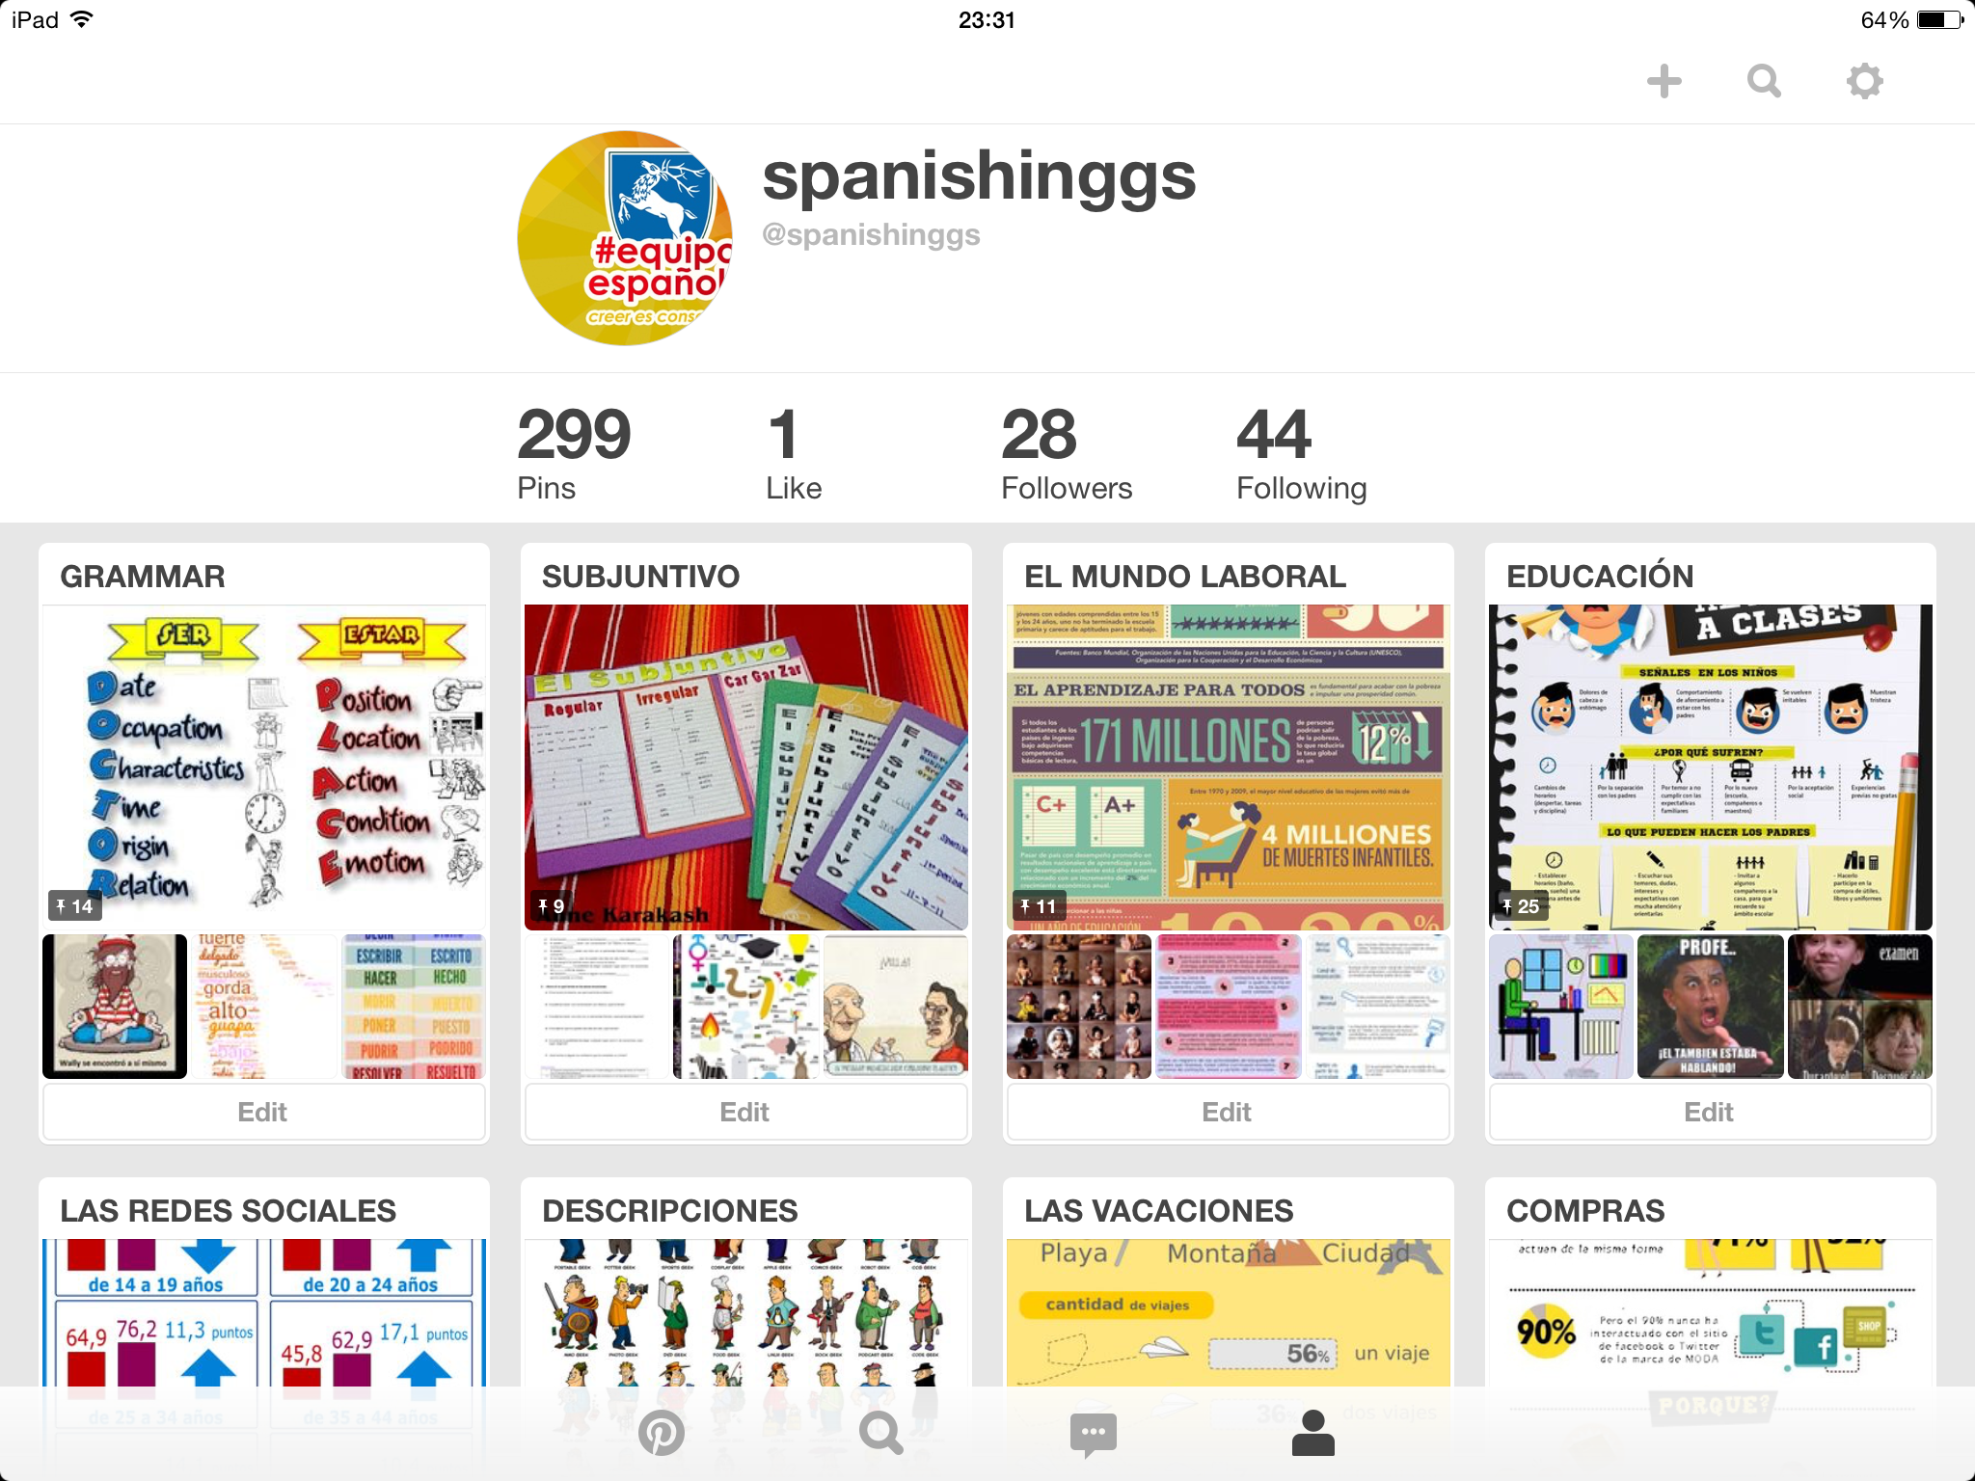
Notes:
Dept account
Tag resources of interest
Starters in class

Slide 5
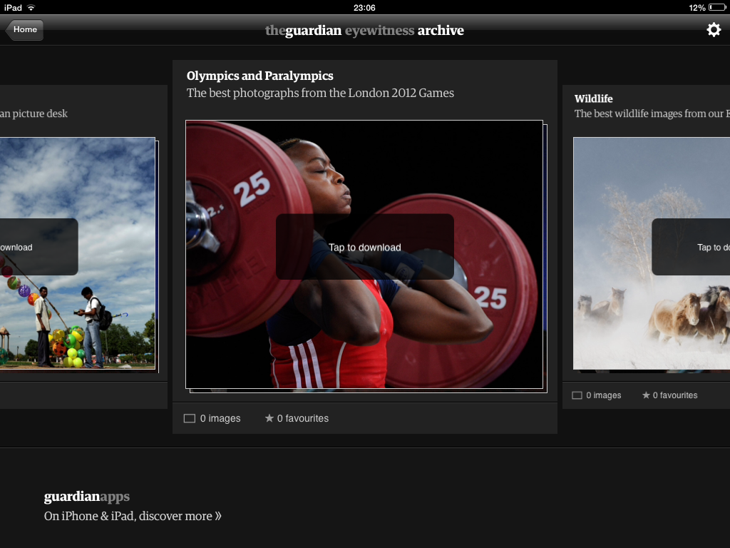
Notes:
Guardian Eyewitness

Slide 6
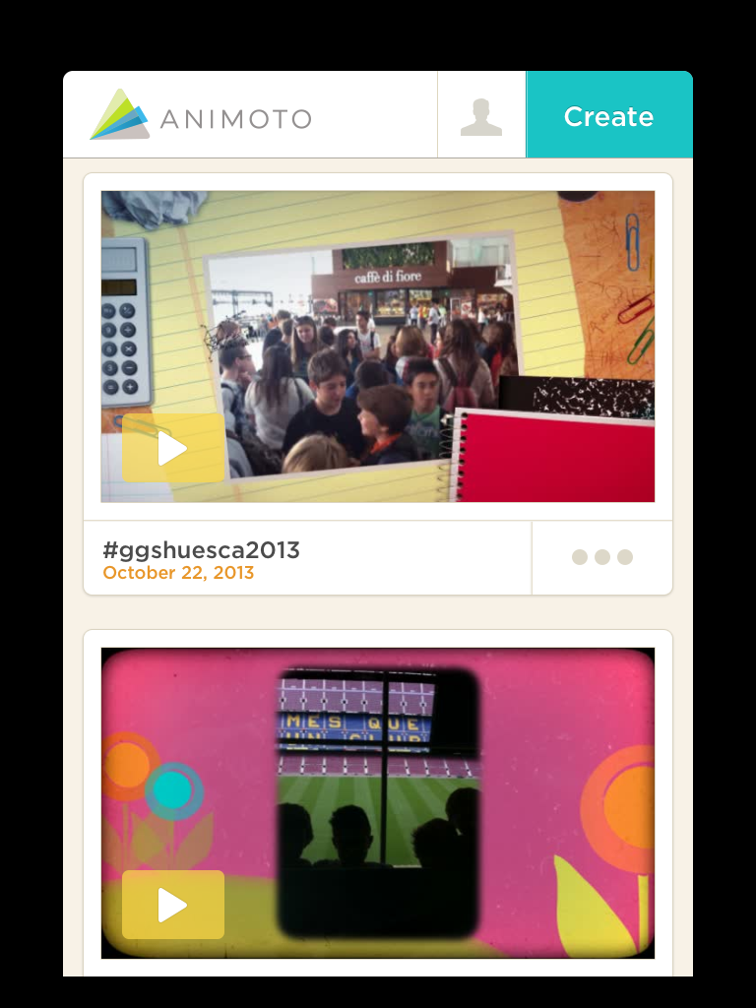

Slide 7
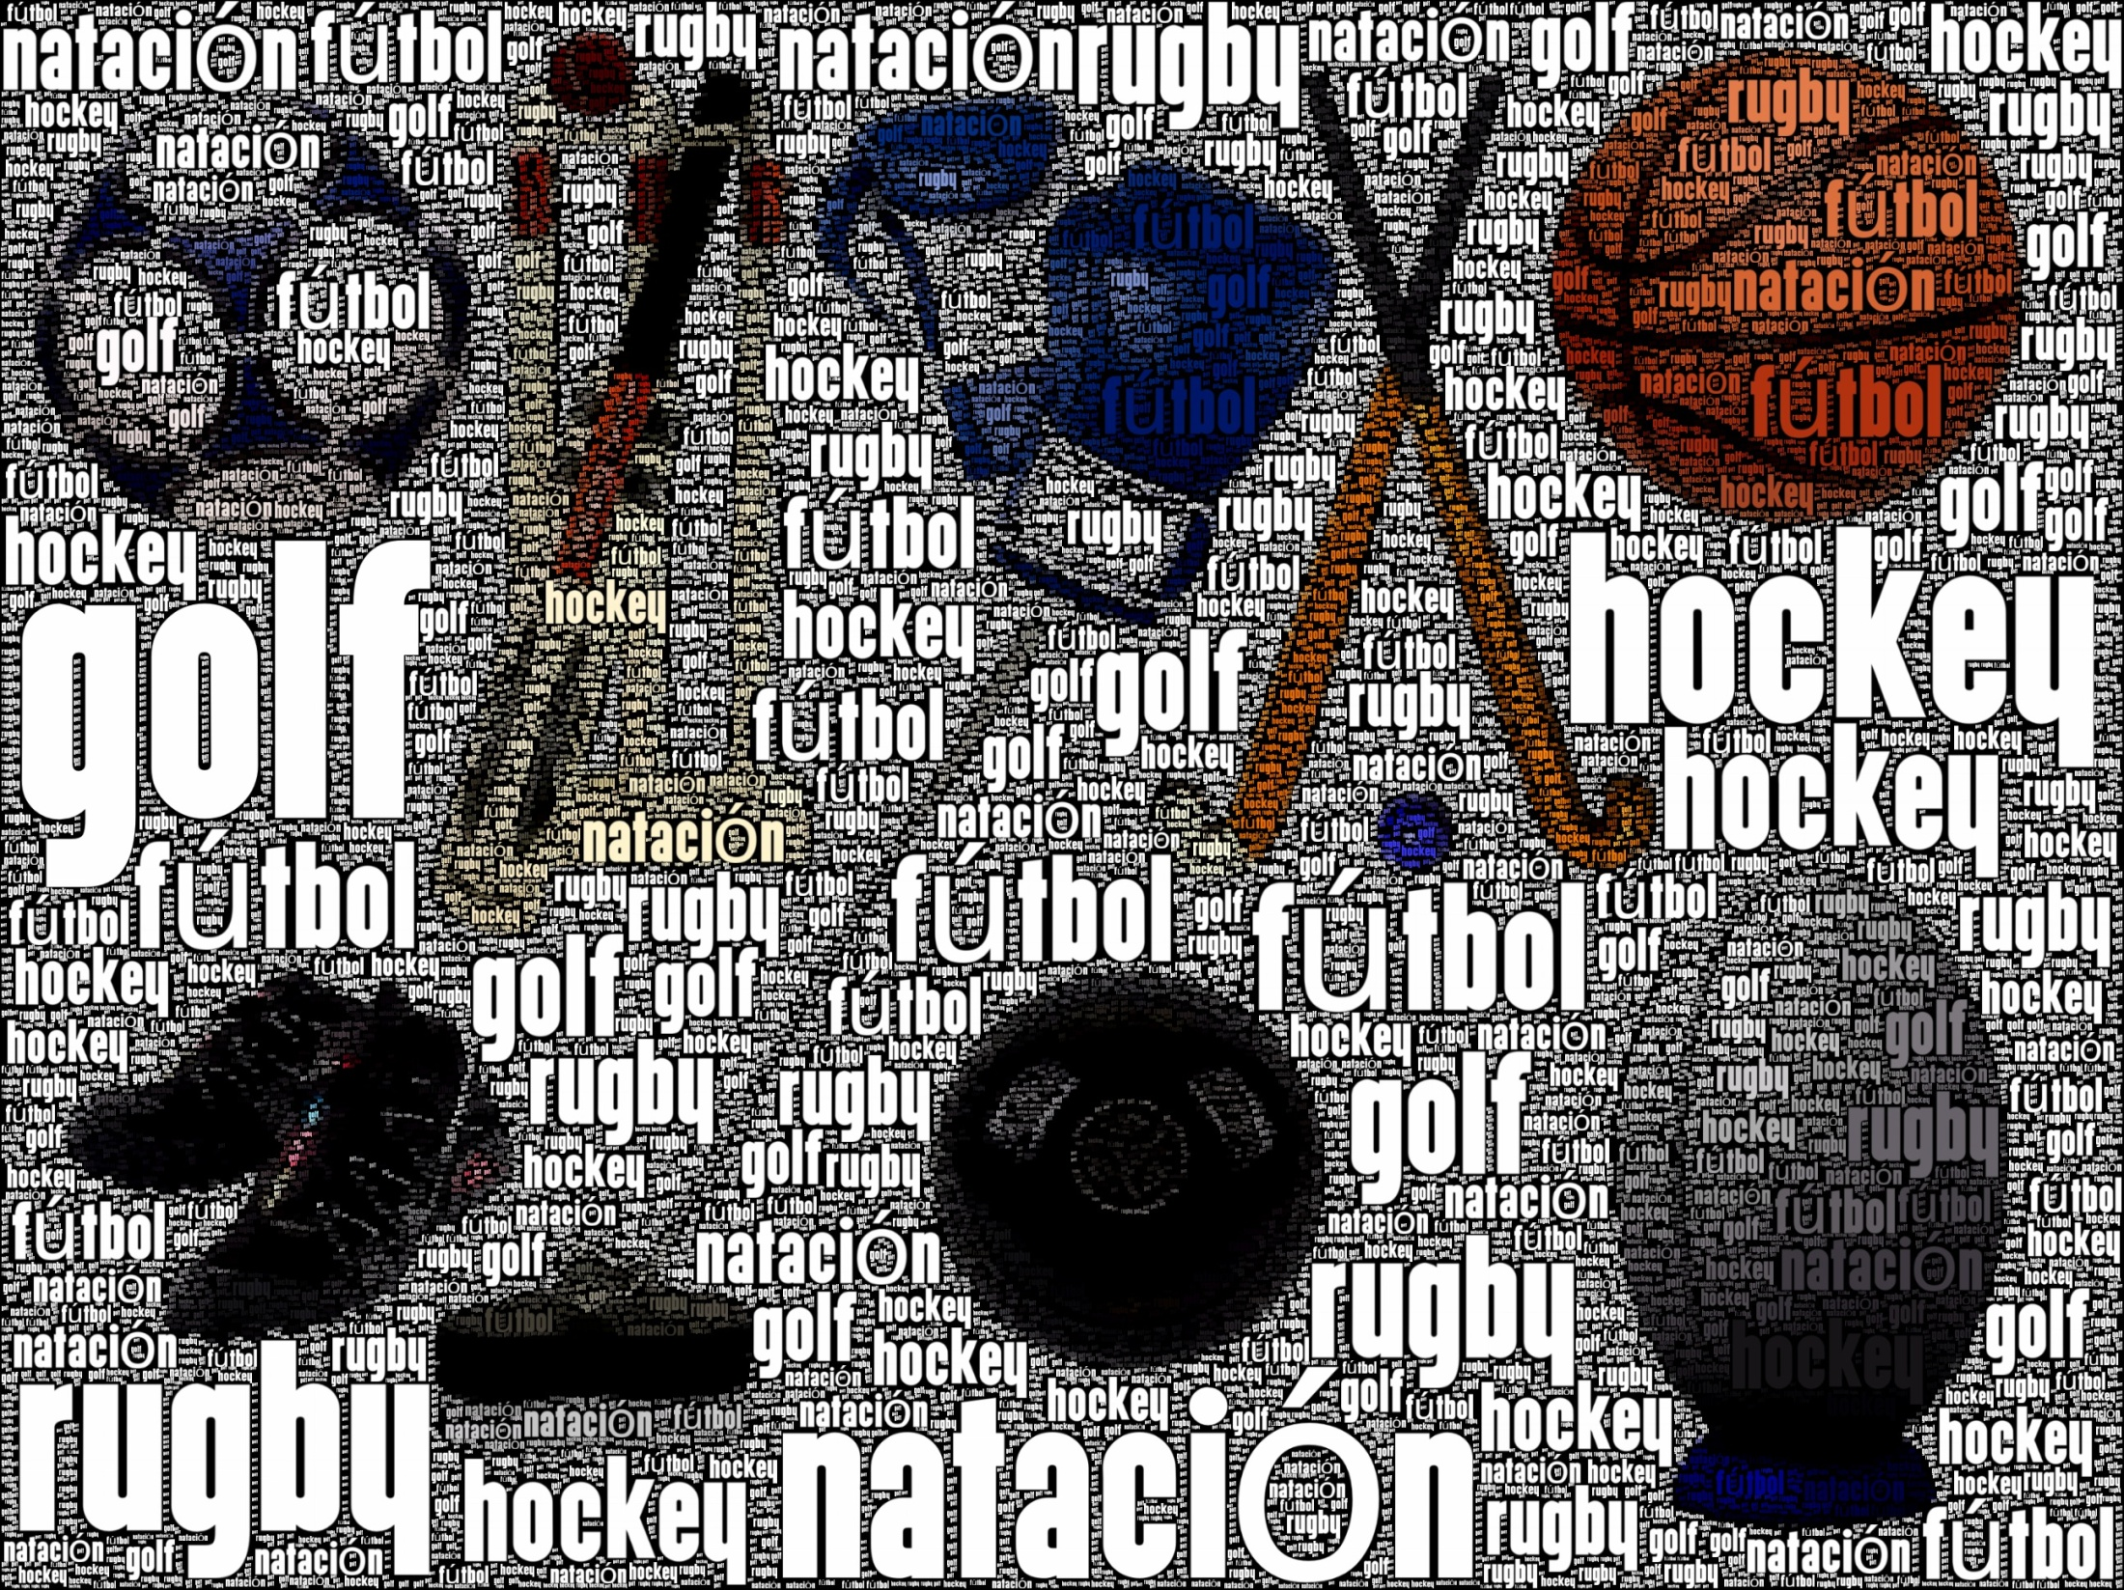
Notes:
Wordfoto

Slide 8
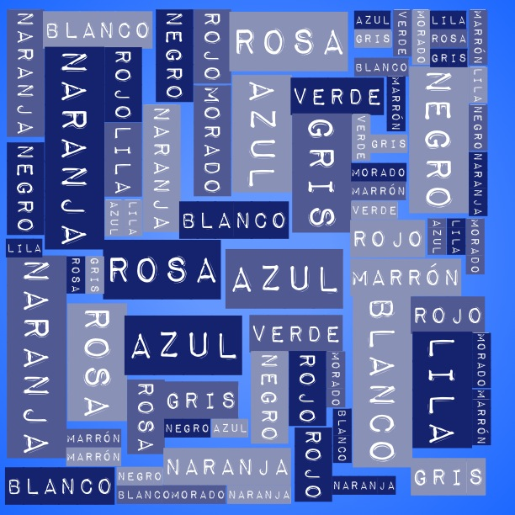
Notes:
ImageChef

Slide 9
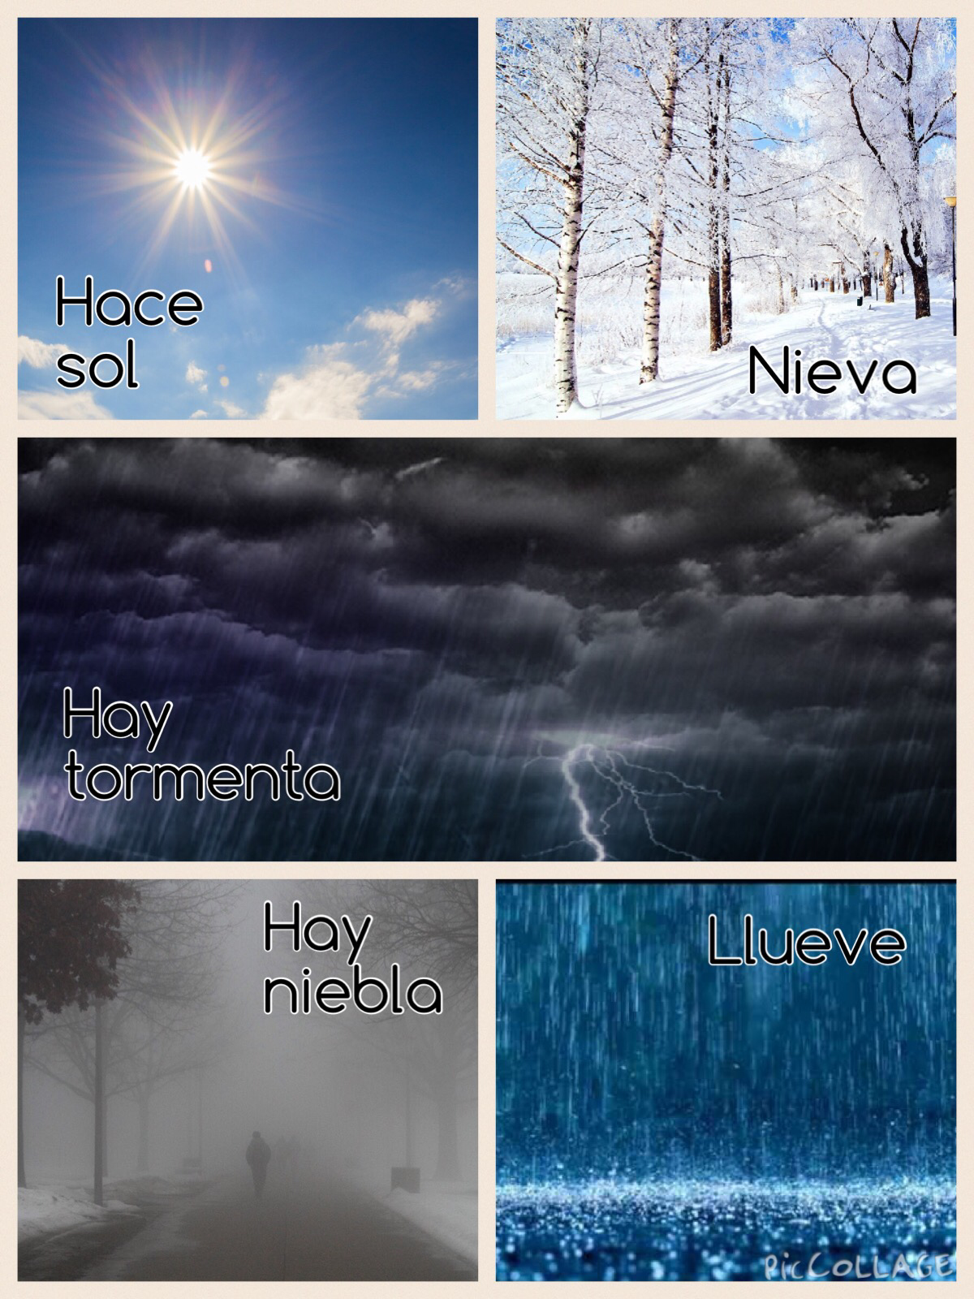
Notes:
Pic Collage

Slide 10
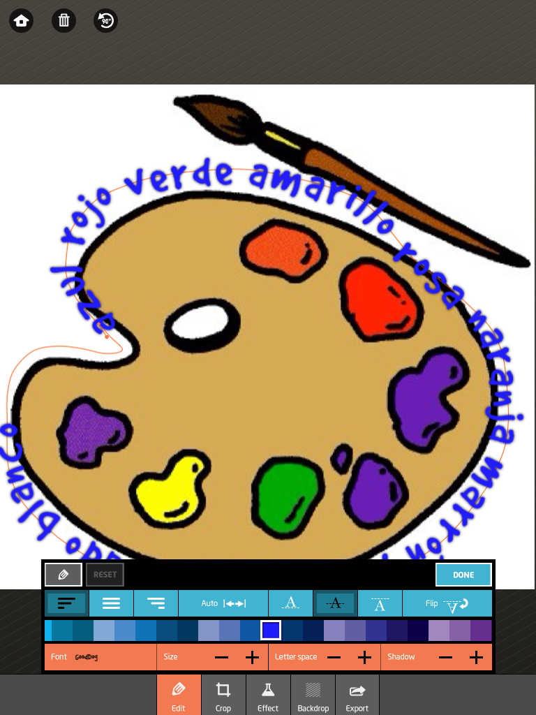
Notes:
Path On

Slide 11
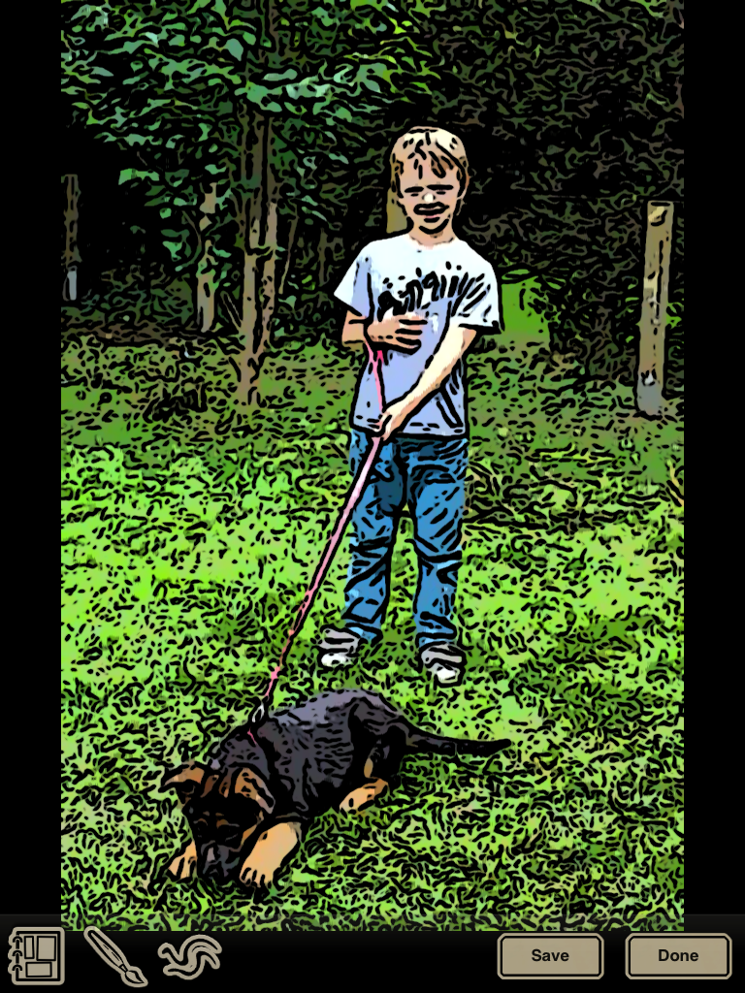
Notes:
Tooncamera

Slide 13
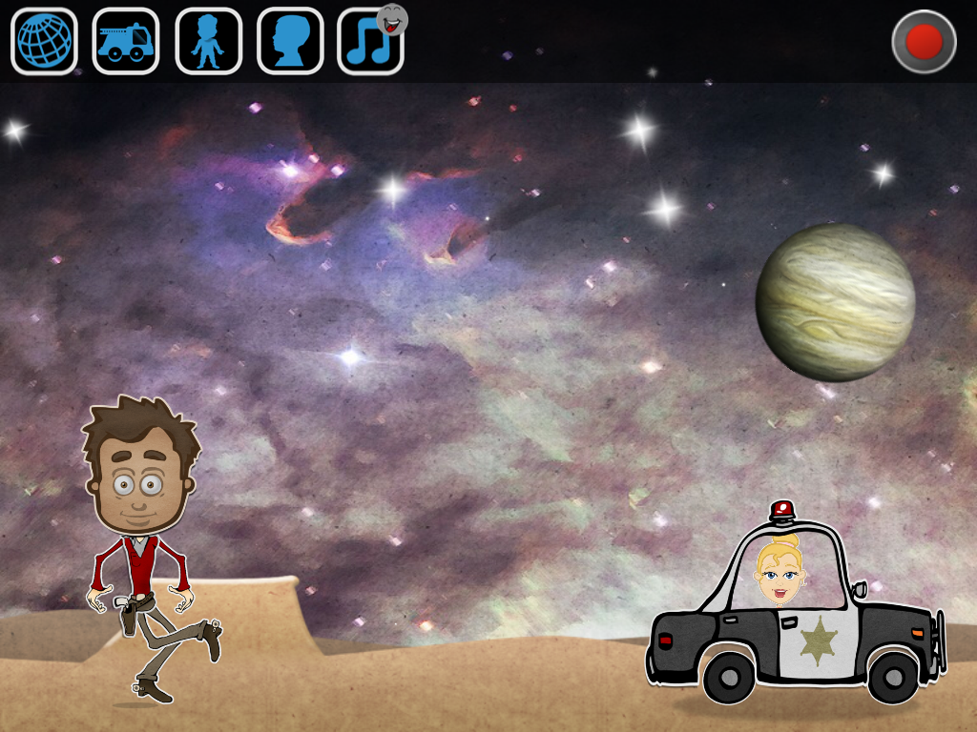
Notes:
Puppet Pals

Slide 14
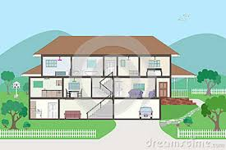
Notes:
Voicethread

Slide 15
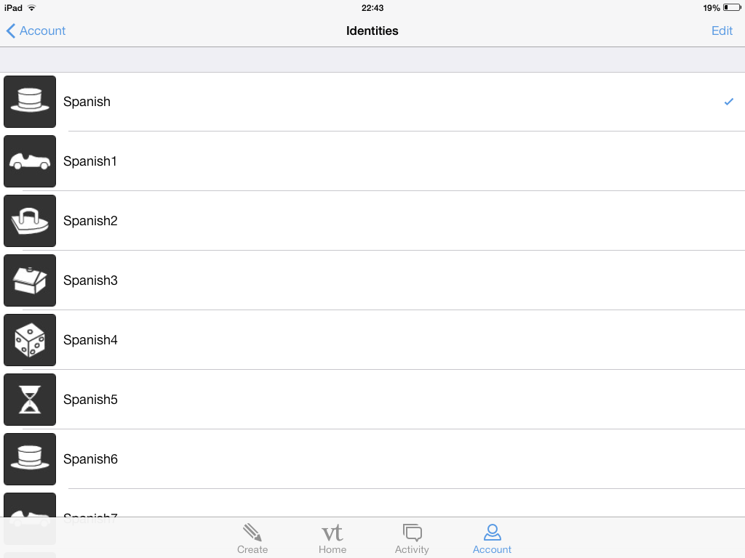
Notes:
Voicethread multiple users on one account

Slide 16
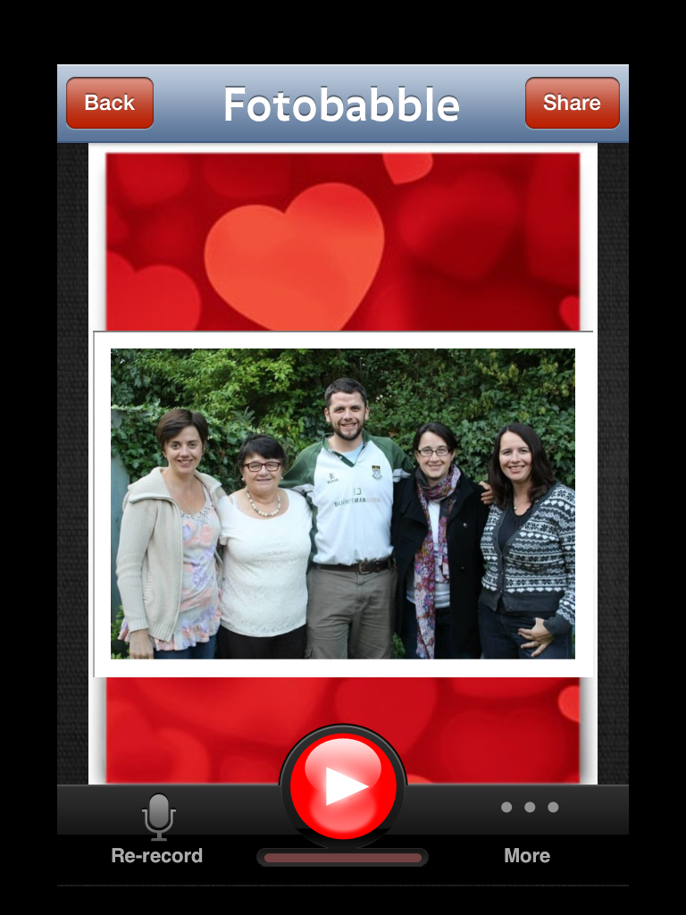

Slide 17
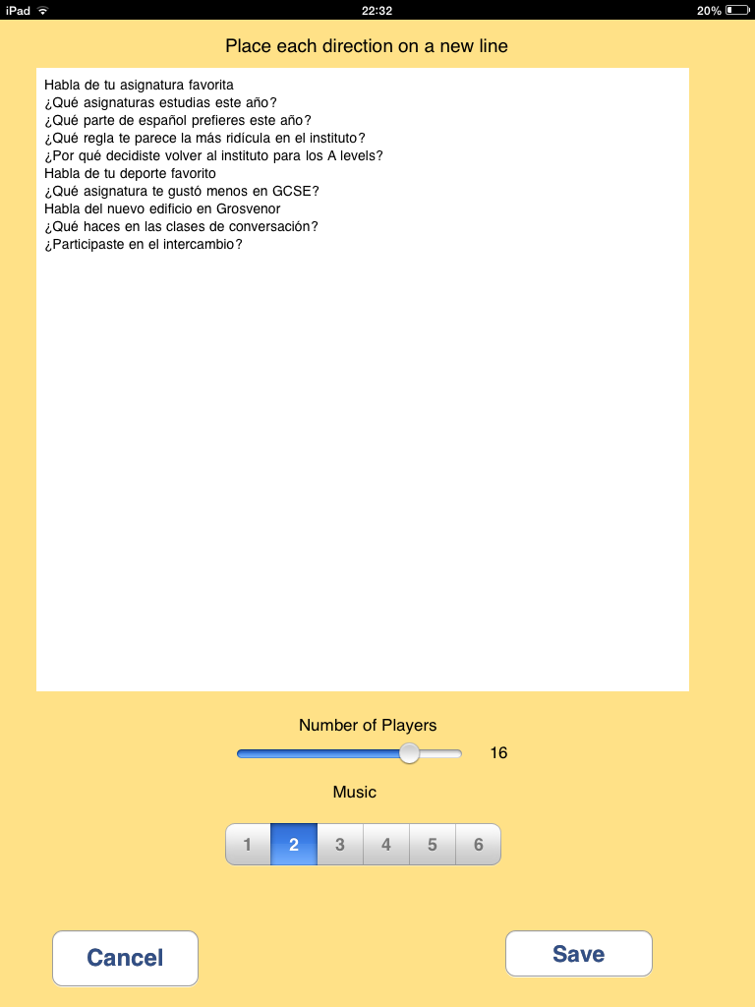
Notes:
Pass the Parcel

Slide 18
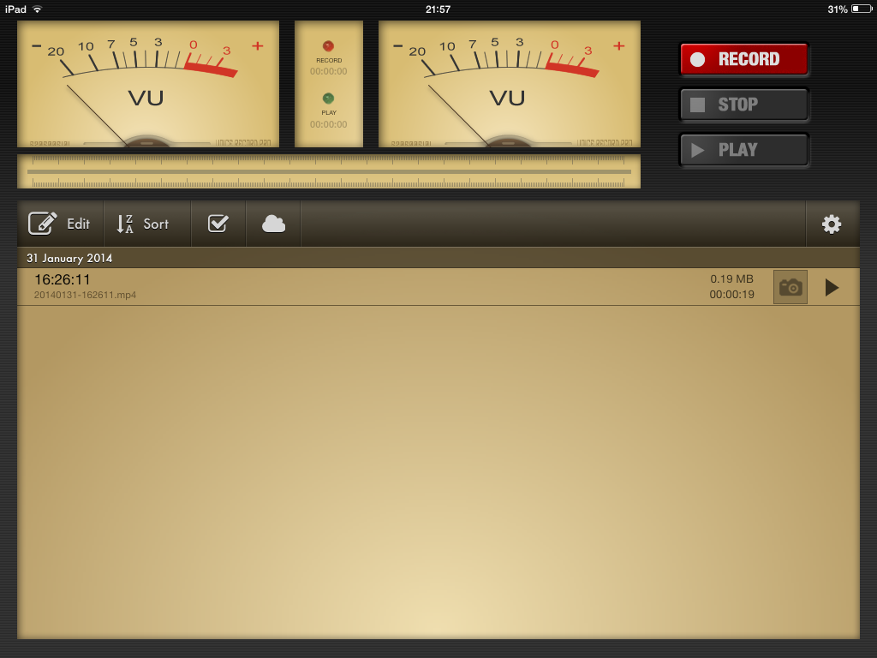

Slide 19
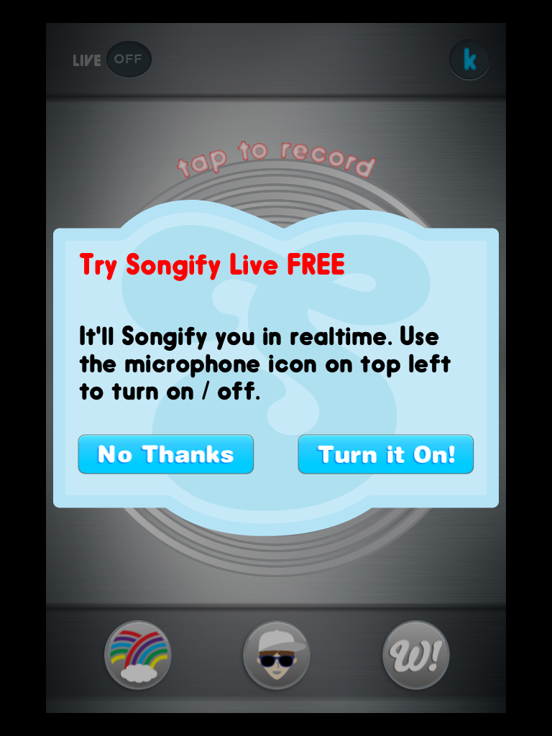
SONGIFY

Slide 21
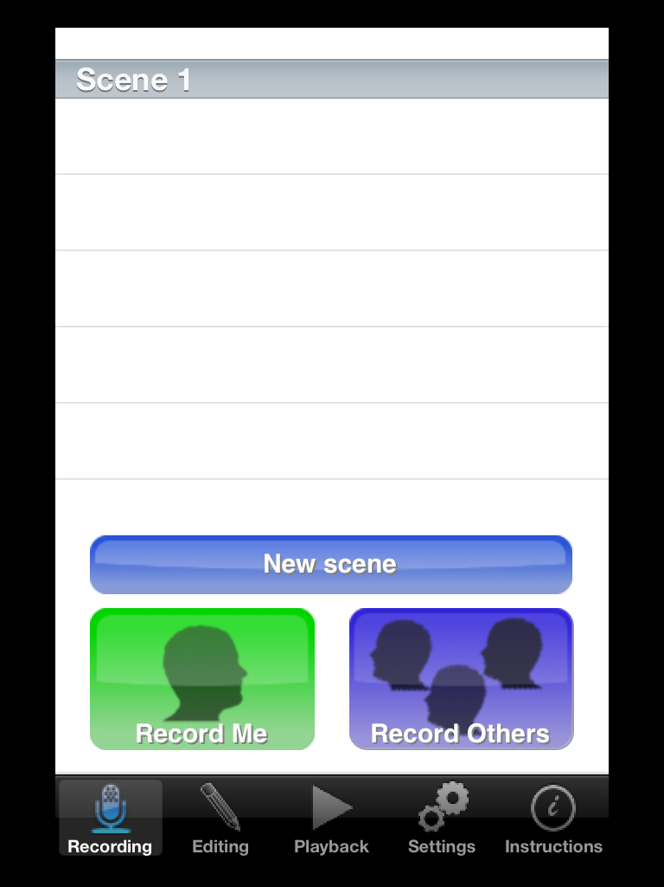

Slide 22
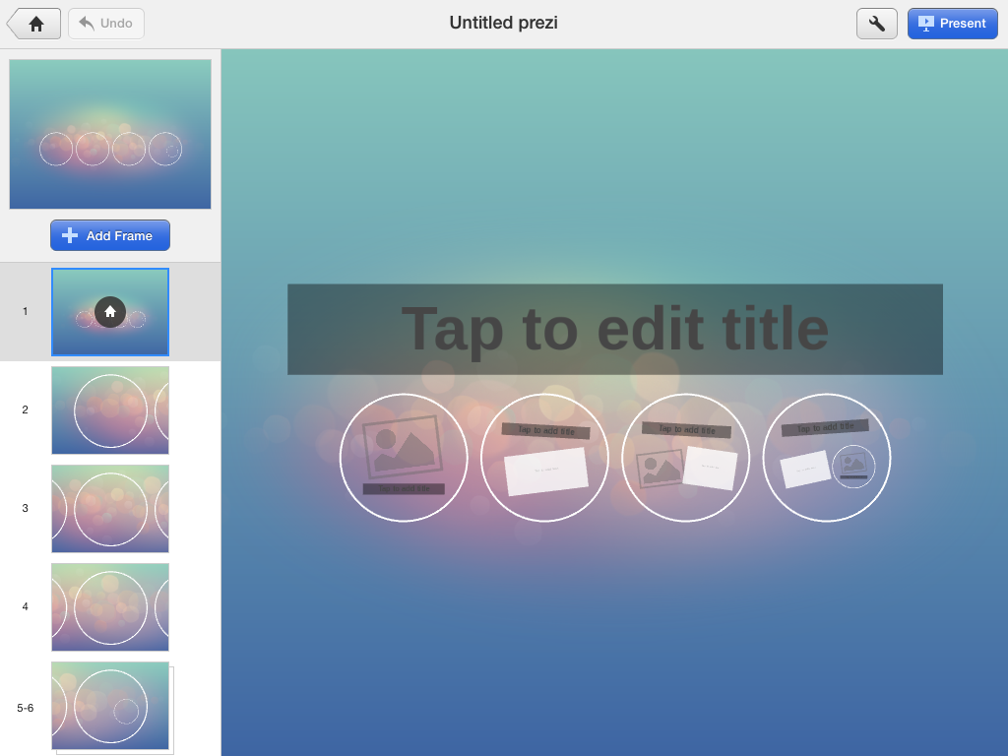
Notes:
Prezi

Slide 23
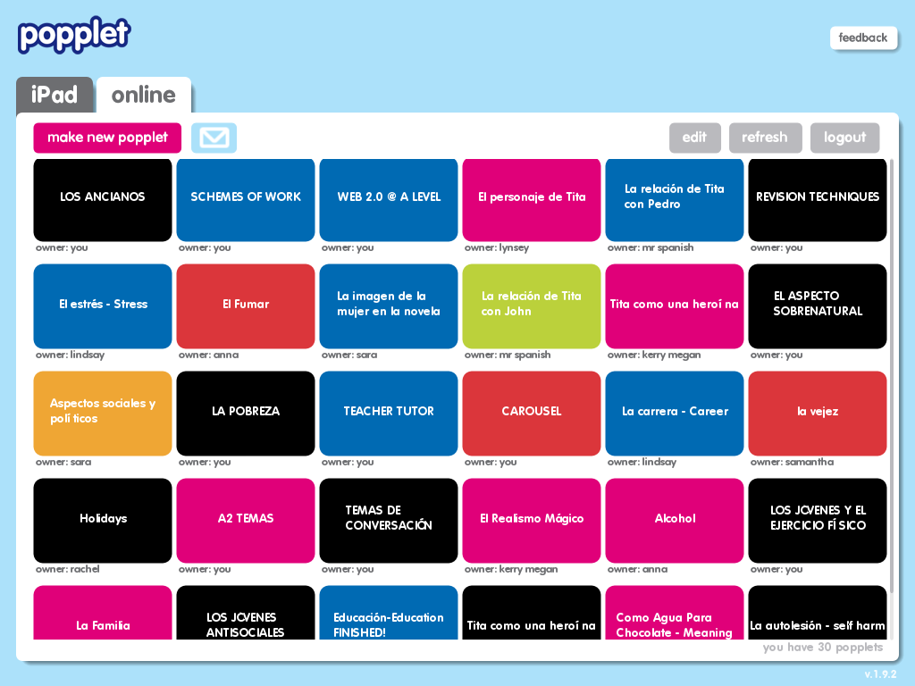
Notes:
Popplet

Slide 24
Notes:
Popplet for essay planning

Slide 25
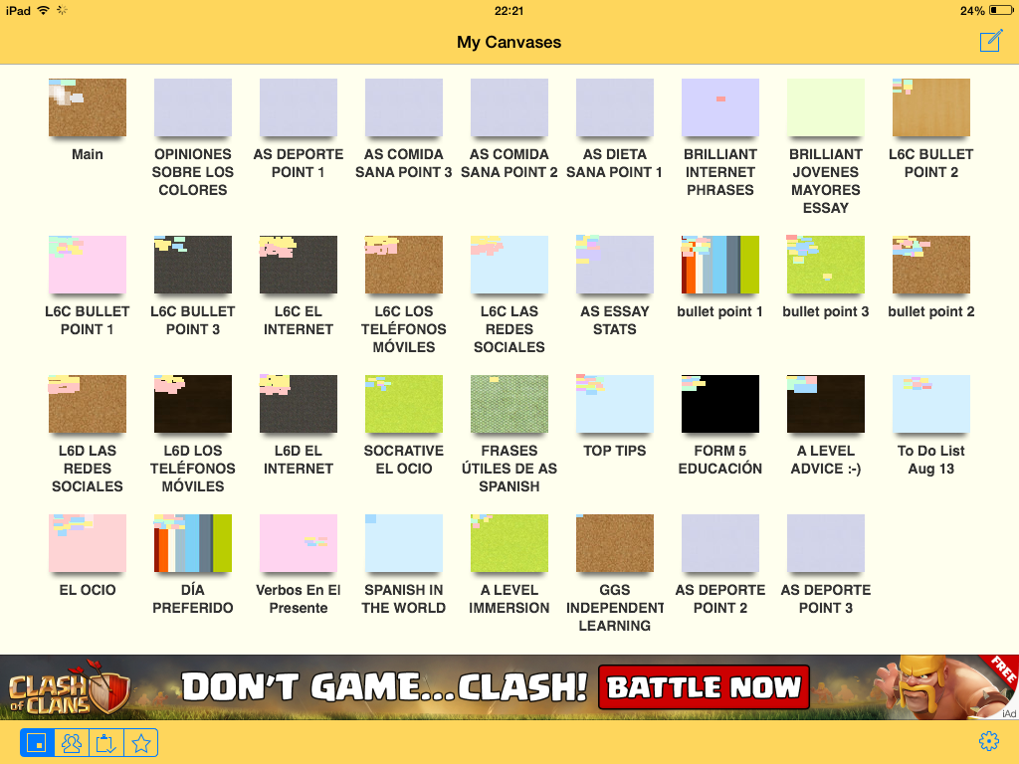

Slide 27
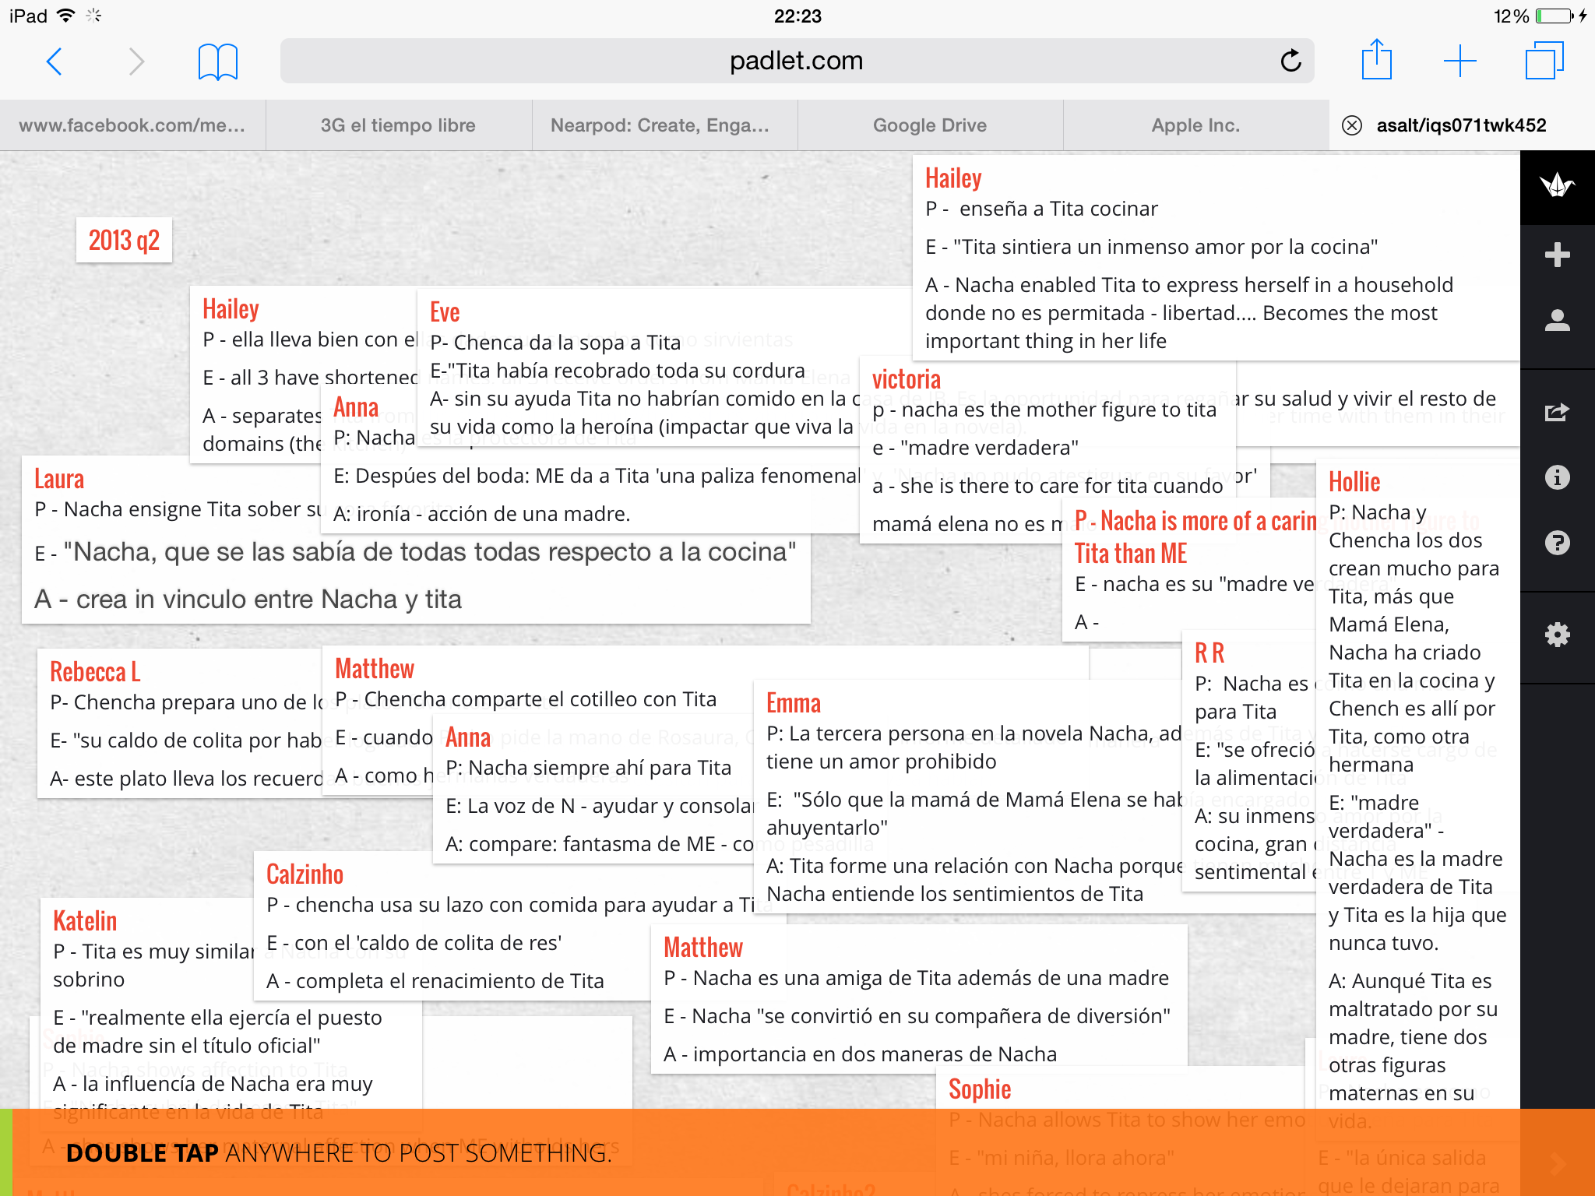
Notes:
Popplet for essay planning

Slide 28
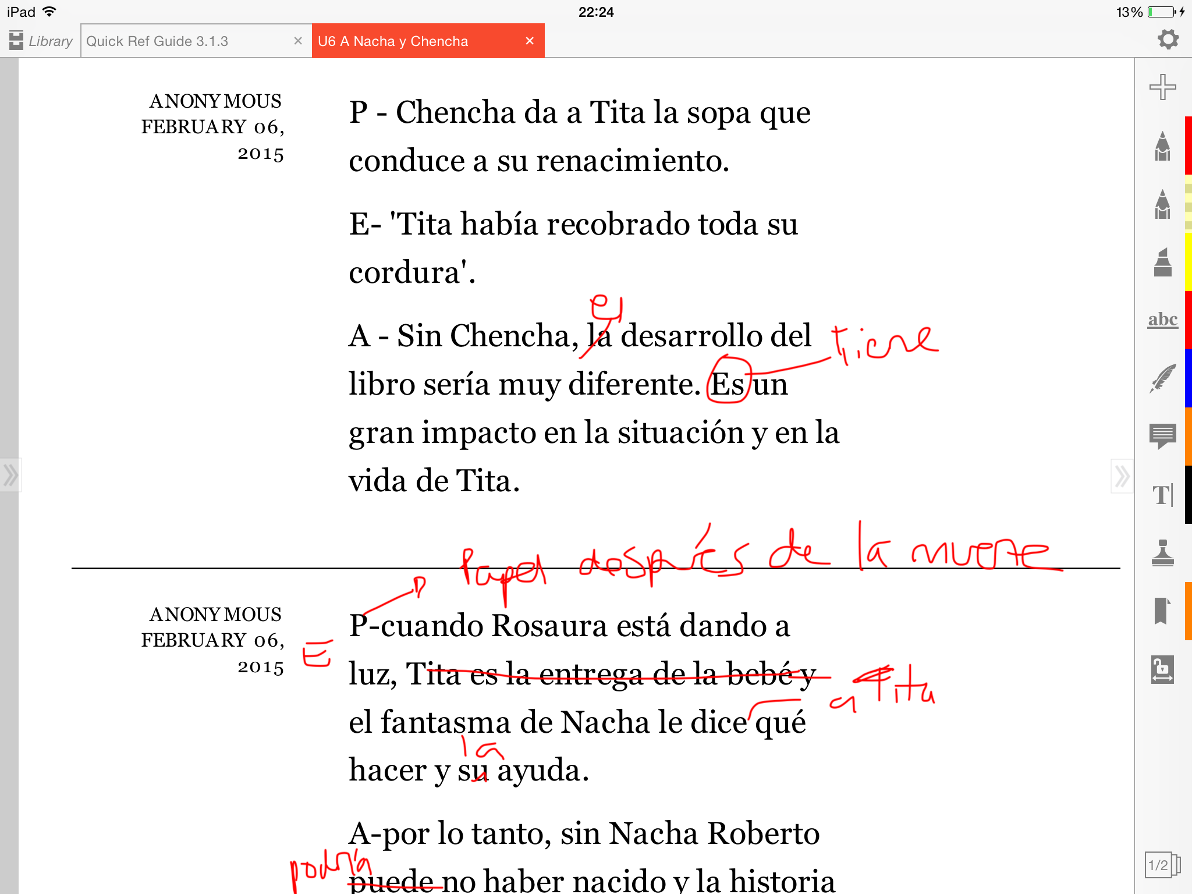
Notes:
Popplet for essay planning

Slide 30
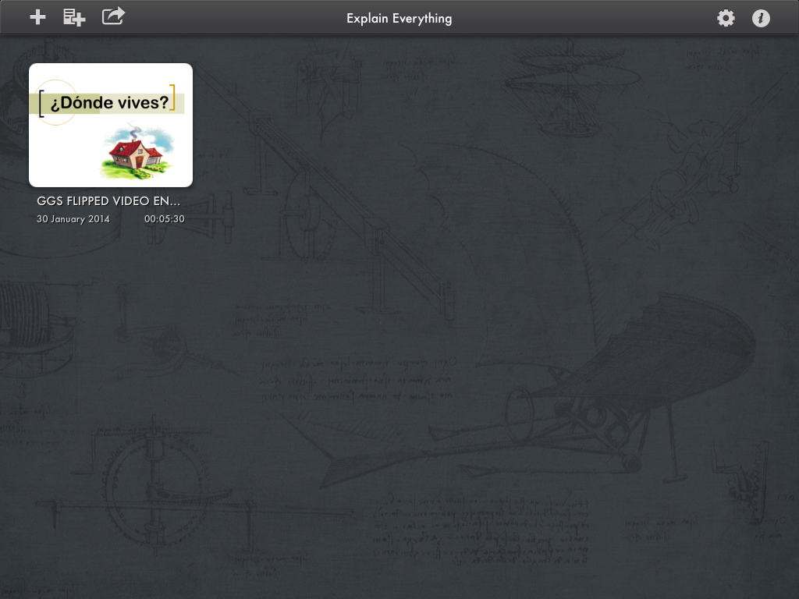
Notes:
Explain Everything

Slide 31
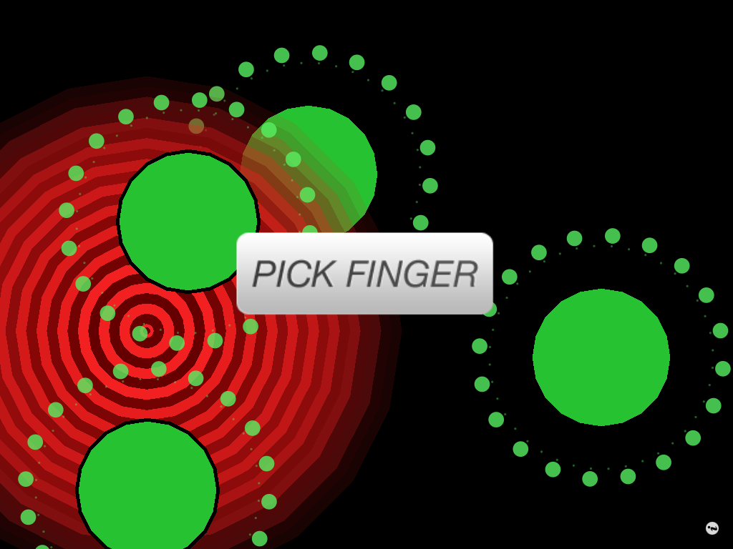
Notes:
Tap Roulette

Slide 32
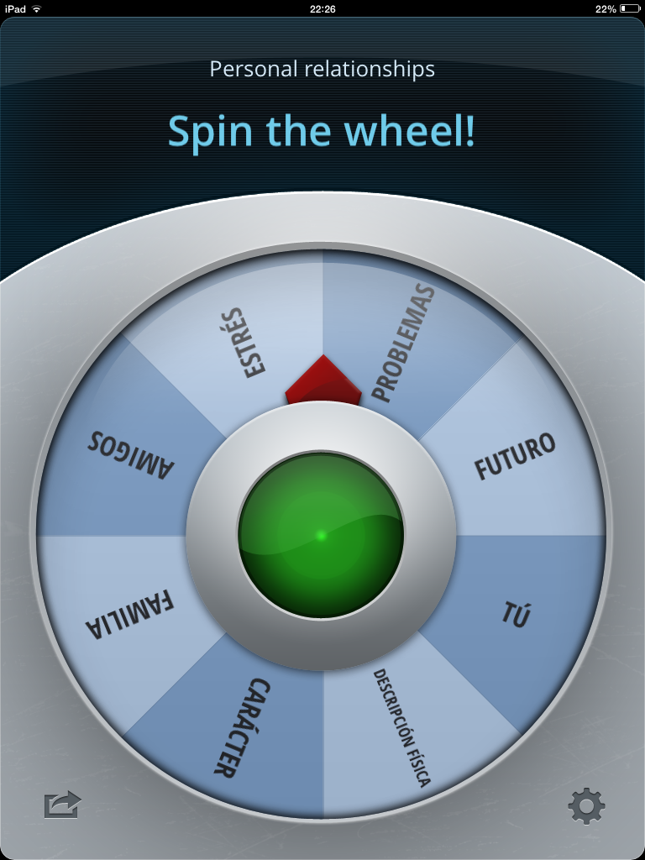
Notes:
Decide Now!

Slide 33
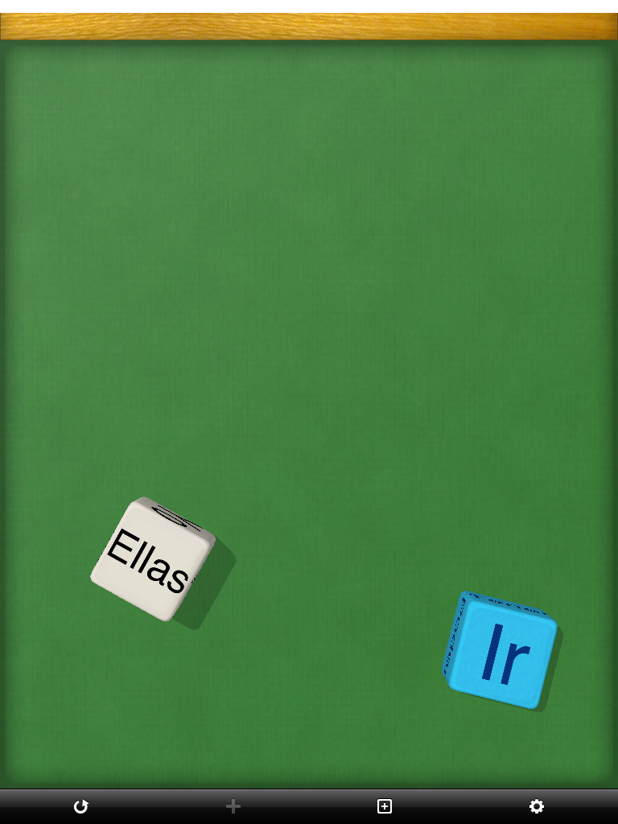
Notes:
Make Dice Lite

Slide 35
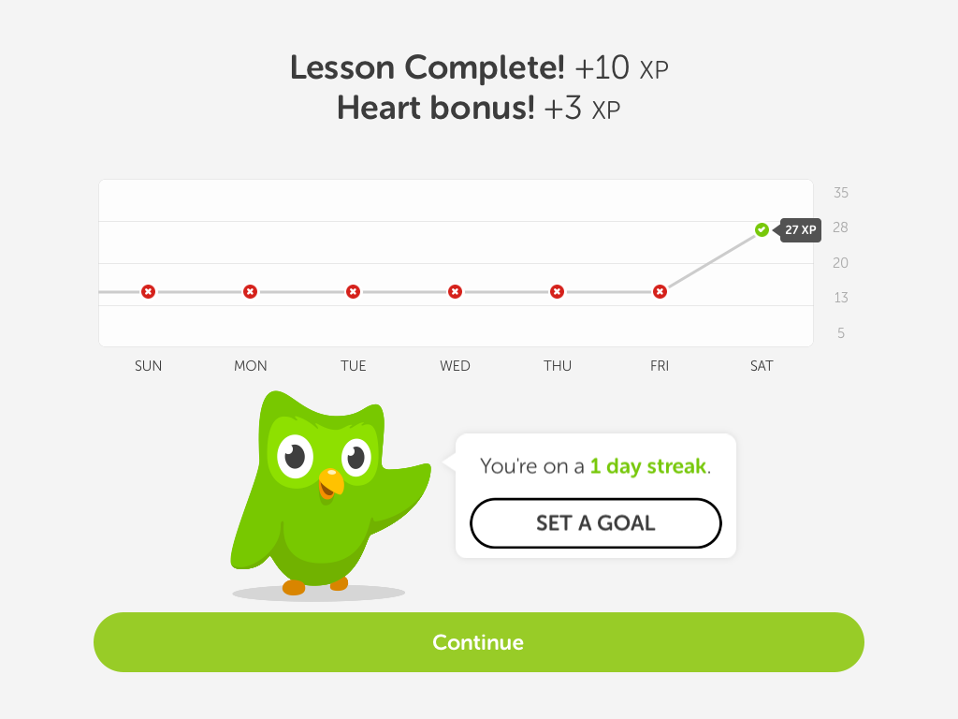

Slide 36
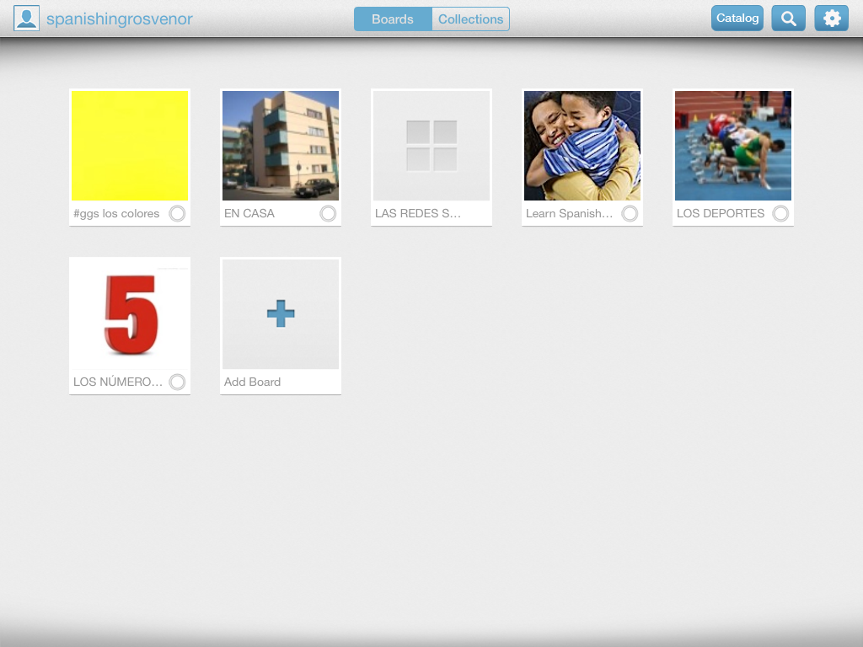

Slide 37
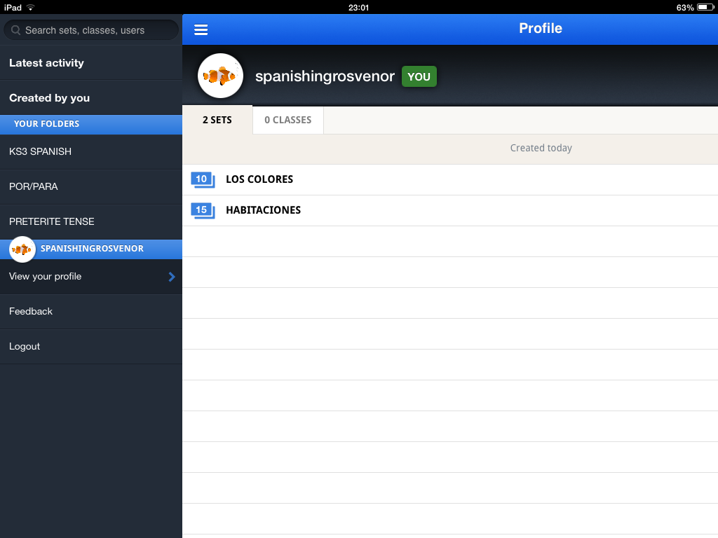

Slide 38
Plickers
Notes:
Self assessment
Pupil voice

Slide 39
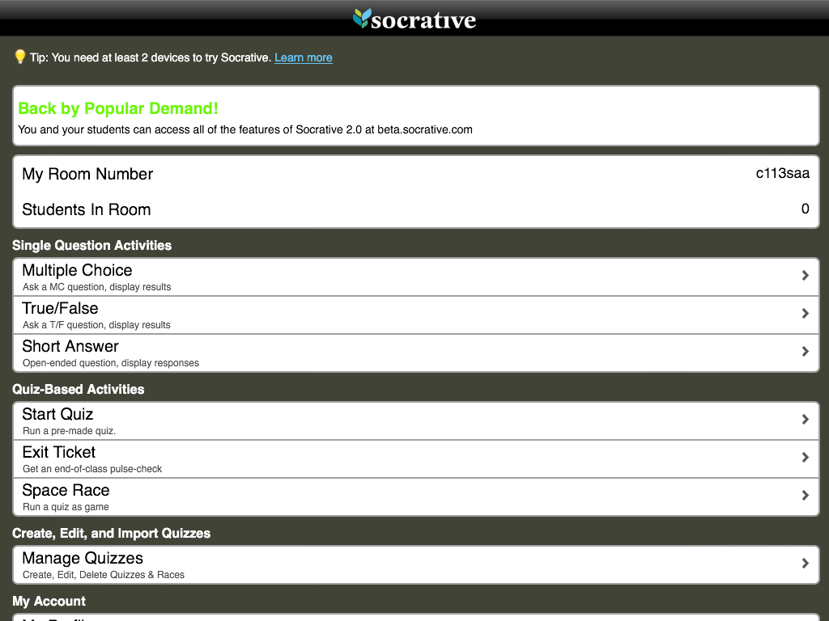
Notes:
Socrative

Slide 40
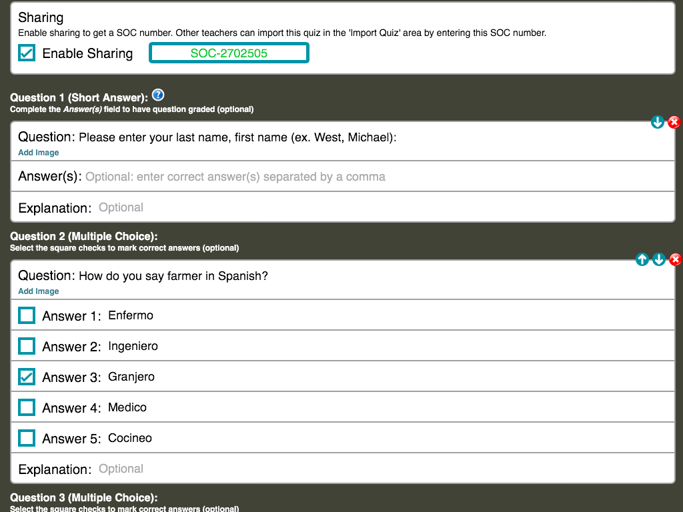
Notes:
Socrative

Slide 41
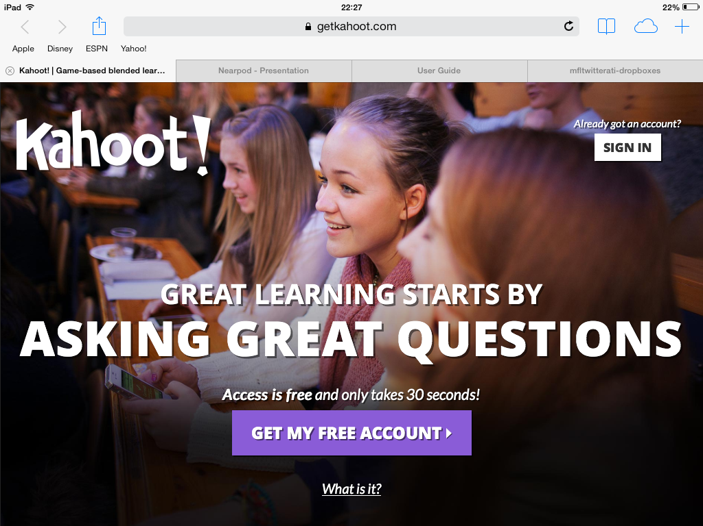
Notes:
Getkahoot

Slide 42
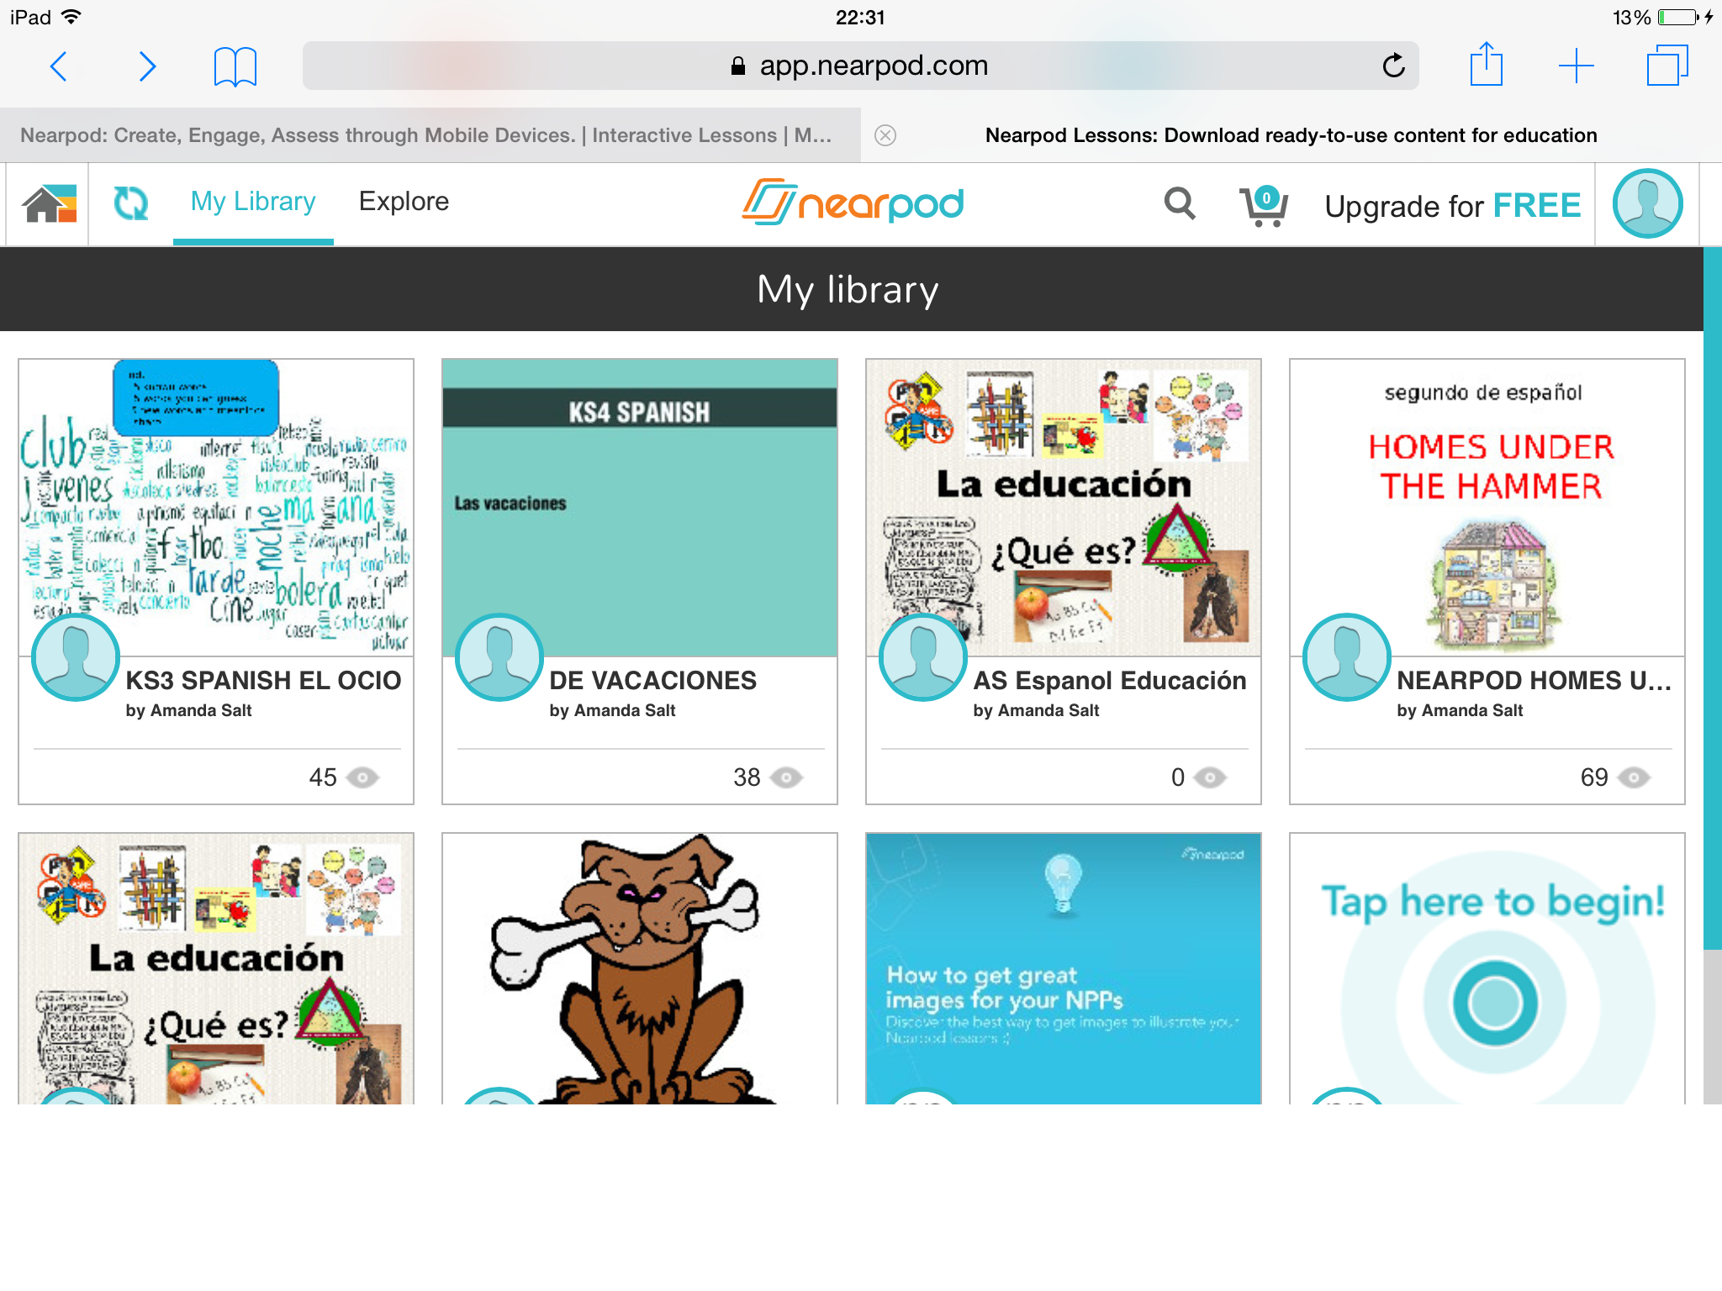
Notes:
Nearpod

Slide 43
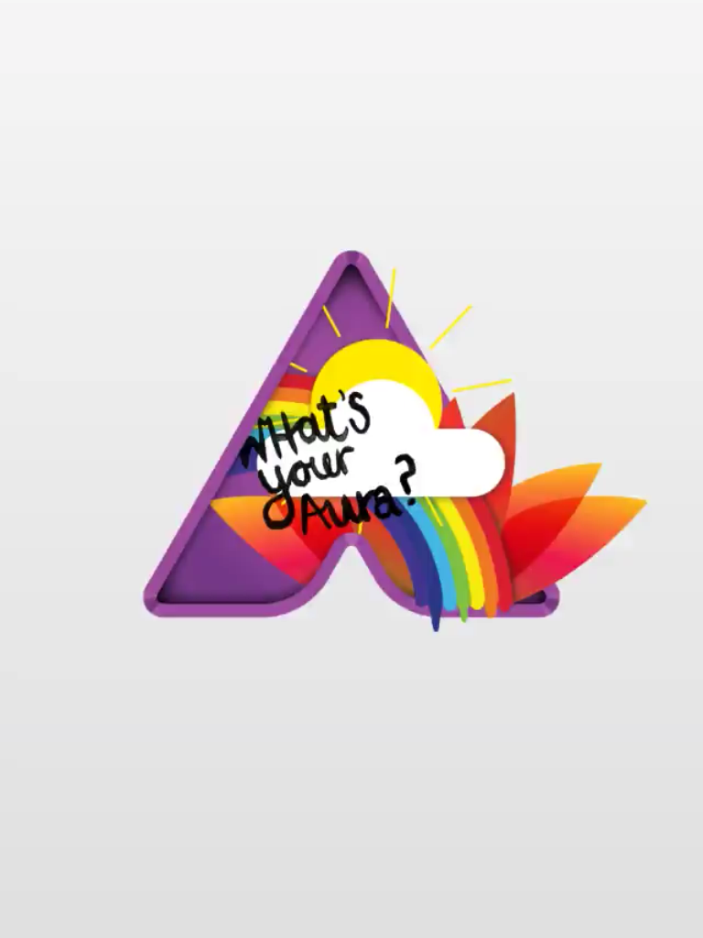
Notes:
Aurasma

Slide 44
iBooks
Notes:
The next level
1:1 best and preferably their own – highlighting etc

Slide 45
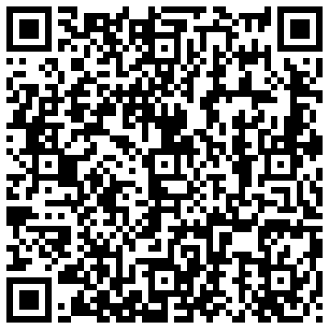
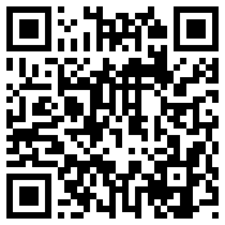
MFL APPS GOOGLE DOC
APPS & WEBSITES LIVEBINDERS

Slide 46
asalt@grosvenorgrammarschool.org.uk
@amandasalt
http://amandasalt.blogspot.com

