Slide 1
OneNote The Digital Copy
Presented by Avril Egan

Slide 2
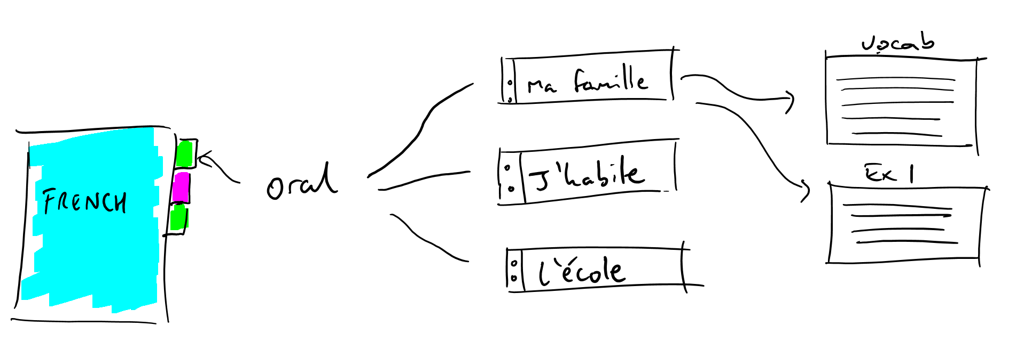
Notes:
Think of it as a folder with dividers

Slide 3
THE BENEFITS OF ONENOTE
Organisation
Ease of access
Always up to date
Time Management
Notes:
Student Work in real time

Slide 4
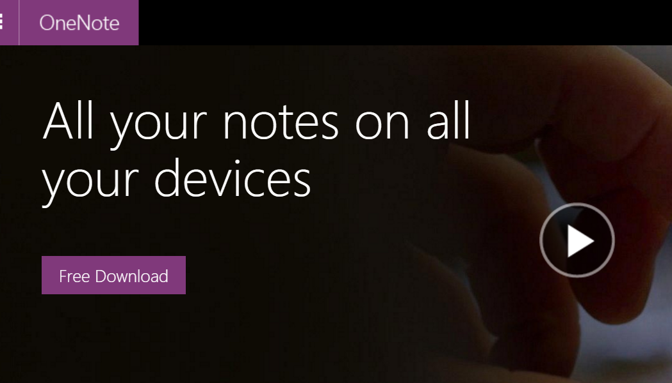
GETTING STARTED
Go to onenote.com
Free download
Install

Slide 5
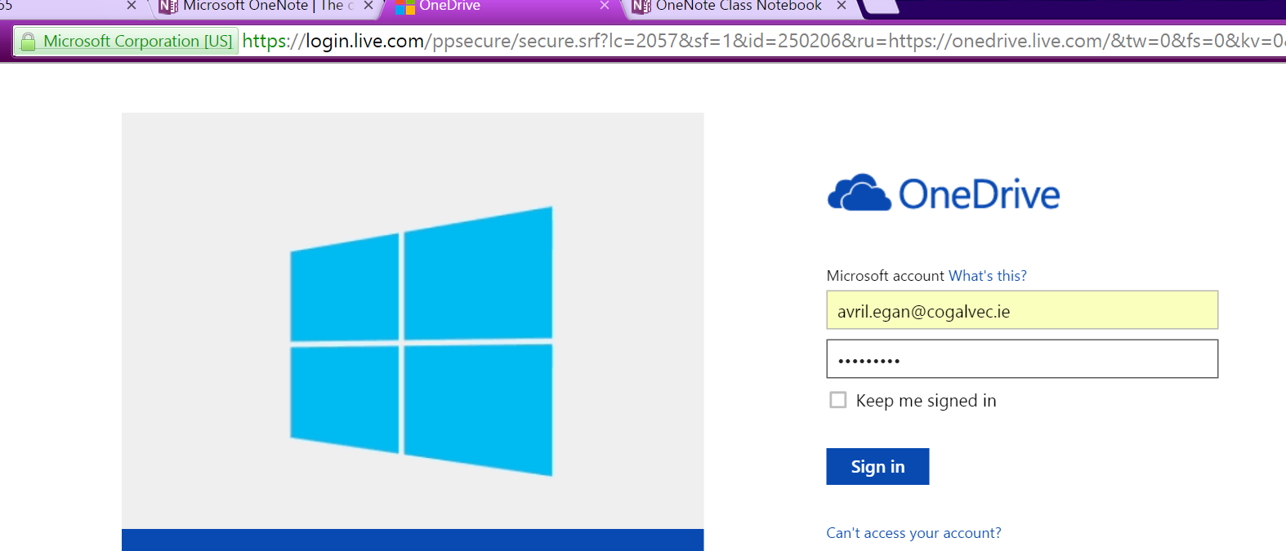
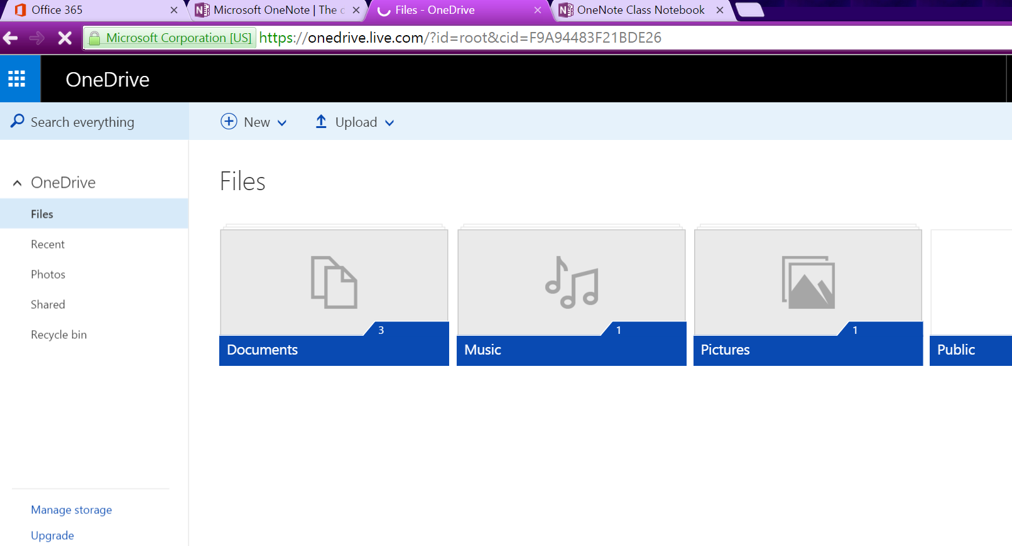
GETTING STARTED
If you don’t have office 365
Go to onedrive.com
Sign up
If you have; login and go to OneDrive
Notes:
Any email you have to sign up
Keep passwords the same as email

Slide 6
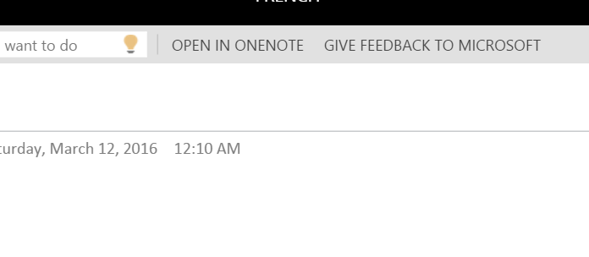
CREATE A ONENOTE BOOK
Notes:
May have to log in using the account they just created or office 365

Slide 7
CREATE A SUBJECT NOTEBOOK
Notes:
File > New

Slide 8
MAKING ONENOTE PERSONAL

Slide 9
Step By Step
Make a section group
Title a section
Create a page

Slide 10
SECTION GROUP
Notes:
Right Click on the white space

Slide 11
CREATE A SECTION
Notes:
Click on the + sign

Slide 12
Add A Page
Notes:
Many benefits to the teacher but primarily the changes it makes in the classroom environment
Allow for a more positive teaching experience.

Slide 13
ADDING RESOURCES
https://www.youtube.com/watch?v=oiKj0Z_Xnjc
Notes:
Copy and paste or drag and drop
Sound file

Slide 14
SHARING WITH STUDENTS
Notes:
You share with students CAN VIEW
They copy and paste sections into the content section

Slide 15
STUDENT STEPS
Notes:
Students follow the same steps and share with you
Name notebook with first and last name e.g. JohnDoe_French15
Check with school about policy on internet safety/sharing work

Slide 16
What Next?
Notes:
Will automatically share with students
List of students emails if they don’t have office 365
Name will do if they have office 365

Slide 17
If you have office 365…
Create digital portfolio
Monitor student work in real time
Improve communication with students
Easily capture exemplar of student work
Notes:
Creativity and entrepreneurship are important for EC policy
Adding chapters, pages or simply correcting errors
The onus is on the key skill of ‘managing myself’ which is a fundamental element of the New Junior Cycle curriculum.
This places the emphasis on the students taking a more productive role in their learning.

Slide 18
What Next?

Slide 19
MOVING FORWARD!
Tweet: @EganAvril
Email: aegan@cbcg.ie

