Slide 1
Introduction to Syntax (sentences)
Linguistics Module

Slide 2
Overview of this Linguistics Module
Topic 1 Introduction to areas of linguistics and problem solving
Topic 2 Historical Linguistics
Topic 3 Phonetics
Topic 4 Sociolinguistics
Topic 5 Writing systems
Topic 6 Language Acquisition
Topic 7 Morphology
Topic 8 Syntax
Topic 9 Psycholinguistics / Neurolinguistics
Topic 10 Machine Translation

Slide 3

Notes:
Cartoonstock.com under educational license

Slide 4
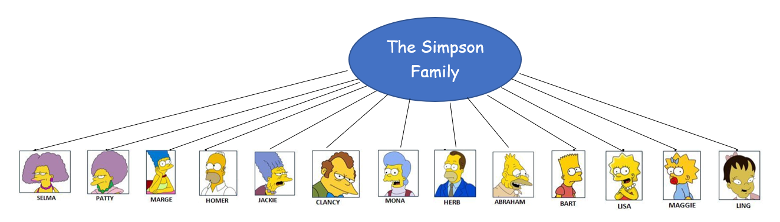
How do we represent family relations?
Does this linear representation show all the family relations?
Can you think of another way to show the internal structure of the Simpson Family?

Slide 5
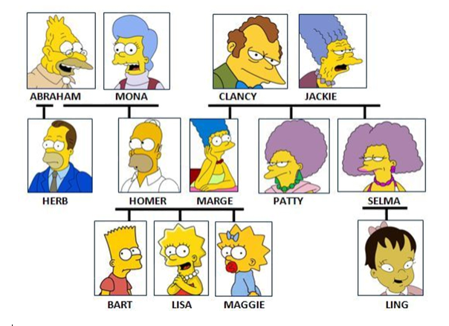
How do we represent family relations?
We use a tree structure to show how the members of a family are related.
The family tree shows who is higher in the hierarchy and who is lower.
It also shows relationships (e.g. daughter/sister/mother)

Slide 6
Task 8.1: Constituents and diagnostic tests

Slide 7
Task 8.1: Constituents and diagnostic tests
Just as families, sentences can also be represented in form of trees in order to show their internal structure.
In this section, we are going to work out the structure of the following sentence:
The cat will chase the mice.
The sentence contains the following words:
  the: Det(erminer) – definite article)
  cat: N(oun)
  will: Aux/T(ense): [Future]
  chase: V(erb)
  the: Det(erminer – definite article)
  mice: N(noun)

Slide 8
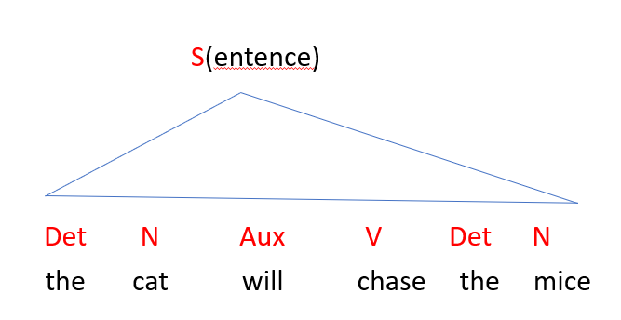
Sentence: [_{S} the cat will chase the mice]
What is the internal structure of S and how do we go about finding out?
Notes:
There are 2 ways to represent the internal structure of a sentence: either with brackets [_{S} the cat will chase the mice] or in form of a tree diagram. In our sentence, S(entence) is the highest category.

Slide 9
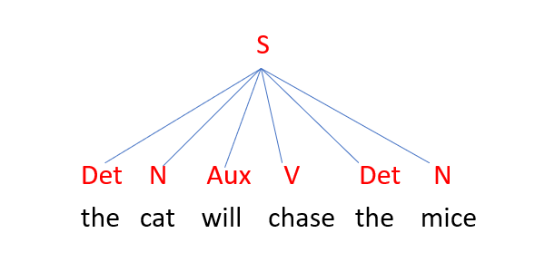
The flat structure (theory)
Remember the Simpsons Family tree!
The flat structure above does not indicate the hierarchical relations.

Slide 10
How can we determine the internal structure of sentences?

Slide 11
How can we determine the internal structure of sentences?
Various diagnostic tests, criteria have been developed for the purpose of figuring out the internal structures of phrases and sentences.
They include one known as Pro-form Replacement, which exploits small words that have the function of replacing (= standing in for) long phrases in sentences in conversation contexts.
The pro-form words include pronouns, which replace (indefinitely) long noun phrases understood in conversion such as
the mice (that live in the house that Jack built) 🡪 they, them
the cat (that lives in the house that Jack built) 🡪 it
Notes:
A pro-form is a word that replaces another word or expression found elsewhere in discourse, or understood from the situational context. Pronouns are the best known pro-forms, but words like did may function as ‘pro-verb phrases’ as in John washed three sheepdogs and Mary did too.

Slide 12
Pro-form Replacement
Applying the Pro-form Replacement test to the group of words [the mice] in our target example:
The cat will chase [the mice]
The cat will chase them.
As pronouns can only replace/stand in for Noun Phrases (NPs), it follows that
[the mice] = Noun Phrase (NP)

Slide 13
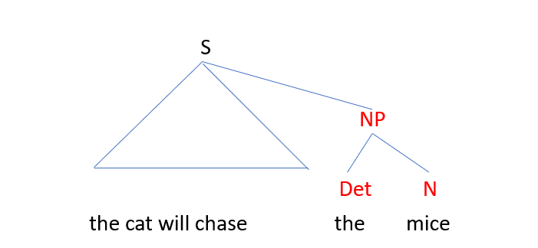
Pro-form Replacement
  Mapping the test result onto the developing structure of S (i.e. the internal structure we are working out):
  [_{S} the cat will chase [_{NP} the mice]]

Slide 14
Worksheet 8.1: Problem Set 1
The reasoning above re [the mice] generalises to the similar group [the cat] in our target sentence.
The cat will chase [_{NP} the mice].
Apply the Proform Replacement test to [the cat]
AND
Try to map the test result onto our embryonic structure of the sentence.
Notes:
‘embryonic structure’ here refers to the syntactic tree structure that we are trying to work out step by step

Slide 15
Feedback Problem Set 1
Applying the test
[The cat (that lives in the house that…)] will chase the mice.
It will chase the mice.
Therefore,
[the cat] = NP
Notes:
Students should take down the feedback (including the tree) on their worksheets. It will help them do Problem Set 2 later.

Slide 16
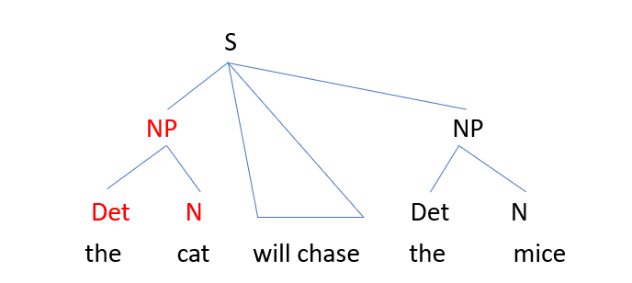
Feedback Problem Set 1
Mapping the test result onto the embryonic structure of the sentence:
[_{NP} The cat] will chase [_{NP} the mice].
Notes:
Students should take down the feedback (including the tree) on their worksheets. It will help them do Problem Set 2 later.

Slide 17
Pro-form Replacement: Verb Phrases
There are also pro-form words that replace/stand in for Verb Phrases.
  The cat will chase the mice and so will the dog.
  so = [chase the mice]
As so replaces verb phrases, it follows that
[chase the mice] = Verb Phrase (VP)
It also follows that the VP has the internal structure
  [_{VP} [_{V} chase] [_{NP} the mice]] = Verb Phrase (VP)

Slide 18
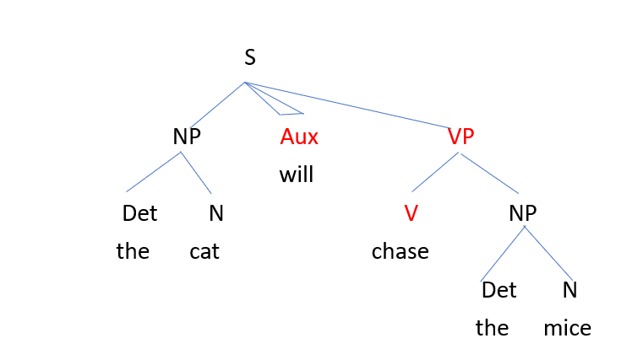
Mapping the test result of VP onto the tree-structure of the sentence
Notes:
Aux is a syntactic category containing auxiliary verbs and abstract tense morphemes.

Slide 19
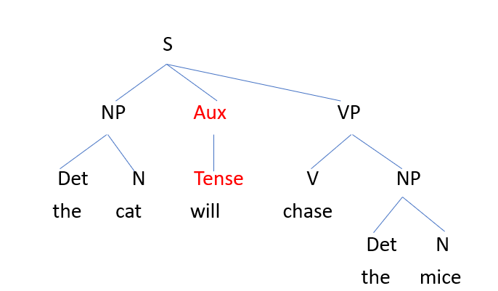
The test results applied above imply that Aux is an independent constituent of S. Aux specifies Tense.
Notes:
Aux is a syntactic category containing auxiliary verbs and abstract tense morphemes.

Slide 20
Worksheet 8.1: Problem Set 2
Assign a tree-structure to the example below.
It will chase them.
Treat the pronouns it and them as N(ouns).

Slide 21
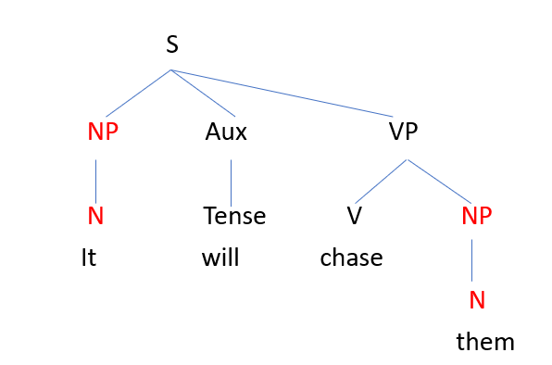
Feedback Problem Set 2
Same structure, except that both NPs have only one constituent each.

Slide 22
Task 8.2: Terminology

Slide 23
Task 8.2: Terminology
A phrase is a family of (one or more) constituents with a head.
  The head of NP is N.
  The head of VP is V.
  S counts as a phrase, the head of which is Aux.
A head implies a phrase such that N implies NP and V implies VP.
The reverse is equally true. A phrase implies a head such that NP implies N and VP implies V.
Notes:
A constituent is syntactic unit in a phrase structure tree, e.g. the cat is a noun phrase constituent in the sentence The cat will chase the mice.
A head is the central word of a phrase whose lexical category defines the type of phrase, e.g. the noun cat is the head of the noun phrase the cat who chased the mice; the verb threw is the head of the verb phrase threw the ball to his friend; the adjective red is the head of the adjective phrase bright red.

Slide 24
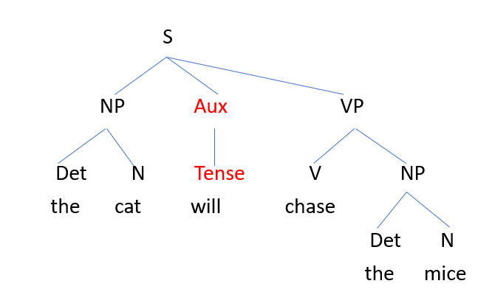
Types of node in the structure
  Root node: Highest node (S in the sentence structure)
  Phrasal nodes (internal nodes): NP, VP (in the sentence structure). S(entence) counts as a phrasal node even though its label does not feature P.
  Terminal nodes: Det, N and V (in the sentence structure).

Slide 25
Types of node in the structure
In the structure of the sentence arrived at above,
  S is the mother of NP, Aux and VP.
  NP, Aux and VP are therefore sisters.
  NP has two daughters of its own: Det and N.
  VP has two daughters of its own: V and NP (junior).

Slide 26
Grammatical functions, relations are structurally based
The subject of the sentence ‘the cat’ is the NP-daughter-of-S (and sister of Aux and VP).
  The cat will chase the mice.
The direct object (of the verb) ‘the mice’ is the NP-sister-of-V and daughter-of-VP.
  The cat will chase the mice.

Slide 27
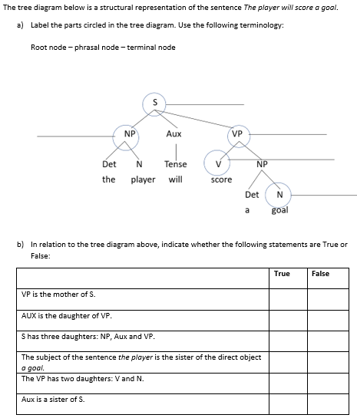
Worksheet 8.2: Problem Set 3

Slide 28
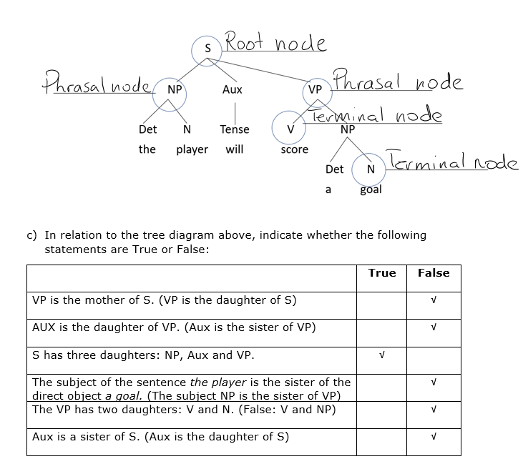
Feedback Problem Set 3

Slide 29
Task 8.2: AILO Puzzle
Dogs and Cats on Trees puzzle and solution

Slide 30
Task 8.3: Phrase Structure (PS) Rules

Slide 31
Task 8.3: Phrase Structure (PS) rules
The tree-diagrams above are visual representations of structures generated by rules known as Phrase Structure (PS) rules.
  PS rules are rewrite rules that rewrite symbols as a sequence of other symbols (think of rewriting code as natural language sentences).
  The set of PS rules that generates the structures arrived at above is provided in the next slide.
  The arrow in the middle is read as ‘goes to’

Slide 32
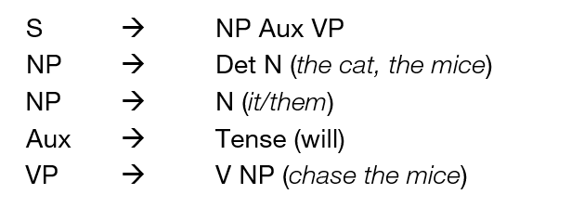
Phrase Structure (PS) rules

Slide 33
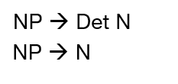
Worksheet 8.3: Problem Set 4
The set of PS rules in the previous slide includes two instances that generate the same phrase, namely NP.
Try to think of a standard notation that makes it possible to reduce the two rules repeated below to one rule that generates both patterns.

Slide 34

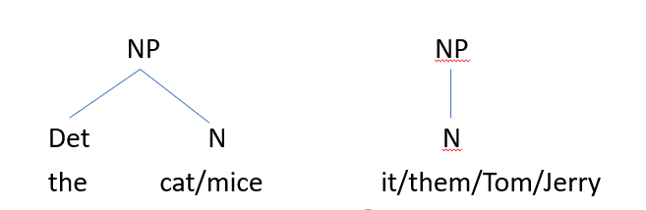
Feedback Problem Set 4
The required notation is one that encodes optionality of occurrence.
The single rule above generates NPs that consist of Det and N as well as NPs that consist of N alone.

Slide 35
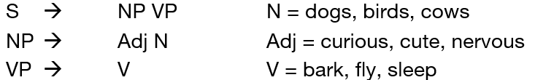
Worksheet 8.3: Problem Set 5
Make up simple sentences generated by the PS rules. Use only the PS rules below and the words given below. Don’t use any other words that are not listed for each example.
Give three sentences which can be generated by the rules and words above:
________________________________________________
________________________________________________
________________________________________________

Slide 36
Feedback Problem Set 5
Any adjective – Noun – Verb combination allowed from a syntax point of view:
Some examples:
Nervous dogs bark.
Cute cows sleep.
Curious birds fly.

Slide 37
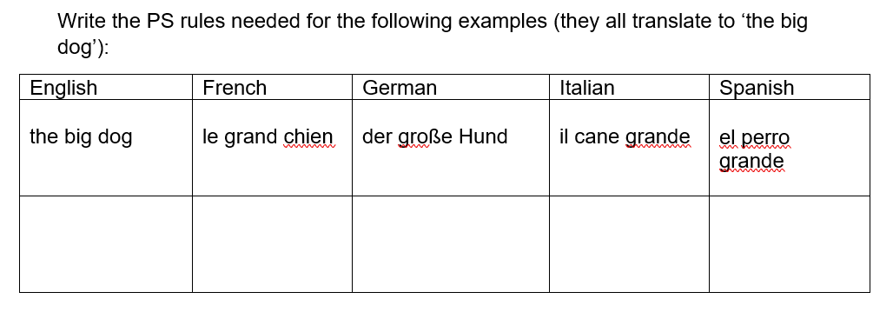
Worksheet 8.3: Problem Set 6

Slide 38
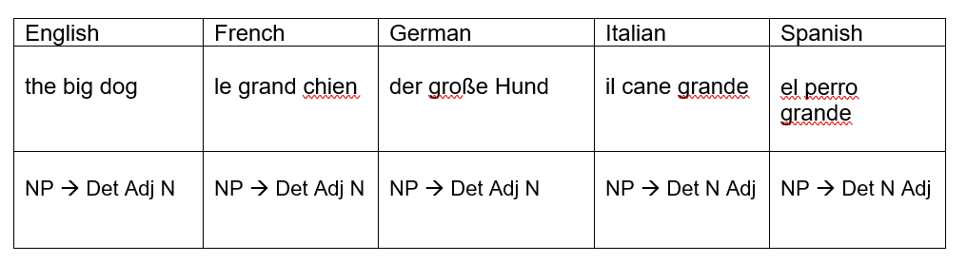
Feedback Problem Set 6

Slide 39
Puzzle: Grammar Rules!
Grammar Rules!
https://www.nacloweb.org/resources/problems/2013/N2013-F.pdf
Solution:
https://www.nacloweb.org/resources/problems/2013/N2013-FS.pdf

Slide 40
More Puzzles
A Matter of Horn Clauses:
https://nacloweb.org/resources/problems/2016/N2016-P.pdf
Solution:
https://nacloweb.org/resources/problems/2016/N2016-PS.pdf
Intergalactic Grammars:
https://nacloweb.org/resources/problems/2018/N2018-D.pdf
Solution:
https://nacloweb.org/resources/problems/2018/N2018-DS.pdf

Slide 41
More Puzzles
Peeled Potato Act with Annie:
https://nacloweb.org/resources/problems/2018/N2018-L.pdf
Solution:
https://nacloweb.org/resources/problems/2018/N2018-LS.pdf
A Makeshift Code:
https://nacloweb.org/resources/problems/2018/N2018-R.pdf
Solution:
https://nacloweb.org/resources/problems/2018/N2018-RS.pdf

Slide 42
More Puzzles
Orwellspeak:
https://www.nacloweb.org/resources/problems/2009/N2009-M.pdf
Solution:
https://www.nacloweb.org/resources/problems/2009/N2009-MS.pdf
Use the Force:
https://nacloweb.org/resources/problems/2015/N2015-E.pdf
Solution:
https://nacloweb.org/resources/problems/2015/N2015-ES.pdf
CCG:
https://nacloweb.org/resources/problems/2014/N2014-O.pdf
Solution:
https://nacloweb.org/resources/problems/2014/N2014-OS.pdf
Combining Categories in Tok Pisin:
https://nacloweb.org/resources/problems/2014/N2014-P.pdf
Solution:
https://nacloweb.org/resources/problems/2014/N2014-PS.pdf

